Slide 1


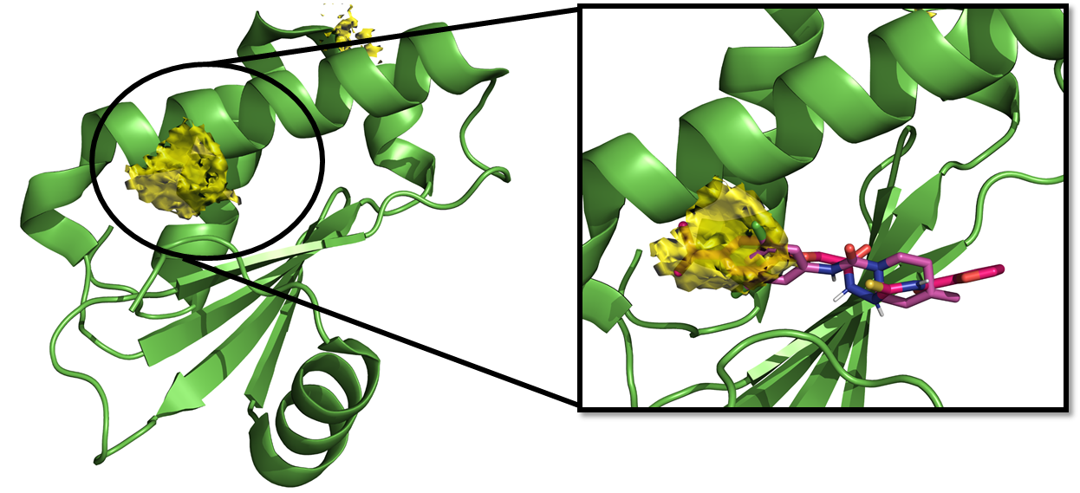
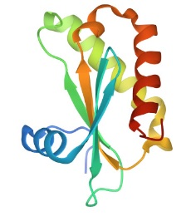

RnpA inhibitors as potential antistaphylococcal agents: computational design, synthesis, and biological evaluation
Lorenzo Suigo¹, Michaelle Chojnacki^{b}, Carlo Zanotto^{c}, Victor Sebastián-Pérez^{d}, Giulia Lodigianiª, Paul Dunman^{b}, Ermanno Valotiª and Valentina Stranieroª
ª Dipartimento di Scienze Farmaceutiche, Università degli Studi di Milano, Via Mangiagalli 25, 20133, Milano, Italy.
^{b} Department of Microbiology and Immunology, University of Rochester Medical Center, 601 Elmwood Avenue, 14642 Rochester, New York.
^{c} Dipartimento di Biotecnologie Mediche e Medicina Translazionale, Università degli Studi di Milano, Via Vanvitelli 32, 20129, Milano, Italy.
^{d} The Schrödinger Building, Exscientia, Oxford Science Park, OX4 4GE Oxford, United Kingdom.
INTRODUCTION
COMPUTATIONAL DESIGN OF NOVEL DERIVATIVES
Besides the current pandemic situation, due to COVID-19, antibiotic resistant remains one of the most worrying health emergency [1]. The unneeded and incorrect use of antibiotics is leading to a pre-antibiotic era, in which simple infections can kill again. One of the strategies to avoid this future is to develop molecules able to interact with unexploited molecular targets. Among them, the RNA processing is a crucial physiological system that has been recently recognized as exploitable for this purpose [2].
RnpA (figure 1) is a 14 KDa protein of Staphylococcus Aureus, known to be crucial for, at least, two important RNA-related bacterial processes: mRNA degradation and ptRNA maturation [3].
Starting from three known RnpA-inhibitors, we aimed at understanding which cleft of the protein could be the interaction site for some, or all, these inhibitors.
Given this, using S. aureus RnpA protein, we performed a Hotspots Maps calculation and docked the three known inhibitors (Figure 2).
Figure 2: Hopspot map analysis of RnpA.
As shown in the figure, one main hotspot scoring area was identified. We docked two of the best known RnpA inhibitors, RNPA2000 [4,5] and JC1/2 [6], and we understood the main interaction achieved by these compounds. With these information, we designed a set of 16 novel derivatives to explore the SAR of these classes (figure 3):
Compounds of the A subfamily are JC1/2 derivatives designed to achieve extra-interactions within the binding site.
Compounds of the B subfamily are RNPA2000 derivatives in which the 2-furanyl moiety was replaced by several mono- or di-halogenated phenyl rings.
Compounds of the C subfamily are RNPA2000 derivatives in which the thiosemicarbazide moiety was simplified in flexible or rigid di-amides.
Figure 1: Structure of RnpA
Indeed, firstly, RnpA alone can catalyse the mRNA degradation, controlling the expression of crucial proteins based on the different growth phases. Secondly, RnpA can associate forming a riboprotein complex which catalyse the removal of the 5’ leader sequence of ptRNA, promoting tRNA maturation. For these reasons, RnpA arose as a great potential target for antibiotic therapy.
Figure 3: Structures of the reference compounds (JC1, JC2 and RNPA2000 above) and of the compounds object of the present work.
CHEMISTRY
Biological evaluation
Compounds 1-16 were evaluated as antimicrobials toward 3-different S.aureus strains: one Methicillin-resistant (MRSA) and two Methicillin-sensitive (MSSA).
Moreover, their capability of inhibit RnpA was tested as well through in vitro assays.
Compound | MIC | MIC | MIC | In vitro Assays
 | MSSA (µM) | MRSA (µM) | UAMS-1 (µM) | _{D}IC₅₀ (µM) | _{p}IC₅₀ (µM)
RNPA2000 | - | - | 44 | 275 | 140
1 | >500 | >500 | >500 | 72.5 | 36
2 | >500 | >500 | >500 | 233 | 37
3 | >500 | >500 | >500 | 324 | >500
4 | 311 | 311 | 250 | 66 | 50
5 | >500 | >500 | >500 | >500 | 75
6 | 21.1 | 21.1 | 64 | 53 | 59
7 | 24.7 | 24.7 | 31.25 | 77 | 28
8 | 22.2 | 22.2 | 62.5 | 49 | 76
9 | >500 | 18.9 | tdb | tbd | tdb
10 | 21.1 | 21.1 | 1.96 | 188 | 33
11 | >500 | >500 | >500 | 31 | 153
12 | >500 | >500 | >500 | 165 | 423
13 | >500 | >500 | >500 | 198 | >500
14 | >500 | >500 | >500 | 174 | 25
15 | tdb | tdb | tdb | tdb | tdb
16 | tdb | tdb | tdb | tdb | tdb
Reagents and solvents: a) DPPA, TEA, toluene, 95°C, 40 min; b) corresponding amine, toluene, 95°C; c) Methyl 2-chloroacetate, K₂CO₃, DMF, 50 °C, 1.5 h; d) Hydrazine hydrate, Methanol, Reflux, 16 h; e) SOCl₂, Reflux, 1 h; f) Potassium thiocyanate, Acetonitrile, room temperature (RT), 1 h; g) Acetonitrile, RT, 30 min. h) 1 - 2.5 N aqueous NaOH, MeOH, RT, 1.5 h; 2- SOCl₂, reflux, 1 h; i) N-Boc corresponding amine, TEA, DCM, RT, 3 h; l) 10% aqueous HCl, MeOH, reflux, 0.5 h; m) corresponding acily chloride, TEA, DCM, RT, 1 h.
Conclusions
Table 1: Antimicrobial activities of compounds 1-16. Tbd = to be determined.
This preliminary set of data allowed us to:
Predict the key interactions that RNPA2000 and JC1/2, known RnpA inhibitors, achieve with their molecular target.
Understand which molecular changes are productive or detrimental for the activity. In particular, the replacement of the 2-furanyl moiety of RNPA2000 with a 3-chlorophenyl ring led to a 2-fold increase in the antimicrobial activity.
Guide the future investigations in order to obtain more potent and promising antibiotics to overcome the very serious problem of antibiotic resistance [7].
References
[1] Lock, R.L. et al. Nature Reviews Drug Discovery 2008, 7, 324-338; [2] Tejada-Arranz, A. et al. Trends Biochem. Sci. 2020, 45, 42-57. [3] Olson, P.D. et al. PLoS Pathogens 2011, 7; [4] Eidem, T.M. et al. Antimicrob. Agents Chemother. 2015, 59, 2016-2028; [5] Lounsbury, N. et al. Bioorg. And. Medic. Letters 2018, 28, 1127-1131 [6] Colquhoun, J.M. et al. Antibiotics, 2019, 8, 48; [7] Suigo, L. et al. Antibiotics, 2021, 10, 438;

