Slide 1


Attitudes and beliefs of primary school mathematics teachers: an exploratory study on the use of INVALSI assessment data in a competency-based approach.
Ottavio G. Rizzo¹, Valentina Vaccaro²
¹University of Milan, ²University of Oviedo, INVALSI - Roma
VI Seminar
“INVALSI data: a tool for teaching and scientific research”
Rome, November 25th – 28th, 2021
Notes:
1
In this talk we present and discuss the early results of an interdisciplinary research project aiming at studying the connection between the INVALSI assessment, mathematics teaching and learning processes at the Primary School level.

Slide 2
VI Seminar
“INVALSI data: a tool for teaching and scientific research”
Rome, November 25th – 28th, 2021
INVALSI information as tools
For students:
To receive feedback on their learning
For teachers:
To design and implement meaningful teaching activities
For teacher trainers:
To meet teachers’ professional needs
Notes:
2
The basic assumption of the research is that the complex system of data revolving around the INVALSI assessments can be viewed as a tool:
To students, the INVALSI assessments are useful to get feedback on their learning;
To teachers, to design and implement meaningful teaching activities;
The assessments, though, can— and should! — be used also as a tool for the professional development of teachers, fostering a more effective didactic impact of the tests that goes well beyond training for the tests.

Slide 3
VI Seminar
“INVALSI data: a tool for teaching and scientific research”
Rome, November 25th – 28th, 2021
Which kind of teacher uses INVALSI item as source of good problem?
Notes:
3
Di Martino defines a good problem as one where students do not know in advance which knowledge is required for the solution, and where exploration is possible and resolution strategies are manifold.
We strongly believe that many INVALSI items could be used in the schoolroom as a source of good problems: do teachers share the same view?
And if some do, which kind of teacher does?

Slide 4
VI Seminar
“INVALSI data: a tool for teaching and scientific research”
Rome, November 25th – 28th, 2021
An interdisciplinary research project
Osservatorio Permanente S.I.R.D.
Disciplinary experts, pedagogists, expert teachers
Understanding primary teachers’ perceptions and practices with regard to INVALSI math assessment
Designing and administering a survey and analysing data
Notes:
4
This project is conducted by the “INVALSI Group – Didactics and Disciplinary Knowledge” of the S.I.R.D. (Italian Society for Educational Research) which is composed of researchers in disciplinary education, in general education, and expert teachers.
In order to investigate—through the voice of teachers — perceptions, meanings and practices of teachers with respect to the INVALSI math tests, we designed a survey that was administered to a sample of more than 500 primary school teachers.

Slide 5
VI Seminar
“INVALSI data: a tool for teaching and scientific research”
Rome, November 25th – 28th, 2021
Personal data and teachers’ training variables
Attitudes towards INVALSI mathematics tests
Beliefs concerning the assessment function of INVALSI tests Attitudes towards INVALSI tests and their impact on teaching
Attitudes towards formative assessment and the ideology of natural gifts
Comparing attitudes and beliefs with the knowledge and the declared practices
Teachers professionalism with respect to INVALSI assessment
Knowledge on reading and interpreting INVALSI math items
Comparing knowledge with the declared practices
Statements on their practices with respect to INVALSI items
Notes:
5
We built this framework in order to specify the different research variables we were interested in, and the research hypothesis concerning the relationships among the variables.
The variables framework consists of three macrosections: one concerning with mathematics teaching professionalism; one related to teachers attitudes towards Invalsi Maths tests and one in which personal information, personal data and context data are collected.

Slide 6
VI Seminar
“INVALSI data: a tool for teaching and scientific research”
Rome, November 25th – 28th, 2021
The three sections of the survey
1. Aspect of mathematics education (how teachers interpret the INVALSI mathematics items and their results)
A. Questions concerning 7 different INVALSI items
B. Comparative questions concerning the 7 INVALSI items of part A.
2. Aspects of general education (which beliefs and attitudes teachers have and how they pour them into teaching practices)
3. Personal data and context information
Notes:
6
According to the research variables framework, the survey consists of the following three sections of questions:
- one concerning mathematics education (how teachers interpret the Invalsi items and their results);
- one relating to aspects of general education (which beliefs and attitudes teachers have and how they apply them into teaching practices);
one that collects personal data and context information.
In this talk we will mainly focus on the second section of the questionnaire which was composed by comparative question on the proximity/remoteness of the 7 items from teaching practices and National Guidelines and on the effectiveness of the considered 7 INVALSI items in assessing certain skills.

Slide 7
VI Seminar
“INVALSI data: a tool for teaching and scientific research”
Rome, November 25th – 28th, 2021
A convenience sample of 526 Italian primary school teachers
68% of the teachers was invited to fill in the questionnaire by their head teacher
71% teaches in Piemonte or in Emilia–Romagna (two Northern regions that together represent 15% of Italian population)
90% hold a permanent position
Our sample is large, but it is not statistically representative.
Notes:
7
A convenience sample of 526 Italian primary school teachers answered the questionnaire; an analysis of answers given in the third section characterizes the sample as follows: 68% of the teachers was invited to fill in the questionnaire by their head teacher; 71% teaches in Piemonte or in Emilia–Romagna (two Northern regions that together represent 15% of Italian population); 90% hold a permanent position. Even if such a large sample is not statistically representative, data is enough to offer many pieces of information to further reflections.

Slide 8
VI Seminar
“INVALSI data: a tool for teaching and scientific research”
Rome, November 25th – 28th, 2021
Q32. Per favore, indica la tua frequenza d'uso delle seguenti pratiche in classe in riferimento a ciascuna delle seguenti affermazioni. Nelle mie pratiche in classe...
 | Never | Almost never | Some times | Often
... addestro gli alunni a svolgere molti quesiti delle prove INVALSI degli anni precedenti | 9.5% | 17.1% | 51.0% | 22.5%
... discuto con gli alunni degli aspetti tecnici di compilazione delle prove INVALSI(struttura delle prove, tempistiche, ecc.) | 1.5% | 15.3% | 52.1% | 31.1%
... rifletto con gli alunni al fine di trovare strategie «veloci» e «furbe» per risolvere i quesiti delle prove INVALSI | 4.5% | 13.4% | 41.0% | 41.0%
... traggo spunto dalle prove INVALSI per attività relative all'argomentazione in matematica | 1.5% | 12.5% | 47.9% | 38.0%
... traggo spunto dalle prove INVALSI per attività relative al problem solving | 1.3% | 8.6% | 49.9% | 40.2%
... traggo spunto dalle prove INVALSI per attività relative alla giustificazione delle proprie risposte | 3.7% | 17.9% | 49.5% | 28.9%
Notes:
8
The research group has carried out numerous exploratory analyzes, finding interesting data already analyzed in other papers and correlations that we are still investigating, including the one we present today. In order to understand the links between the questions we have decided to analyze we would like to read them with you. We decided to leave them in Italian on the slides and just read them in English.
For each of these classroom practices, state how often you use them
I train pupils on many questions of previous years INVALSI tests
I talk with the pupils about the many technicalities of INVALSI tests (structure, timing, etc.)
I have the pupils thinking over fast and smart strategies to solve the INVALSI tests
I draw from INVALSI tests the inspiration for activities about argumentation in Mathematics
[I draw from INVALSI tests the inspiration for activities] about problem solving
[I draw from INVALSI tests the inspiration for activities] about the justification of answers

Slide 9
VI Seminar
“INVALSI data: a tool for teaching and scientific research”
Rome, November 25th – 28th, 2021
Q32. Per favore, indica la tua frequenza d'uso delle seguenti pratiche in classe in riferimento a ciascuna delle seguenti affermazioni. Nelle mie pratiche in classe...
... addestro gli alunni a svolgere molti quesiti delle prove INVALSI degli anni precedenti
... discuto con gli alunni degli aspetti tecnici di compilazione delle prove INVALSI(struttura delle prove, tempistiche, ecc.)
... rifletto con gli alunni al fine di trovare strategie «veloci» e «furbe» per risolvere i quesiti delle prove INVALSI
... traggo spunto dalle prove INVALSI per attività relative all'argomentazione in matematica
... traggo spunto dalle prove INVALSI per attività relative al problem solving
... traggo spunto dalle prove INVALSI per attività relative alla giustificazione delle proprie risposte
66% of explained variance
Teaching to the test
Teaching with the test
Notes:
9
With the aim of investigating better, to deepen the information, we decided to proceed with a factor analysis that allowed us to identify two distinct factors.
To label the first factor it seemed natural to us to refer to teaching to the test while for the second we chose the label teaching with the test in which the goal is teaching and the test becomes a tool.
The second level analysis provided us significant correlations between this second index and other indices of the questionnaire. Let's see them together:

Slide 10
VI Seminar
“INVALSI data: a tool for teaching and scientific research”
Rome, November 25th – 28th, 2021
Q31_Ci interessa comprendere se e quanto i quesiti INVALSI possano essere utili o meno per un insegnamento–apprendimento efficace della matematica. Ci interessa la tua opinione in merito, che potrai esprimere indicando il tuo grado di accordo con le seguenti affermazioni
3_L'analisi in classe dei quesiti INVALSI contribuisce a far capire l'importanza di riflettere sul proprio apprendimento
4_Analizzare le prove INVALSI aiuta gli insegnanti a capire quali sono gli obiettivi di apprendimento in matematica da raggiungere
5_Nel definire gli obiettivi di apprendimento per la classe si deve fare riferimento ai risultati delle prove INVALSI
6_La progettazione didattica di classe deve includere attività che fanno riferimento alle prove INVALSI
7_Le prove di valutazione che l'insegnante utilizza in classe devono contenere solo quesiti simili a quelli INVALSI
8_I dipartimenti (o ambiti disciplinari o gruppi interclasse) devono lavorare allo sviluppo verticale del curricolo disciplinare anche tenendo conto dei risultati ottenuti alle prove INVALSI
9_I risultati degli alunni alle prove INVALSI sono una fonte che non può essere trascurata per definire le scelte curricolari di Istituto
Utility of INVALSI tests to analyze, to reflect on, and to design the teaching experience
Notes:
10
The first index is a factor from a 9-item cluster that we decided after a long discussion of labeling as Utility of INVALSI tests to analyze, to reflect on, and to design the teaching experience
We are interested in understanding if, and how much, INVALSI questions could be useful for the effective teaching and learning of Mathematics: how much do you agree with the following statements?
3 Classroom analysis of INVALSI questions helps pupils to understand the importance of reflecting about their learning
4 The analysis of INVALSI questions helps teachers to understand which learning goals in Mathematics should be attained
5 Teachers must refer to INVALSI outcomes when defining their learning goals
6 Didactical design must include activities dealing with INVALSI questions
7 The assessment tests used in the classroom should include only questions like the INVALSI ones
8 School departments should take in consideration also INVALSI outcomes of the pupils in their work on the vertical development of curricula
9 The INVALSI outcomes of pupils should not be overlooked while designing the school curricula

Slide 11
VI Seminar
“INVALSI data: a tool for teaching and scientific research”
Rome, November 25th – 28th, 2021
Ti è stata delegata una funzione o una referenza dal DS nell'ambito della valutazione (RAV, INVALSI, Nucleo di valutazione, ecc.)?
In the past two years, did you take part in any teacher training programs about Mathematics Education or about the INVALSI assessments?
In the past two years, did you read any papers on the INVALSI assessments or on educational assessments on scientific or professional journals?
Involved teachers
Notes:
11
The second index that correlates with our factor is the one made up of questions that refer to the third part of the questionnaire, the one on personal data:
We left the first question in Italian since it really depends on the organization of Italian schools, and we were afraid that its sense would be lost. It’s about having any role in your school about evaluation — apart from evaluating your students, of course.
The second question is: In the past two years, did you take part in any teacher training programs about Mathematics Education or about the INVALSI assessments?
The third question of the index is: In the past two years, did you read any papers on the INVALSI assessments or on educational assessments on scientific or professional journals?
The profile of a teacher who is committed not only to classroom teaching but also to meta-didactic issues seems to emerge.
As a last index we considered the scale validated by Ciani and Vannini on formative evaluation, also included in the questionnaire.

Slide 12
VI Seminar
“INVALSI data: a tool for teaching and scientific research”
Rome, November 25th – 28th, 2021
Utility of INVALSI tests to analyze, to reflect on, and to design the teaching experience
Formative Assessment
Involved teachers
Teaching with the test
Q32. Per favore, indica la tua frequenza d'uso delle seguenti pratiche in classe in riferimento a ciascuna delle seguenti affermazioni. Nelle mie pratiche in classe...
... traggo spunto dalle prove INVALSI per attività relative all'argomentazione in matematica
... traggo spunto dalle prove INVALSI per attività relative al problem solving
... traggo spunto dalle prove INVALSI per attività relative alla giustificazione delle proprie risposte
Notes:
12
As we find reasonable the existence of a causal relationship between what we have called teaching with the test and the three indices: Utility of INVALSI tests to analyze, to reflect on, and to design the teaching experience, formative Assessment and being involved teachers we decided to implement a linear regression model that was actually present in the data.

Slide 13
VI Seminar
“INVALSI data: a tool for teaching and scientific research”
Rome, November 25th – 28th, 2021
The three indices identify a teacher that
is involved with valuation at different levels (member of leadership team, participation to training in service, to professional and scientific debate)
makes use of formative assessment
believes in the utility of INVALSI tests to analyze, to reflect on, and to design the teaching experience
Notes:
13
So we have the answer to our research question: Which kind of teacher uses INVALSI item as source of good problems?
The profile we found identifies a teacher that:
• is involved with evaluation at different levels (member of leadership team, participation to training in service, to professional and scientific debate)
• makes use of formative assessment
• believes in the utility of INVALSI tests to analyze, to reflect on, and to design the teaching experience

Slide 14
VI Seminar
“INVALSI data: a tool for teaching and scientific research”
Rome, November 25th – 28th, 2021
Next steps…
Comments and questions are welcomed!
Thanks for your attention
…and thanks to the other members of the Research Group on INVALSI - Didactics and Disciplinary Knowledge - S.I.R.D.:
Ira Vannini, Ferdinando Arzarello, Giorgio Asquini, Barbara Balconi, Giorgio Bolondi, Eleonora Faggiano, Federica Ferretti, Violetta Lonati, Daniela Maccario, Annarita Monaco, Elisa Truffelli.
Notes:
14
The analyses are still ongoing because the questionnaire has provided us a large number of data.
We have requested the collaboration of INVALSI to extract a significant sample and we plan to interview a larger number of teachers.
We believe that this kind of data can be useful for the training of teachers already in service and for teachers still pre-service.
We thank all members of the research team and all the teachers who answered the questionnaire.
Now, if there is still a few minutes, we will be happy to answer your questions.

Slide 15
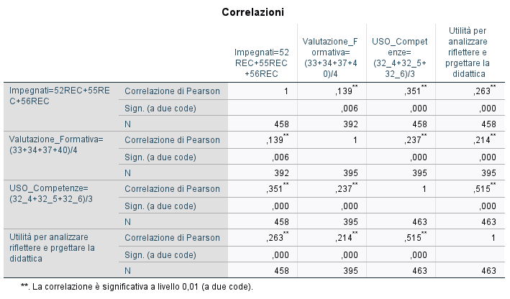
VI Seminar
“INVALSI data: a tool for teaching and scientific research”
Rome, November 25th – 28th, 2021
Notes:
15

Slide 16
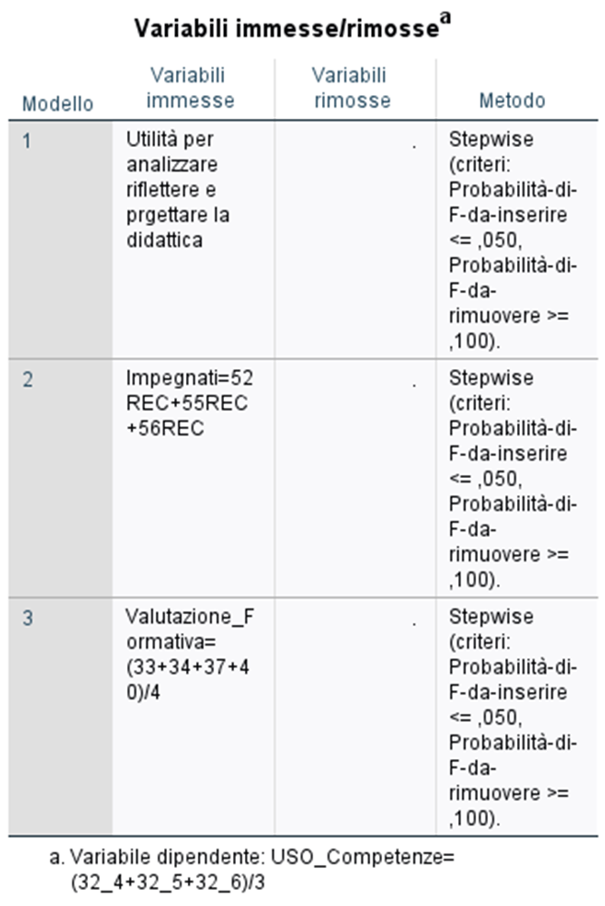
VI Seminar
“INVALSI data: a tool for teaching and scientific research”
Rome, November 25th – 28th, 2021

