Slide 1


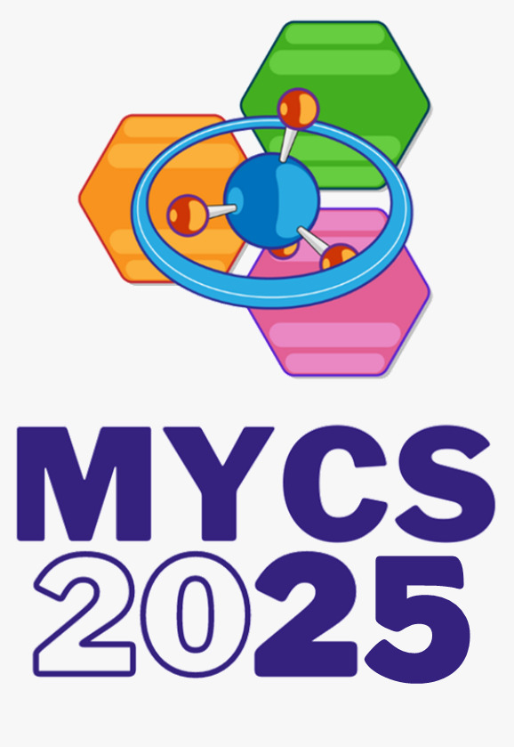


Merck young chemists’ symposium 2025 XXIV edition
Functionalization of E3-ligase recruiters in the green solvent CyreneTM : a sustainable approach for the synthesis of PROTACs precursors
Michela Galli
2nd year PhD student in Industrial Chemistry
University of Milan

Slide 2
Proteolysis Targeting Chimeras
Green optimization
Bivalent molecules able to induce targeted protein degradation through the ubiquitin
proteasome system (UPS)
Ub
POI
E3 ligase
1

Slide 3
Proteolysis Targeting Chimeras
Green optimization
Bivalent molecules able to induce targeted protein degradation through the ubiquitin
proteasome system (UPS)
Ub
Ub
Ub
POI
E3 ligase
1

Slide 4
Proteolysis Targeting Chimeras
Green optimization
Bivalent molecules able to induce targeted protein degradation through the ubiquitin
proteasome system (UPS)
Ub
Completely dependent from the chosen target
Ub
Ub
POI
E3 ligase
2

Slide 5
Proteolysis Targeting Chimeras
Green optimization
Bivalent molecules able to induce targeted protein degradation through the ubiquitin
proteasome system (UPS)
Ub
Completely dependent from the chosen target
Ub
Recurrent fragment present across several PROTACs
→ Space for synthetic optimization
Ub
POI
E3 ligase
Limited number of ligases exploited for PROTACs
3

Slide 6
Most common E3 ligase recruiters
Amide
Coupling
Amide
Coupling
4

Slide 7
Most common E3 ligase recruiters
Usually performed in toxic or volatile solvents like DCM or DMF
Green solvent Cyrene
Amide
Coupling
Amide
Coupling
4

Slide 8
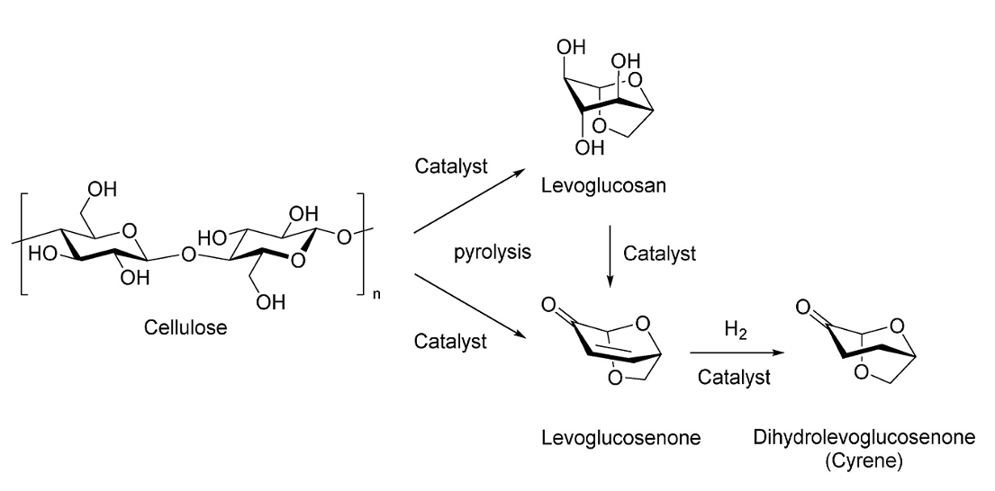
Cyrene
CyreneTM
Dihydrolevoglucosenone
Biodegradable
Non-mutagenic
Non-toxic
Not volatile
High miscibility with water
Replacement for DMF/NMP
High boiling point (difficult to remove through evaporation
5

Slide 9
Lenalidomide functionalization
6

Slide 10
(VH-032)-Me functionalization
7

Slide 11
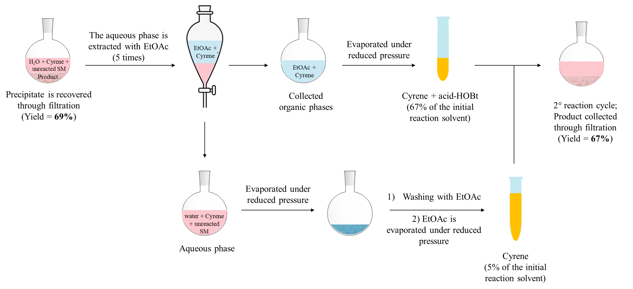
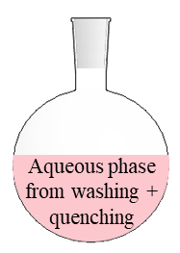

Lenalidomide - Gram scale reaction and Cyrene recovery
Synthesis of compound 1
Synthesis of compound 14
EtOAc
Cyrene recovery
EtOAc
Cyrene recovery
71%
67%
1.0 g
(3.85 mmol)
69% yield
2nd cycle:
67% yield
1.0 g
(3.85 mmol)
67% yield
2nd cycle:
71% yield
8

Slide 12
Merck young chemists’ symposium 2025 XXIV edition
Thank you for your attention!
For any questions you can find me at Poster FL19
Michela Galli
2nd year PhD student in Industrial Chemistry
University of Milan

