Slide 1
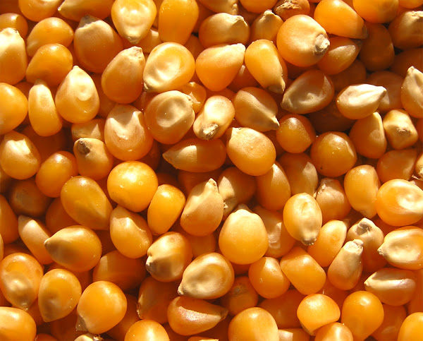


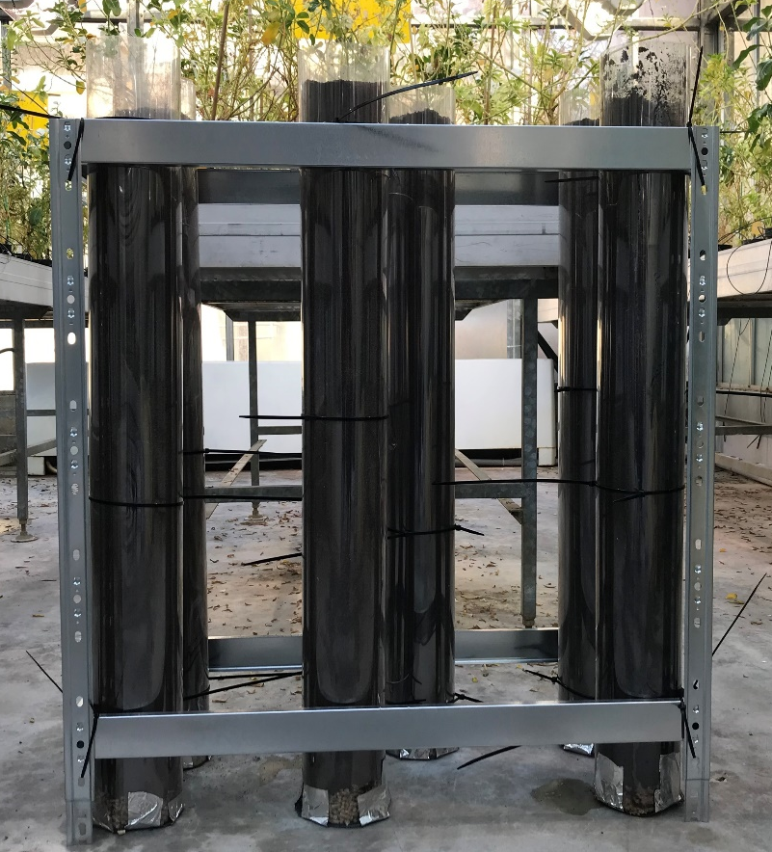
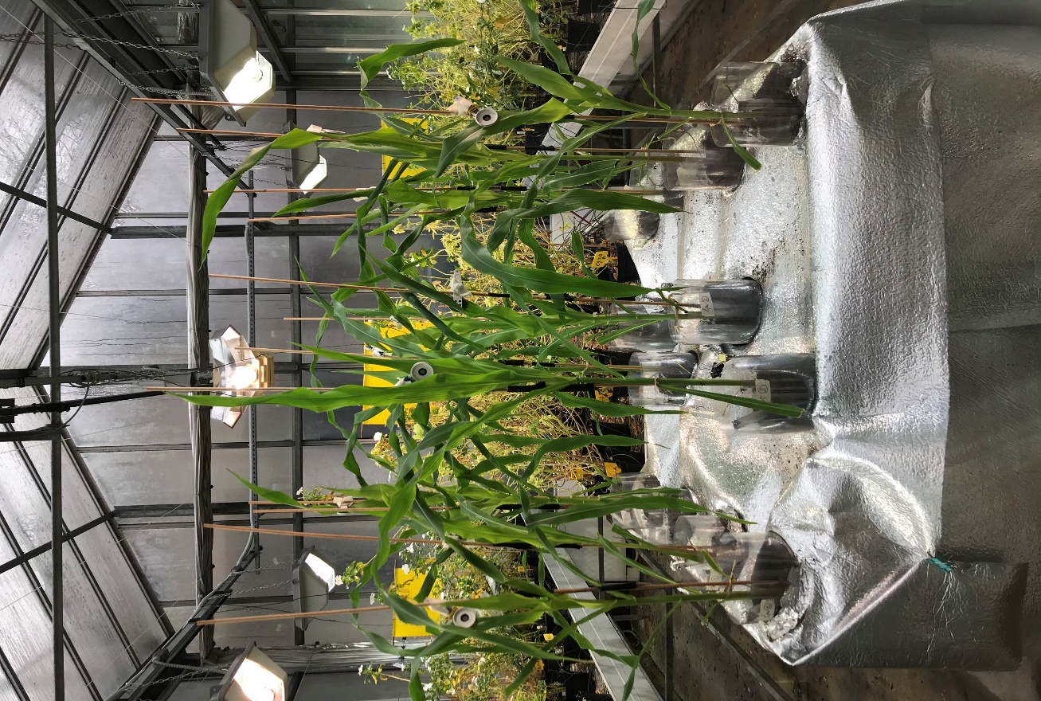
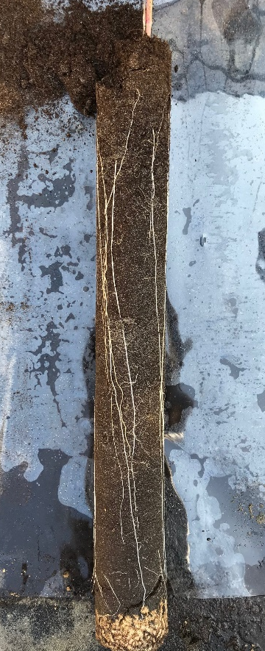
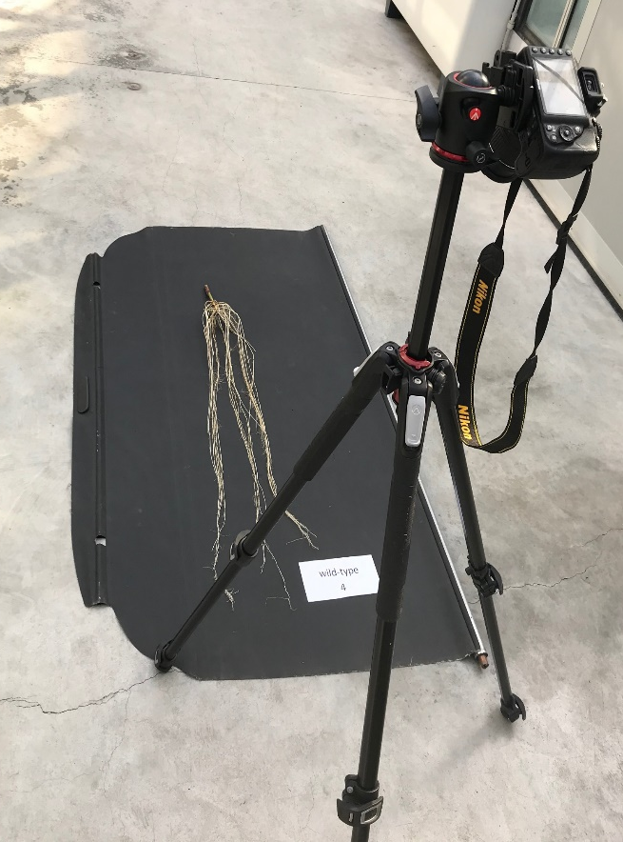
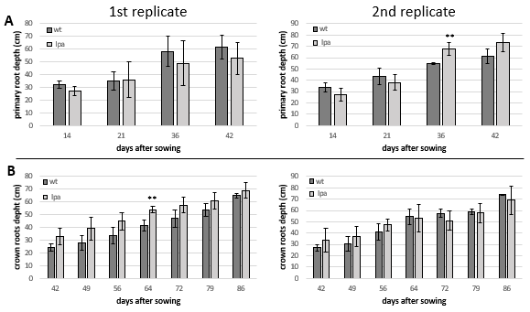
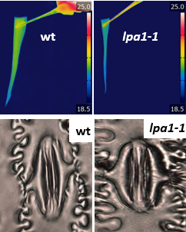
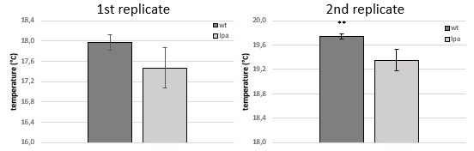
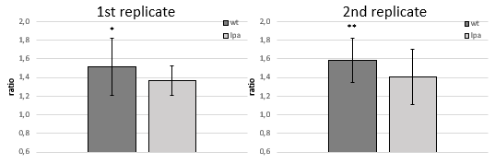
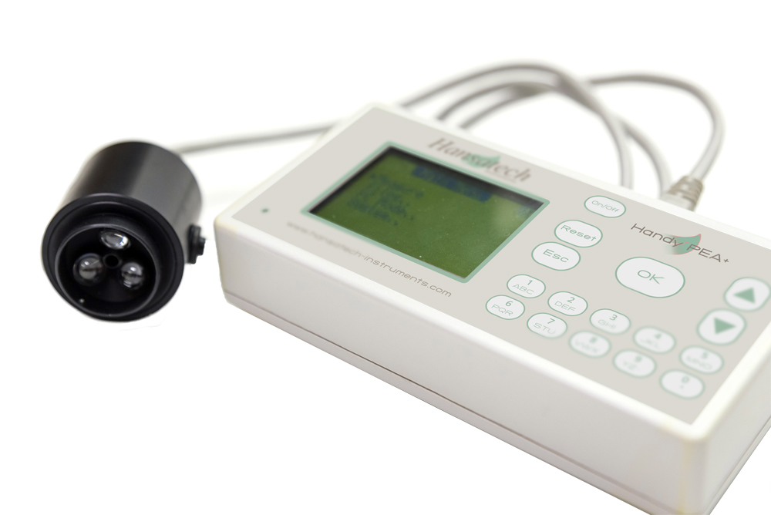
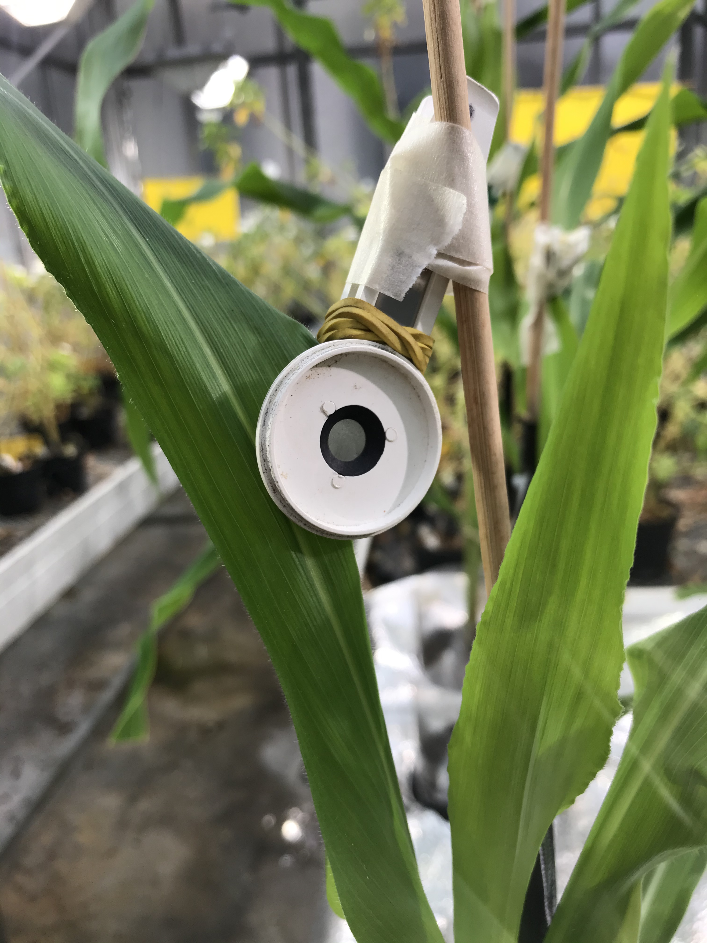
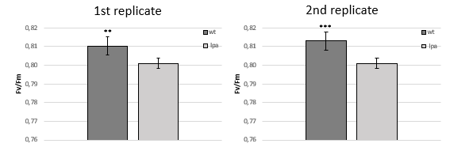
THE ROOT SYSTEM ARCHITECTURE IN LOW PHYTIC ACID1-1 MAIZE MUTANT: PHENOTYPIC AND MORPHOLOGICAL CHARACTERIZATION
F. Colombo*, G. Bertagnon, S. Virgadaula, M. Pesenti, R. Pilu
Department of Agricultural and Environmental Sciences-Production, Landscape, Agroenergy, University of Milan, Italy
*Corresponding author: federico.colombo@unimi.it
Introduction
Phytic acid (PA) represents the major storage form of phosphate (P) in the seeds. It is accumulated as phytate salts with different cations, reducing their bioavailability. Only ruminants can degrade PA due to the presence of phytases in the digestive tract, while monogastrics assimilate only 10% of phytate in feed and 90% is excreted, contributing to P pollution and water eutrophication. In underdeveloped countries, the lack of important cations in the diet represents a serious problem for human health. On the other hand, in rich countries the problem is not nutritional, but related to feed: farmers must supply mineral phosphorus to the feed of monogastrics (economic problem). Hence, many low phytic acid (lpa) mutants have been isolated and characterized in all major crops. Among different lpa mutants in maize, lpa1-1 is characterized by a 66% reduction in PA, followed by a proportional increase in inorganic P. Unfortunately, PA decrease is followed by different negative pleiotropic effects on the seed and on plant performance. One of these agronomic defects observed on lpa1-1 in field conditions is a greater susceptibility to drought stress, which could be caused by an alteration in the Root System Architecture (RSA).
Objective of the present research is to assess the effect of drought stress on the lpa1-1 mutant with the aim to deeply investigate this pleiotropic effect.
Here we compared the RSA of lpa1-1 to a wild phenotype (the pure line B73) in a two-replicates greenhouse experiment in order to study the impact of RSA on drought stress.
Figure 1_ (above) Schematic representation of the experiment: from the initial setup to the final cleaning of the roots. The mesocosms were built in an economical way using transparent PVC sheets to better access the root system. Plants were grown till flowering using the same amount of water and urea.
Figure 2_ (on the right) Depth of the embryonic primary root (A) and of the post-embryonic crown roots (B) measured weekly till flowering. The data represent the means of three biological replicates. Significant differences between wt and lpa1-1 were assessed by Student’s t test (* P<0,1, **P , 0.05 and ***P , 0.01).
The graphs clearly show that in the two replicates there are no significant differences in the depth of the RSA (both primary and crown roots). Furthermore, the dry weight of the roots measured after the final cleaning is statistically the same in both replicates (data not shown).
A
B
Figure 3_ (A) Representative images of the leaf temperature acquired with the thermographic camera (FLIR T650sc) in wild-type and homozygous lpa1-1 plants.
(B) Temperature of the fifth fully expanded leaf in the wild-type and lpa1-1 homozygous plants measured at 60 days after sowing (DAS). In both replicates, the wild phenotype shows a higher leaf temperature compared to the mutant. Values represent the mean of three biological replicates. Significant differences between wt and lpa1-1 were assessed by Student’s t test (* P<0,1, **P , 0.05 and ***P , 0.01).
A
B
Figure 4_ Using clear nail varnish is a traditional method to measure stomatal density and opening, since making the impression and viewing it under the optical microscope.
(A) Representative images of the stoma acquired at 60 DAS on the fifth fully expanded leaf in wild-type and lpa1-1 mutant plants.
(B) Ratio between the long side and the short side of the stoma. This parameter gives us an indication about the shape of the stoma and its opening: the higher the ratio, the more elongated the shape; vice versa, if the ratio is close to 1, the stoma has a circular shape. Values represent the mean of eighteen biological replicates. Significant differences between wt and lpa1-1 were assessed by Student’s t test (* P<0,1, **P , 0.05 and ***P , 0.01).
Figure 5_ The parameter Fv/Fm is an indication of the maximum quantum efficiency of Photosystem II and is considered a sensitive indicator of plant photosynthetic performance.
(A) The fluorimeter Handy PEA+ used to measure Fv/Fm and other important photosynthetic parameters such as the performance index (PI), the dissipation (DIo/CS) and others.
(B) In both replicates, the wild phenotype shows a higher photosynthetic efficiency compared to the mutant. Values represent the mean of three biological replicates. Significant differences between wt and lpa1-1 were assessed by Student’s t test (* P<0,1, **P , 0.05 and ***P , 0.01).
A
B
Conclusion
low phytic acid mutants represent a great opportunity both in rich countries but especially in underdeveloped ones: studying and overcoming the pleiotropic effects affecting them would determine several potential benefits for the nutritional quality of food and feed and for the environmental P sustainability in agriculture.
The current work give us more information on lpa1-1 RSA, currently neglected. In this work we present the results obtained in a two-replicates greenhouse experiment, which clearly show that a variety of morphological changes occurred in the aerial part of the mutant plant rather than in the root system architecture. The pleiotropic effect of the drought stress observed in the mutant seems to be caused by a different photosynthetic efficiency and not by a shallower root system. Compared to the mutant, the wild phenotype is warmer and better controls evapotranspiration under drought stress, probably closing the stomata.

