Slide 1


93°Congresso nazionale SIBS, 24 Aprile 2021
Understanding the potential health benefits of plant foods proteins beyond their nutritive role
Giuditta C. Heinzl, Jessica Capraro, Chiara Magni, Alessio Scarafoni and Stefano De Benedetti
Department of Food, Environmental and Nutritional Sciences
giuditta.heinzl@unimi.it

Slide 2



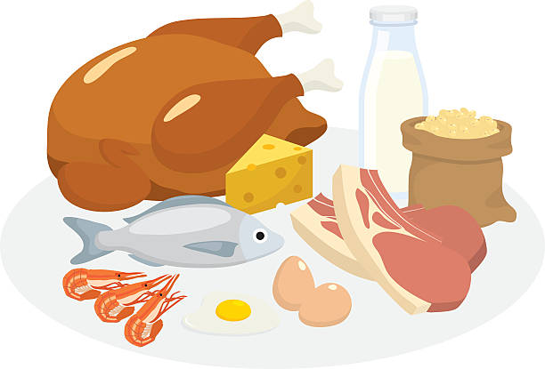


Background
Dietary approaches
Ethycs
Environmental sustainability

Slide 3
Background
Dietary approaches
Ethycs
Environmental sustainability
Nutraceutics

Slide 4
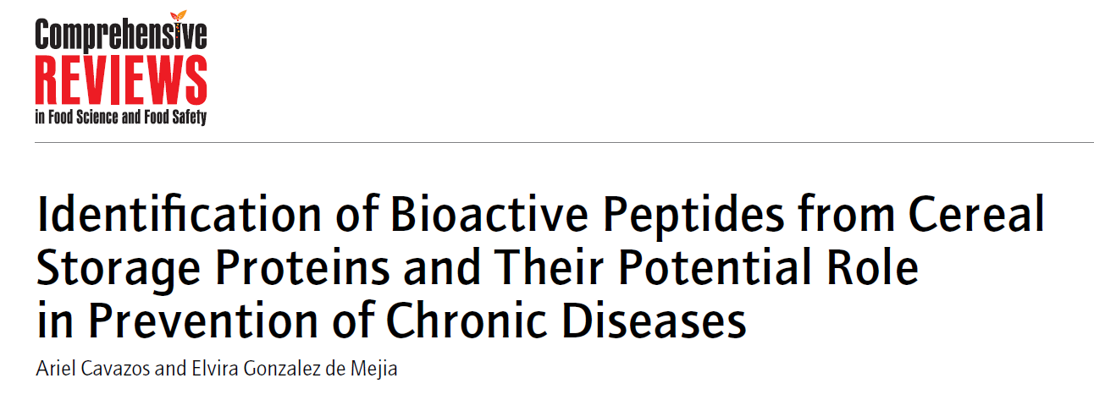
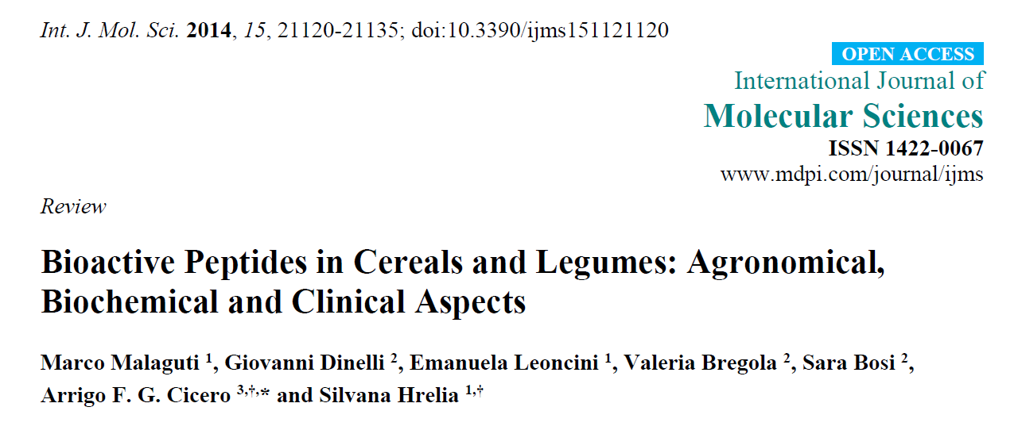
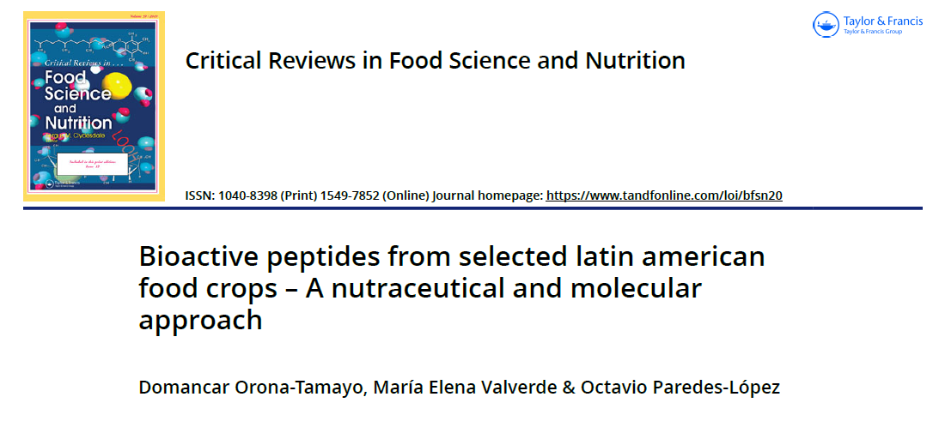
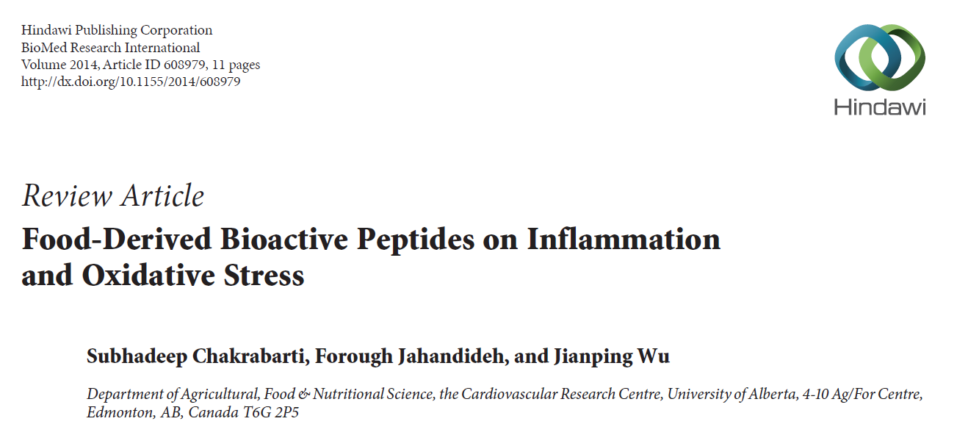
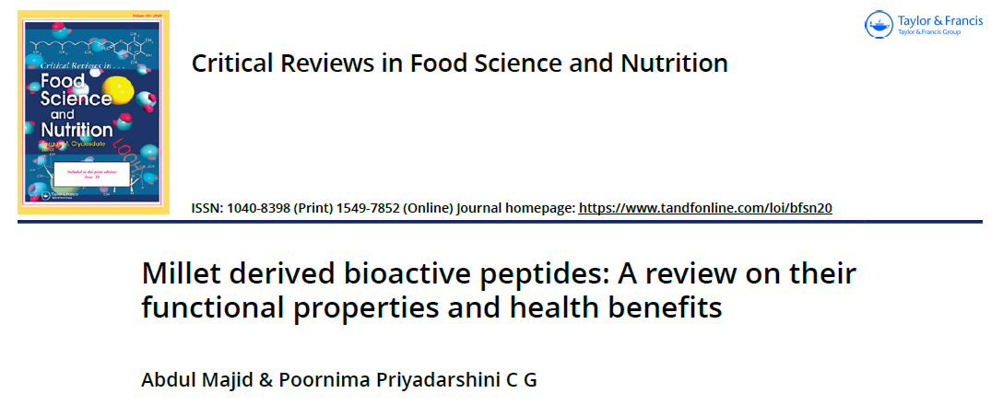
Background

Slide 5
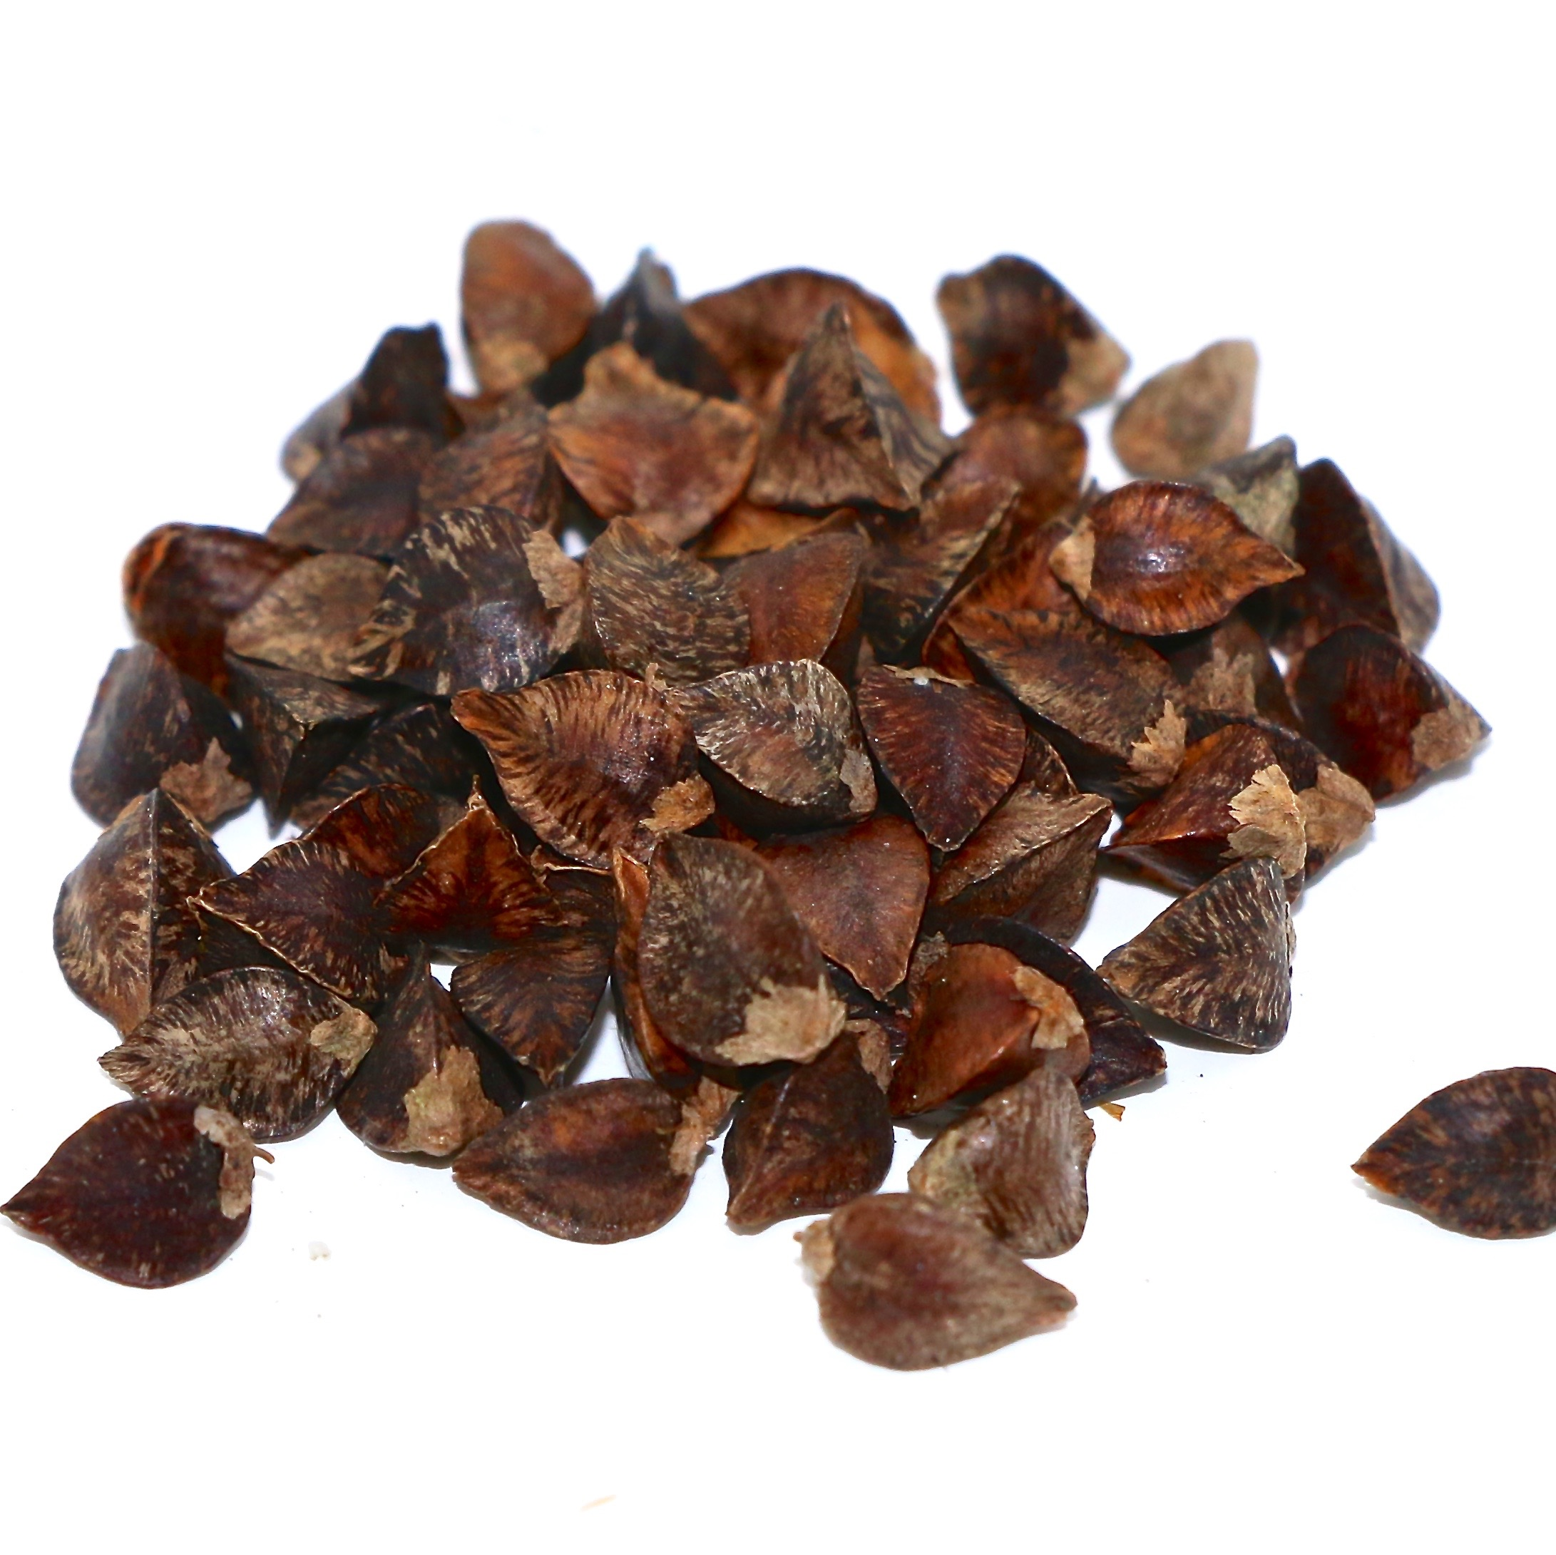
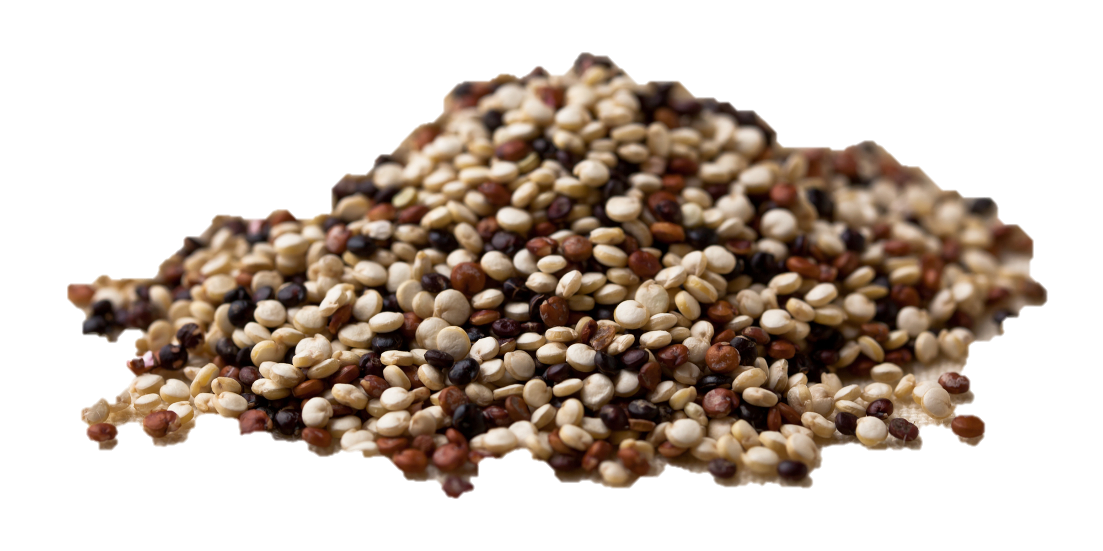
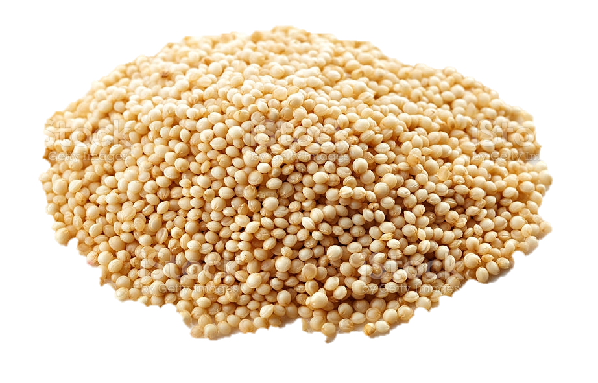
Experimental set up
Buckwheat
Quinoa
Amaranth
Protein fractionation
Water extraction
Salt extraction
Albumins
Globulins
IEC pH 8
VLC
LC
HC
Biological activities
Antioxidant, trypsin-inhibitor and immune-modulatory activities

Slide 6
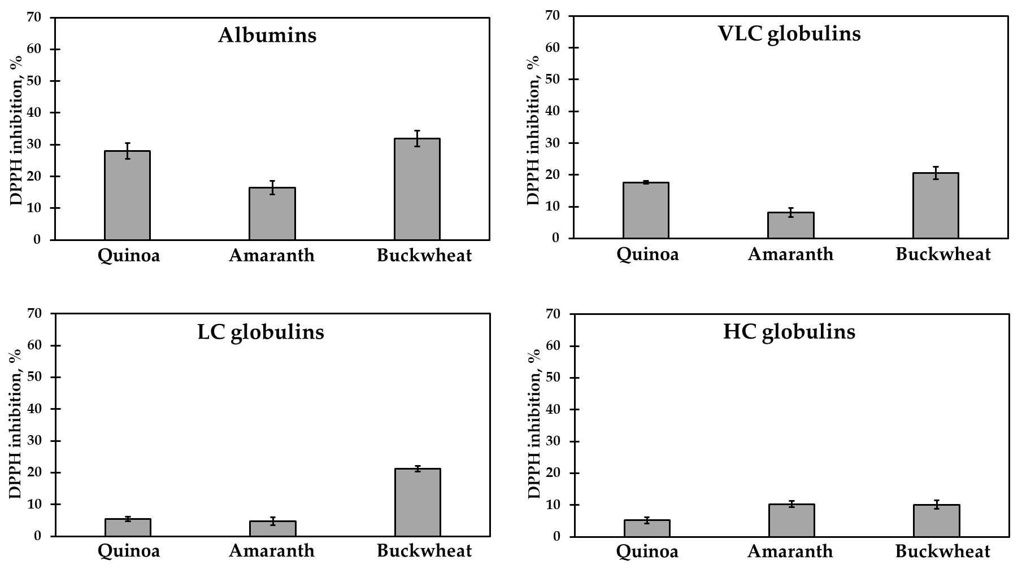
Antioxidant activity
Antiox activity: All albumin, buckwheat VLC and LC, and quinoa VLC fractions
AA possibly involved in redox reactions
Capraro et al Int. J. Mol. Sci. 2021

Slide 7
Trypsin-inhibitor activity
 | Fraction | Inhibition
Quinoa | Albumins | ++++
 | VLC | +++
 | LC | ++
 | HC | ++
Amaranth | Albumins | n.d.^{a.}
 | VLC | ++
 | LC | ++
 | HC | ++
Buckwheat | Albumins | ++
 | VLC | ++++
 | LC | ++++
 | HC | -
^{a.}n.d.: not determined
Serine proteases act on immune system and inflammatory response
Anomalous functioning → disease and inflammation
Inhibition → prevention
+ correspond to approximately 20% inhibition
Capraro et al Int. J. Mol. Sci. 2021

Slide 8
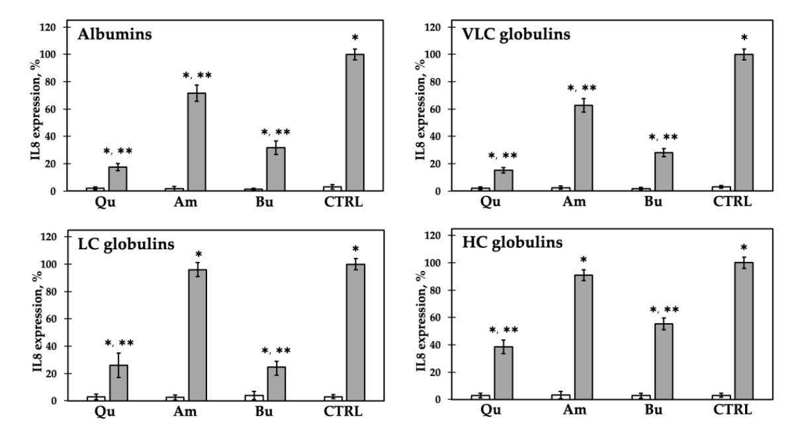
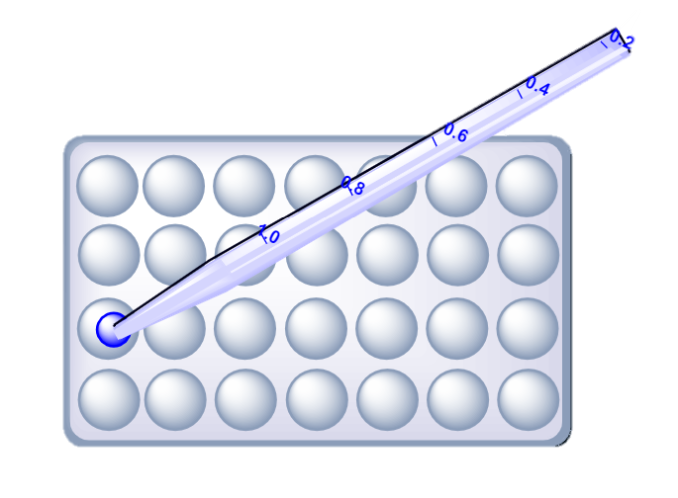
Immune-modulatory activity
Caco-2 cells with IL-1β
Caco-2 cells withouth IL-1β
Quinoa fractions possess a higher anti-inflammatory potential
Capraro et al Int. J. Mol. Sci. 2021

Slide 9
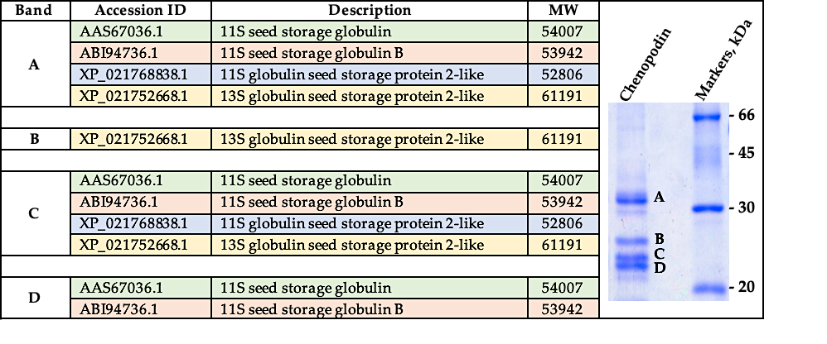
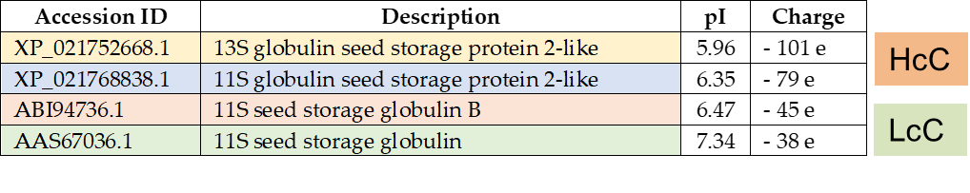
Quinoa globulins - Chenopodin
Two main group of polypeptides with Mr 35-37 and 22-25 kDa
Mass spectrometry analyses assigned proteins to the 11-13S globulin family
Different isoforms of the same protein
Capraro et al Biomolecules 2020

Slide 10

Chenopodin focus
Receptor
sample
IL-1β
Caco-2 Cell
Capraro et al Biomolecules 2020

Slide 11
Chenopodin focus
Receptor
sample
Cell
30 min
Capraro et al Biomolecules 2020

Slide 12
Chenopodin focus
Receptor
sample
IL-1β
Cell
30 min
Capraro et al Biomolecules 2020

Slide 13
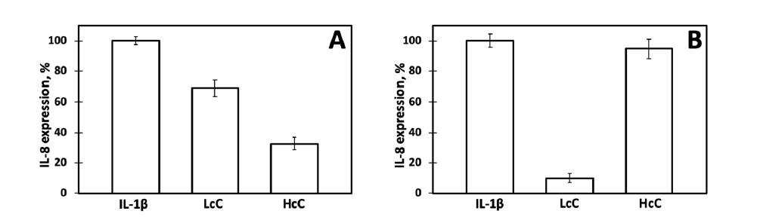
Chenopodin focus
Receptor
sample
IL-1β
Cell
30 min
Capraro et al Biomolecules 2020

Slide 14
Chenopodin focus
Receptor
sample
IL-1β
sample
IL-1β
Cell
30 min
30 min
Capraro et al Biomolecules 2020

Slide 15
Chenopodin focus
Receptor
sample
IL-1β
sample
IL-1β
Receptor
Cell
Cell
30 min
30 min
Capraro et al Biomolecules 2020

Slide 16
Chenopodin focus
Receptor
sample
IL-1β
sample
IL-1β
Receptor
Cell
Cell
30 min
30 min
The two incubation approaches led to different results -> HcC and LcC act with a different mechanism?
Capraro et al Biomolecules 2020

Slide 17
Chenopodin molecular docking
Capraro et al Biomolecules 2020

Slide 18
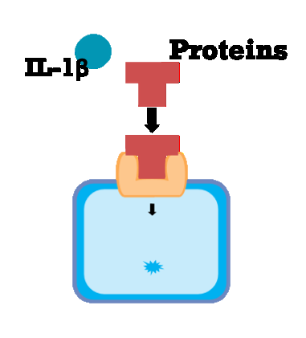
Chenopodin molecular docking
Chenopodin
Chenopodin
IL-1β
Capraro et al Biomolecules 2020

Slide 19
Chenopodin – IL1 Receptor Antagonist
Recombinant form of IL-1RA approved for the treatment of autoinflammatory disorders (Anakinra)
3 regions with sequence similarity
5 AA crucial for interaction with IL-1R in conserved regions
Capraro et al Biomolecules 2020

Slide 20
Chenopodin

Slide 21
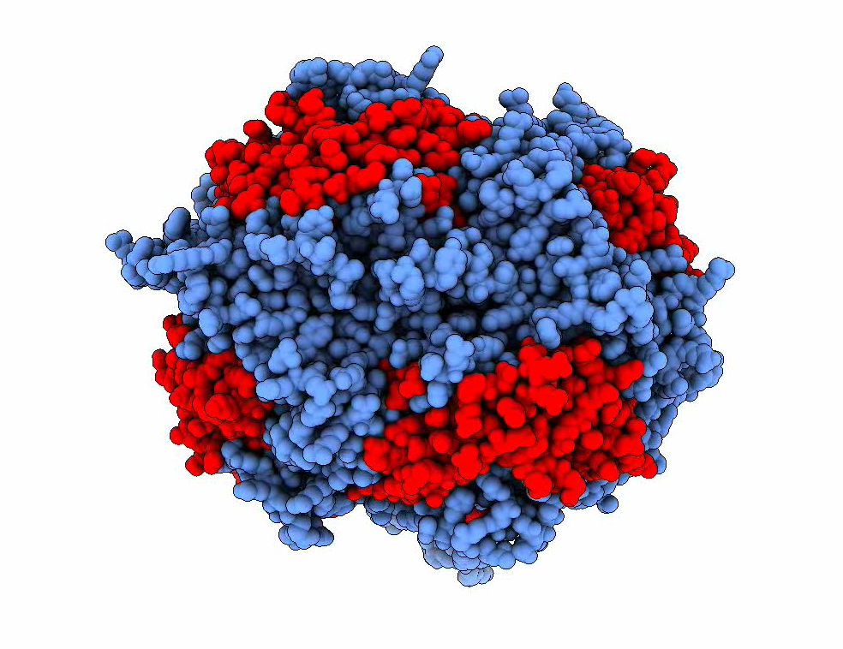
Chenopodin
Blue: chenopodin hexamer
Red: IL1RA homolog sequences

Slide 22
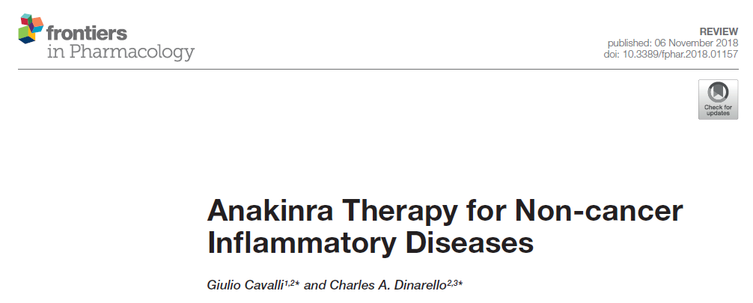
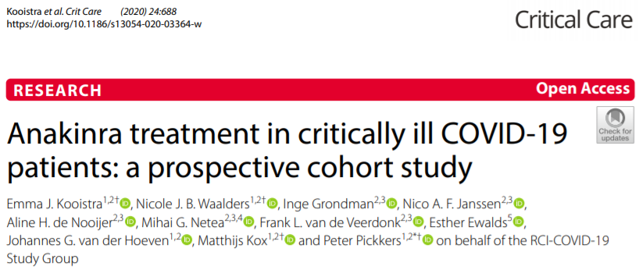
Conclusions
Role of pseudocereal proteins on human health
New possible applications: es.nutraceutical formulations
Chenopodin as adjuvant in the treatment of autoinflammatory disorders?

Slide 24
Chenopodin molecular docking
Chenopodin
Chenopodin
IL-1β
Capraro et al Biomolecules 2020

