Slide 1
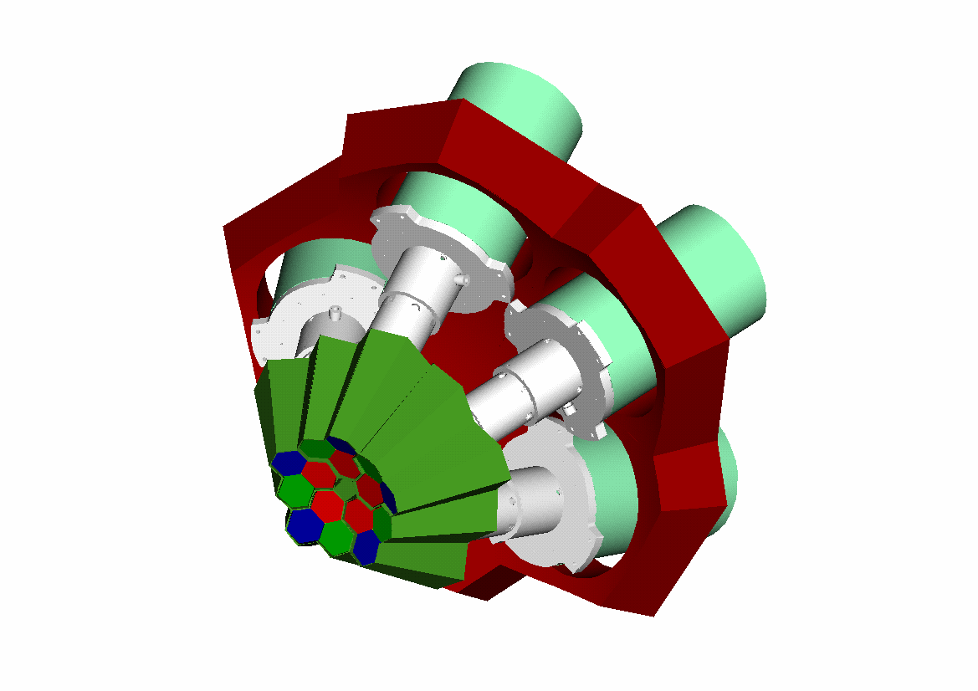


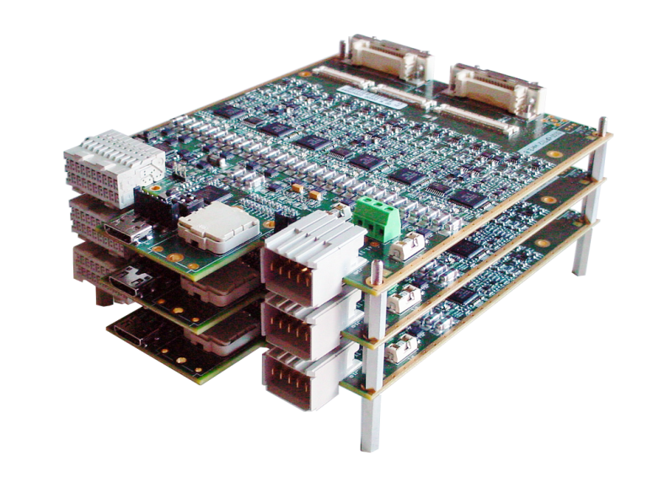
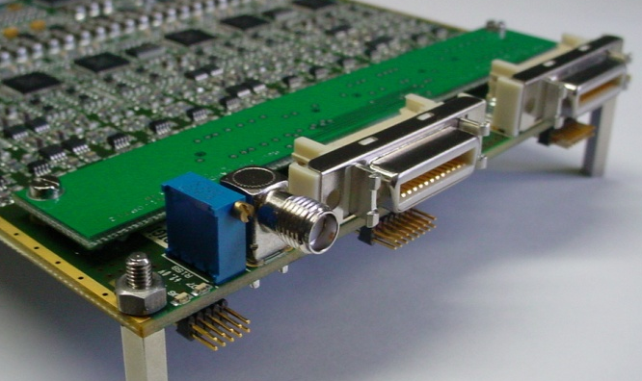
INFN - Milano University of Milano
Department of Physics
Status of the new AGATA digitizer*
Alberto Pullia
* White paper available: DIGI-OPT12: 12-channel 14/16-bit 100/125-MS/s Digitizer with Optical Output for AGATA/GALILEO - version 1.8
14th AGATA Week January 22-24, 2014 Madrid, Spain
January 23, 2014

Slide 2
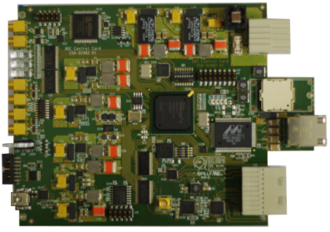
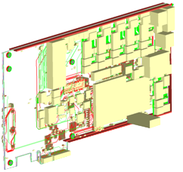
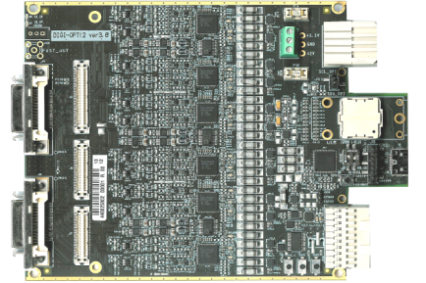
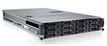
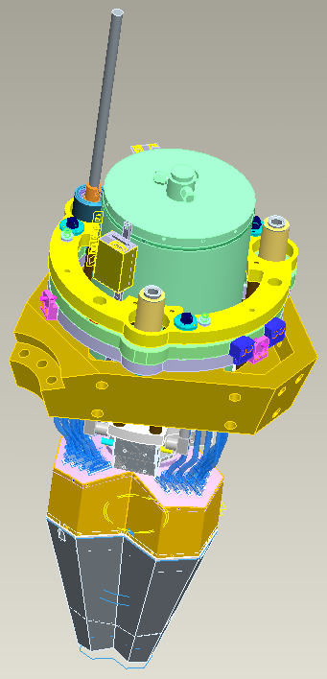
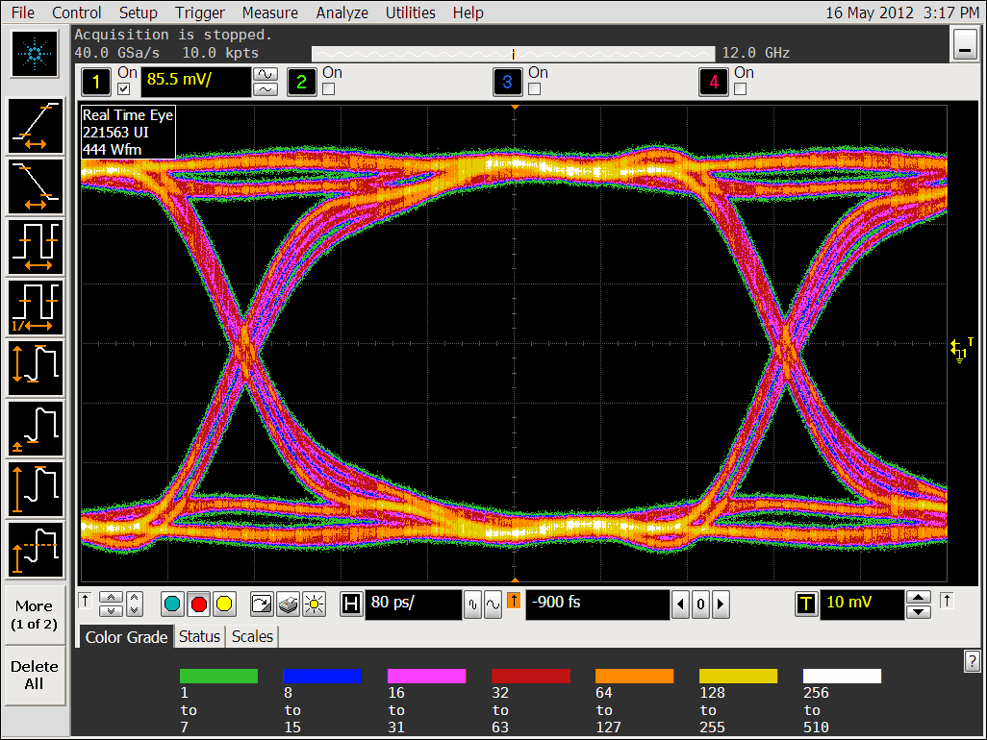


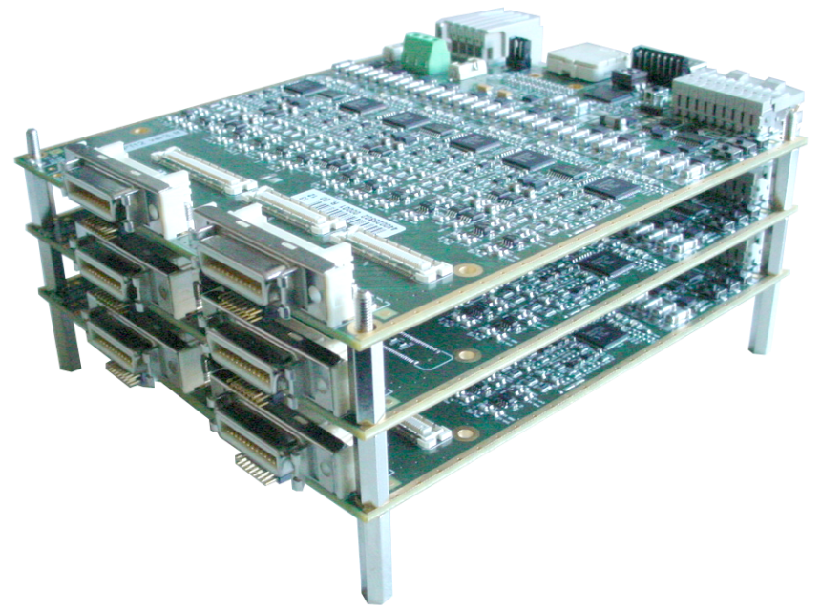
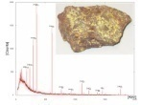

System parts and connections (1 AGATA crystal)
GTS
link
backplane
MDR cables
fibers
Core ADC
Module
backplane
PCIe expansion box
500 ps
Eye diagram @ 2Gb/s
Workstation
backplane
PS Module, backplane, cooling
48V
3 Segment ADC Modules
(12 channels each)

Slide 3
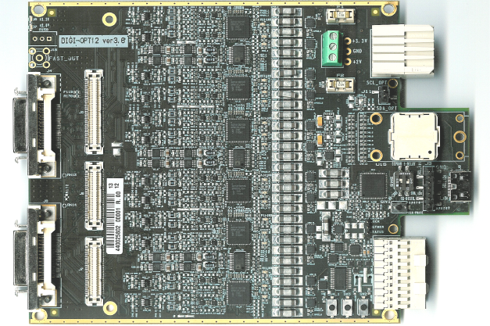
The card – top view
Power (3.3V, 2.0V) via screw header
Power (3.3V, 2.0V) via backplane
conn’s for routing card
SNAP12 TX (not connected)
J5
120 mm
ck, sync, test i2c, spi via mini-HDMI
MDR in
J6
J7
ck, sync, test i2c, spi via backplane
160 mm

Slide 4
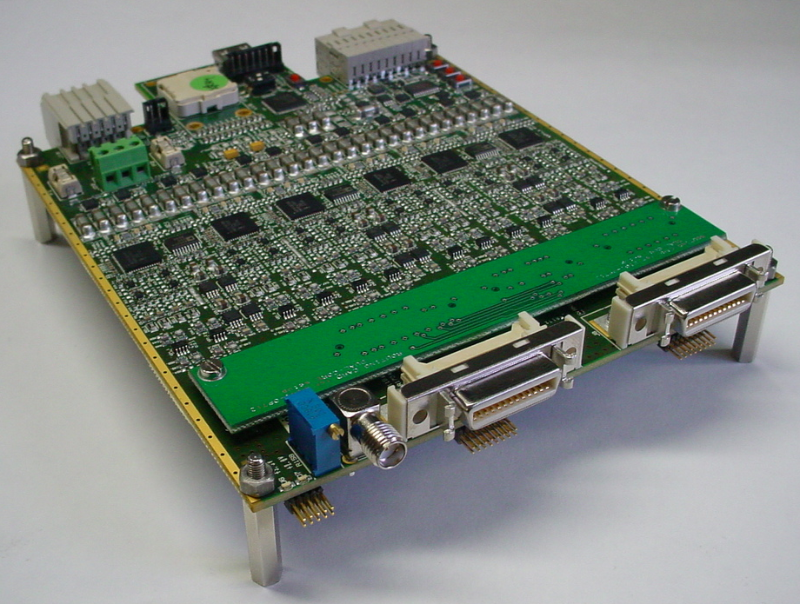
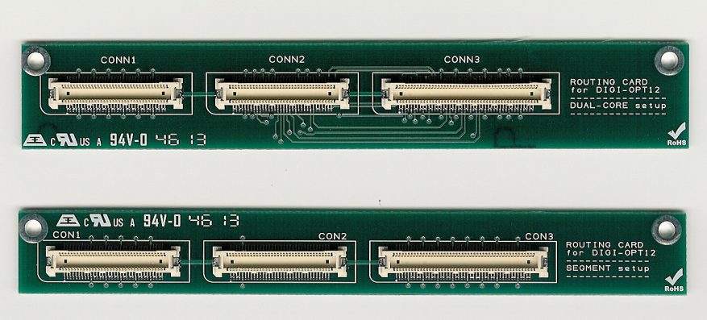
Routing cards (dual-core and segment setups)
Delivered in December 2013
Tested in January 2014
Routing card for dual-core setup (type A)
Routing card for segment setup (type B)
Type-B routing card turns the core digitizer into a fully functional segment digitizer. So any stocked core-digitizer card may be used as a spare either for core or segments

Slide 5

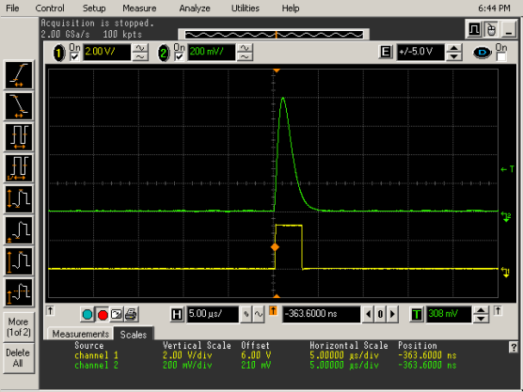
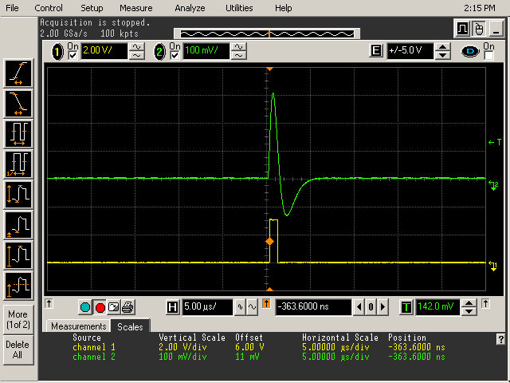
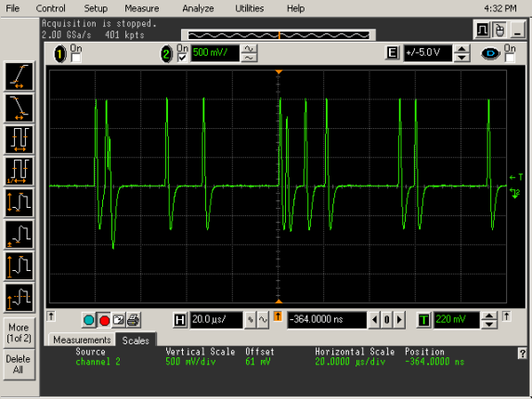
Trigger signal for ancillaries (core digitizer only)
5 us
Optionally unipolar (but BL is less stable @ high rate)
Analog fast signal
5 us
Digital signal (LVDS)
Low-Level Discriminator manual adjustment
(from slow control also)
Single 500keV trigger pulse
20 us
Trigger signals @ 50 kcount/s

Slide 6
Production of DIGI-OPT12 cards for AGATA
In June 2013 n. 57 “DIGI-OPT12 ver 3.6.1” cards have been assembled and delivered (684 ADC channels) for 14 segmented germanium crystals of AGATA
42 cards of segment type
30 ordered by INFN Milano
12 ordered by IFIC Spain
15 cards of core type
11 ordered by INFN Padova (including 1 spare)
4 ordered by IFIC Spain
A testbench for the acceptance of the realized cards has been developed and put into operation. The software part of the test system is open source (Arduino IDE, Processing IDE, Scilab).

Slide 7
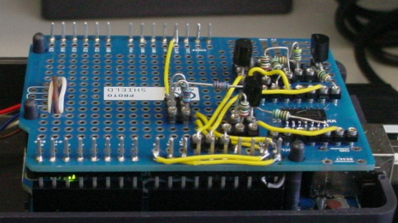
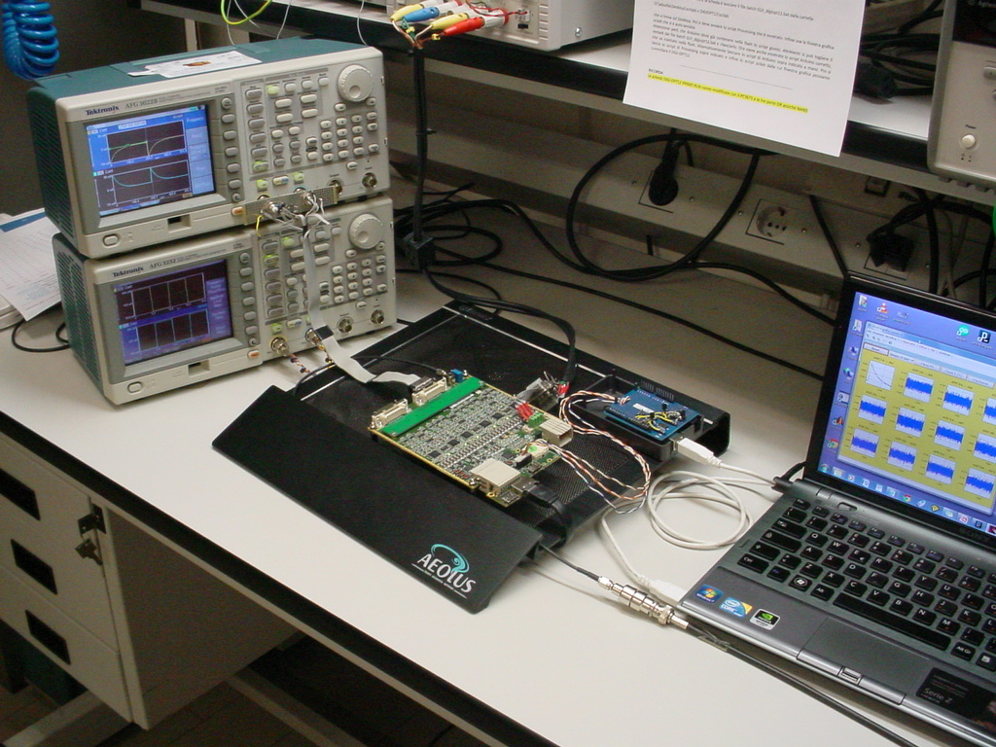
Setup for testing the DIGI-OPT12 card
I2C/SPI protocol interface Arduino Uno + custom shield
Differential analog test signal Tektronix AFG3022B
I2C/SPI
USB
Differential clock Tektronix AFG3252
Laptop w USB link to Arduino
DIGI-OPT12 card

Slide 8
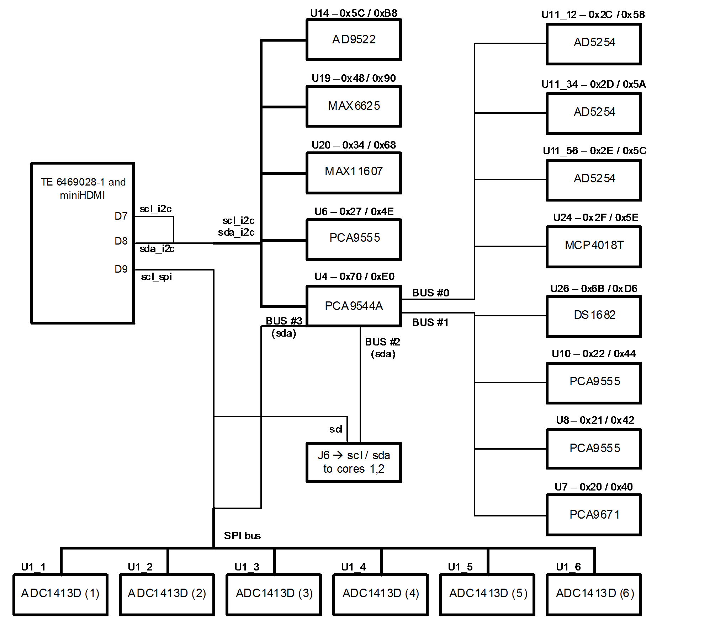

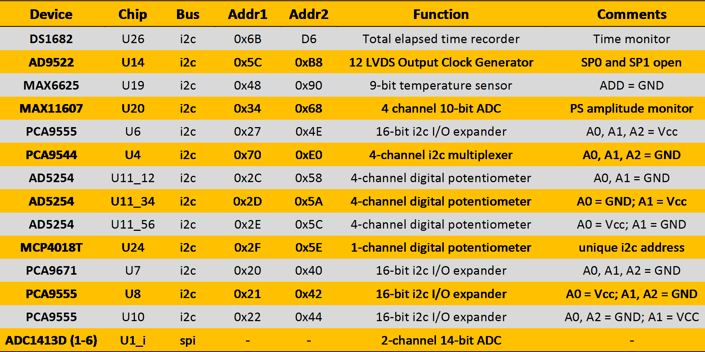
Map of DIGI-OPT12 devices
SPI control of ADCs settings
I2C control of clock distribution settings
I2C analog MUX for time-calibration test pulse
I2C GPIO for range setting (7 and 21 MeV)
I2C digipots for offset setting (on a ch by ch basis)
I2C temperature meter
I2C volt-meter for PS check
I2C elapsed time meter (option)
and more …..

Slide 9
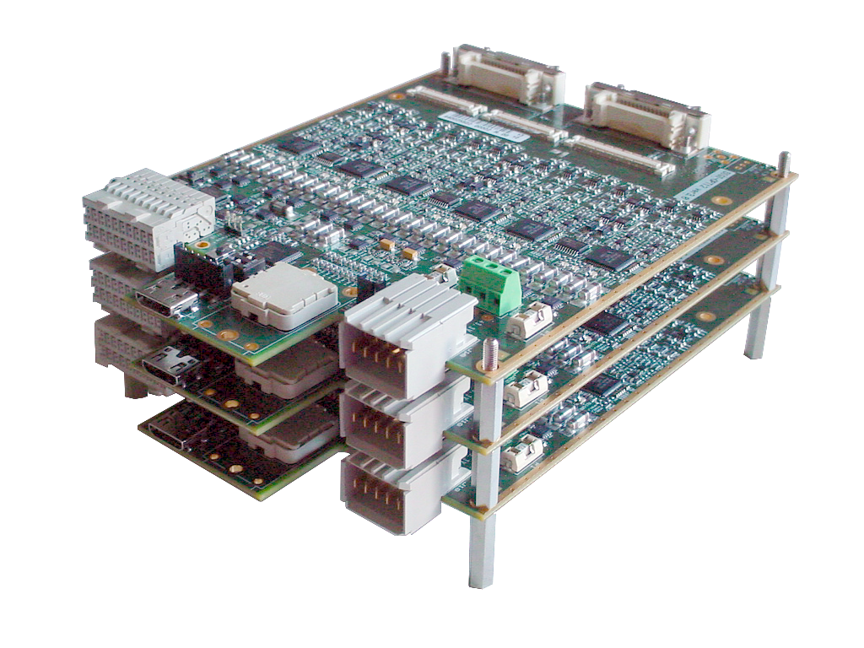
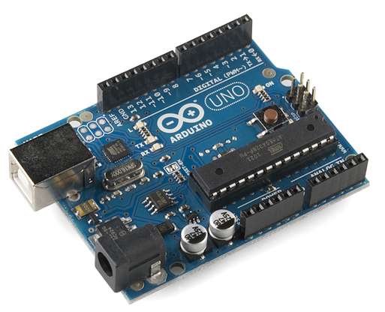
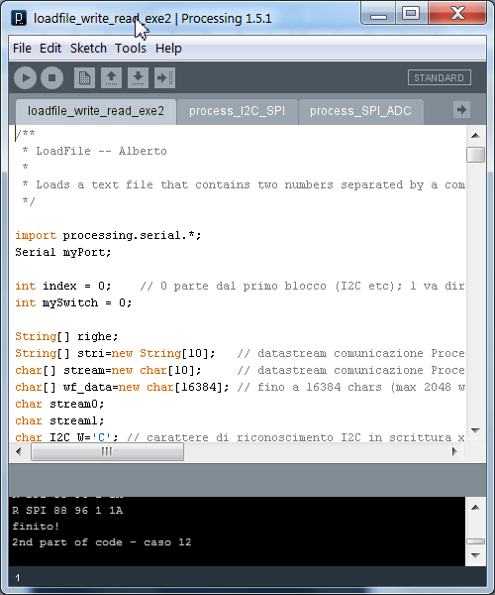
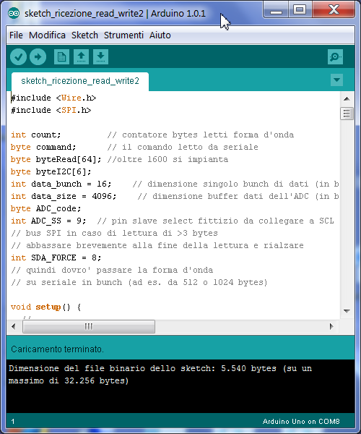
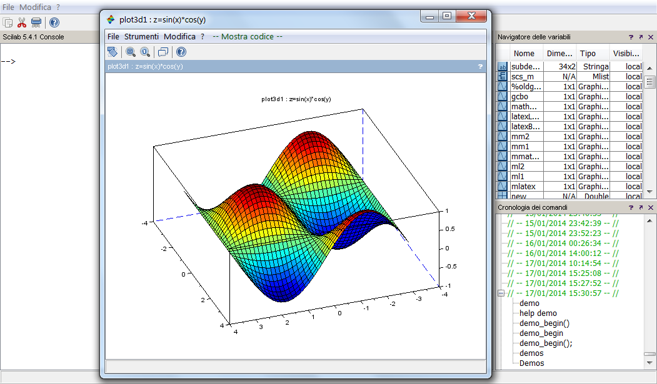
Setup for testing the DIGI-OPT12 card
I2C / SPI protocol three wires
Custom shield
USB link
Mini
HDMI
Arduino UNO
DIGIOPT-12
Notebook
Processing IDE
Arduino IDE
Custom scilab scripts for real-time data analysis
Exchange data with Arduino through USB serial connection
Communication through files in RAMDisk

Slide 10
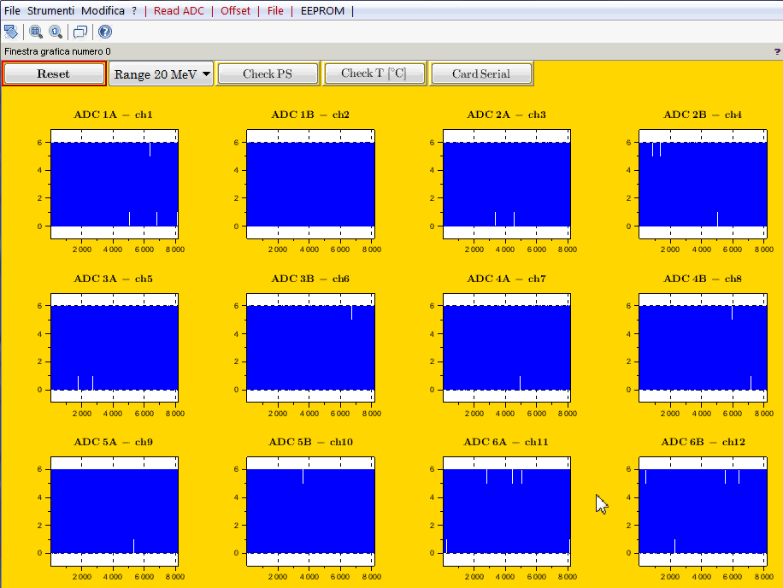
Matlab GUI for digitizer testing
The ADC chip contains an undocumented 16 kB RAM where the waveforms can be stored and read out via SPI, which is used in the demoboard. I gained full control on that by reverse engineering. Very useful functionality for test benching and diagnostic.

Slide 11
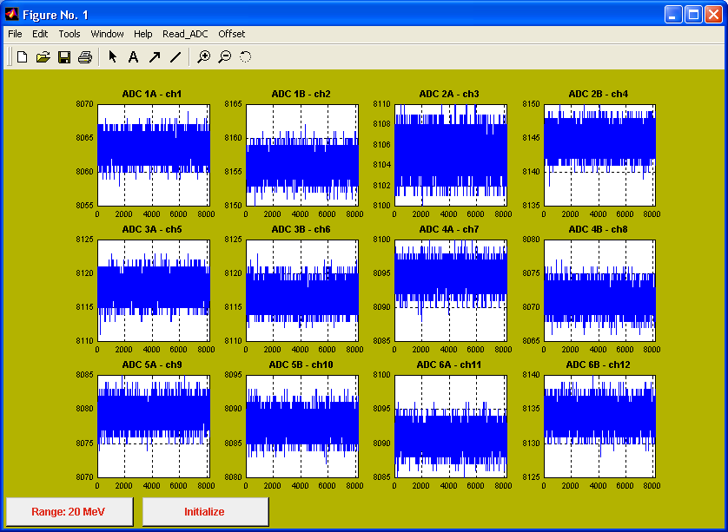
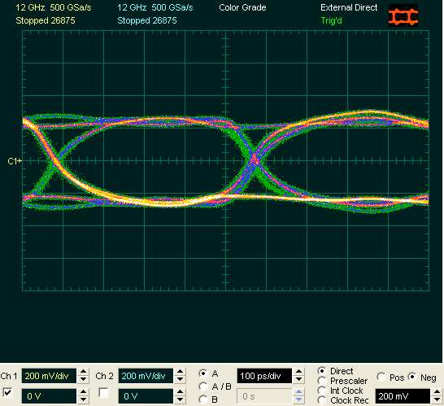
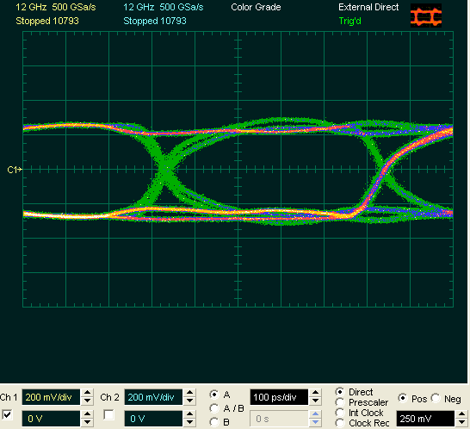
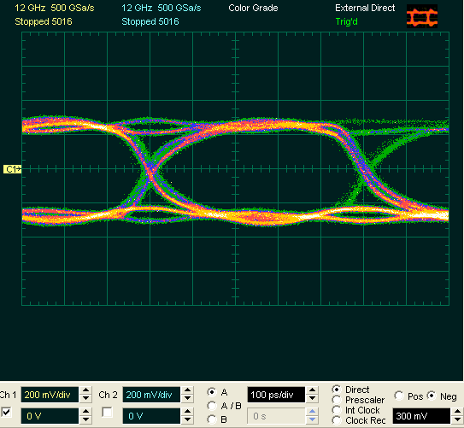
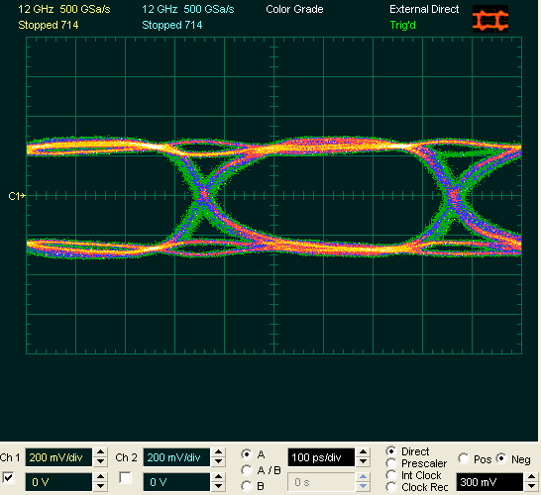
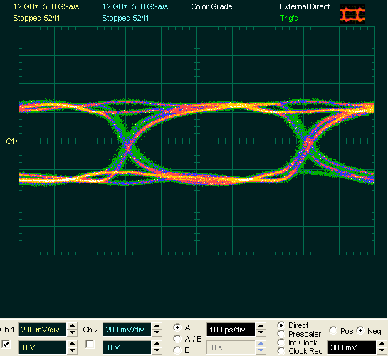
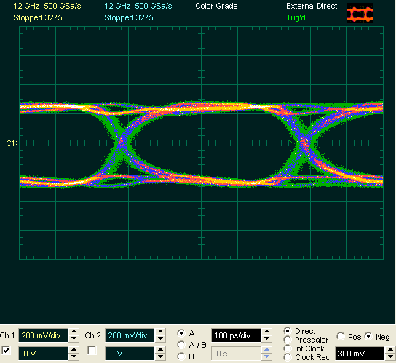
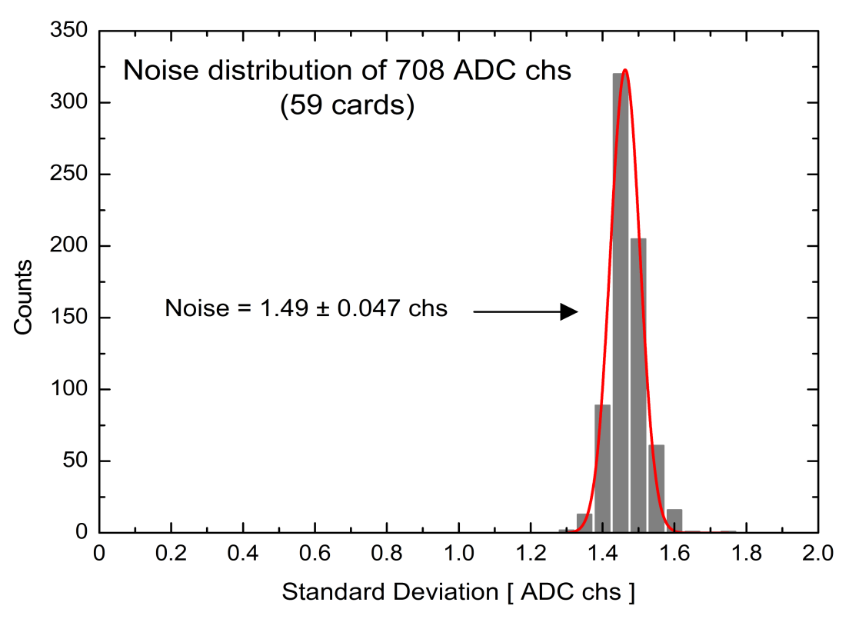
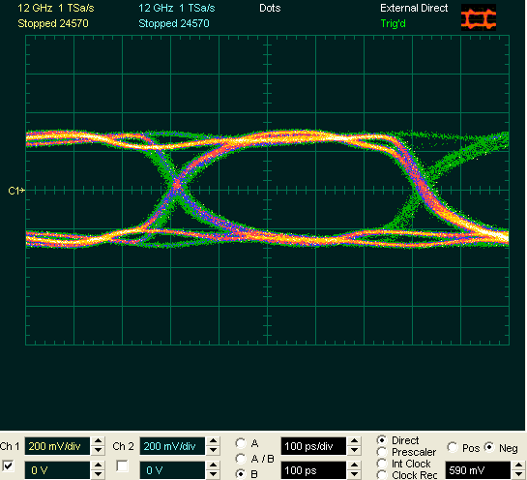
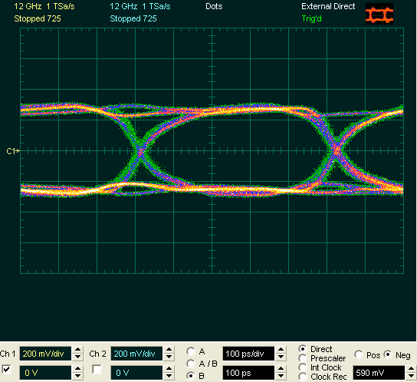
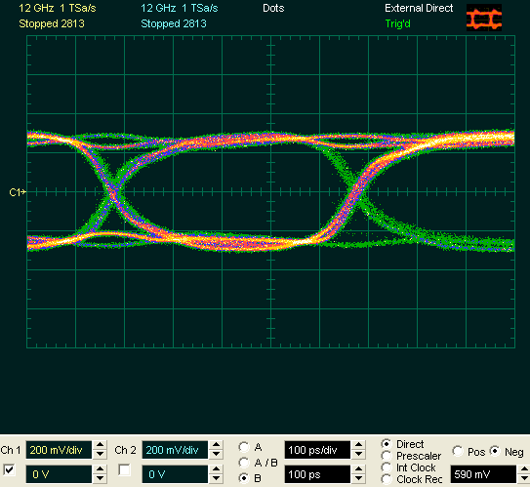
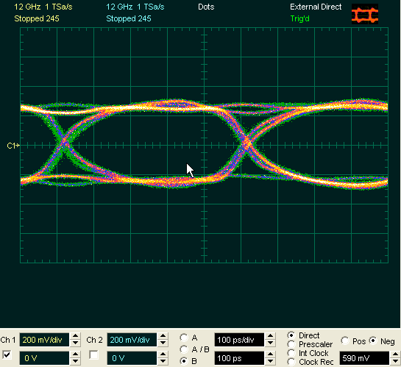
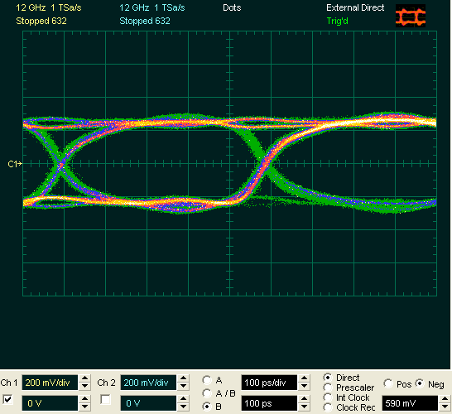
Acceptance tests
Noise, functionality, and quality of 2Gb/s serialized signal have been checked for acceptance
500 ps
57 +2 cards
Eye plots of 2 Gb/s serialized signals are clean and open
Noise limit for acceptance
Notes:
11

Slide 12
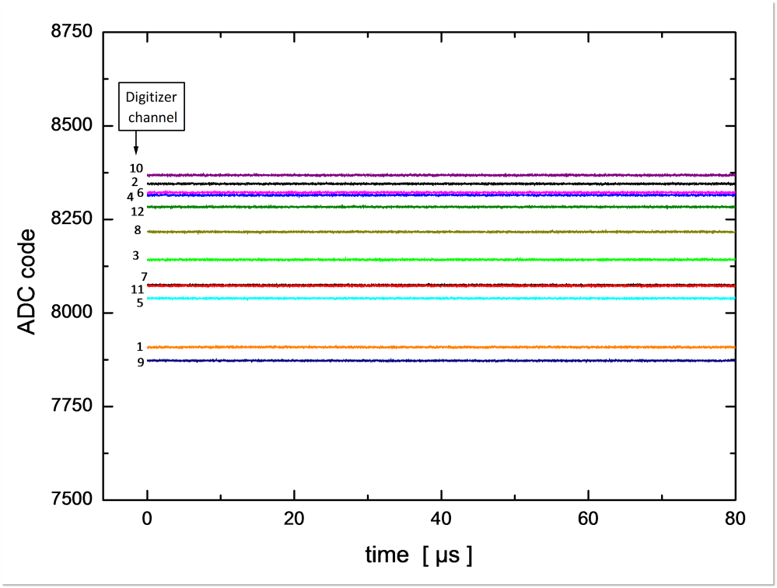
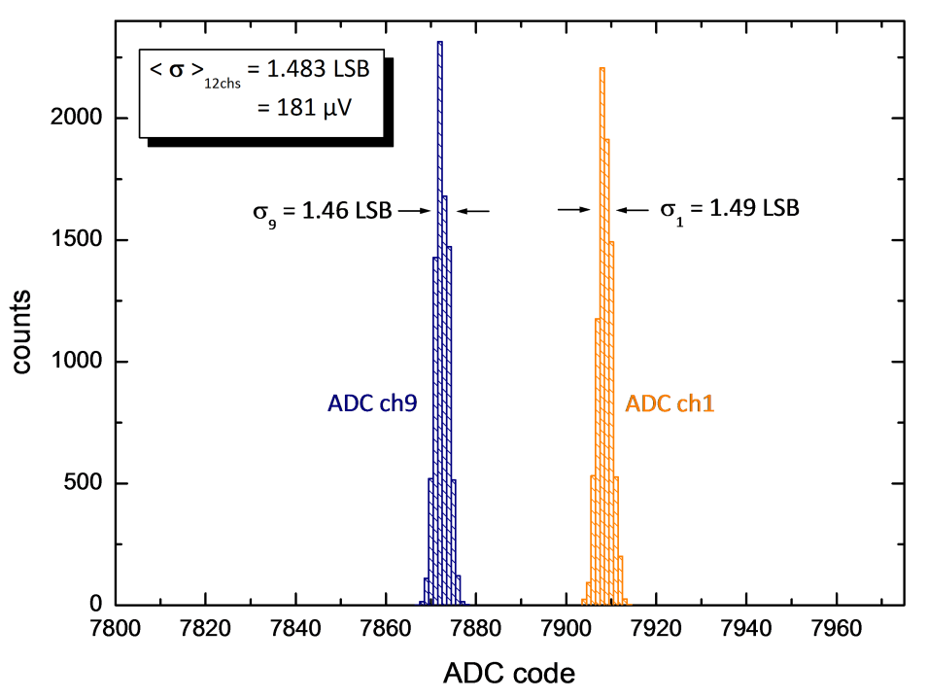
Measurements - noise
20 MeV range
Acquired data - no input signal provided
20 MeV range
7 MeV range
Identical to the value rated in ADC datasheet: ENOB = 11.6 @ 70MHz !!

Slide 13
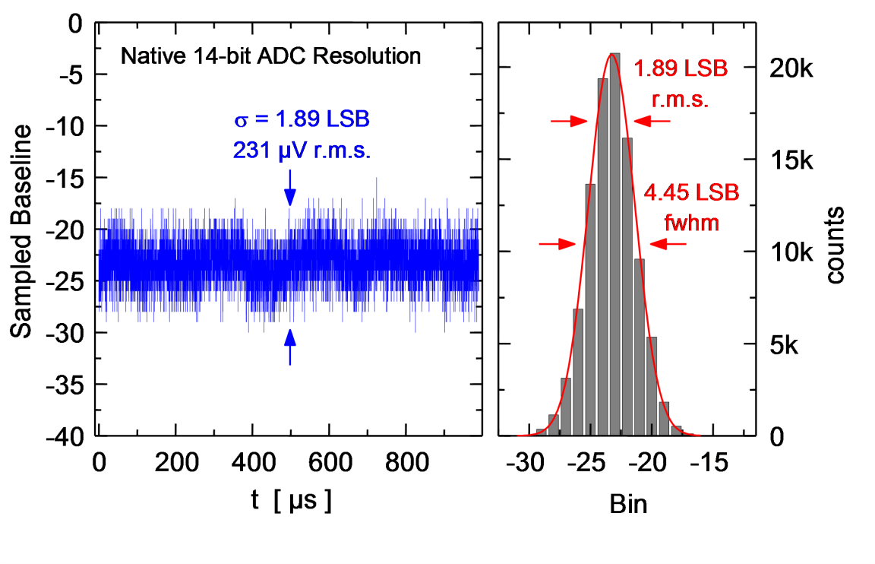
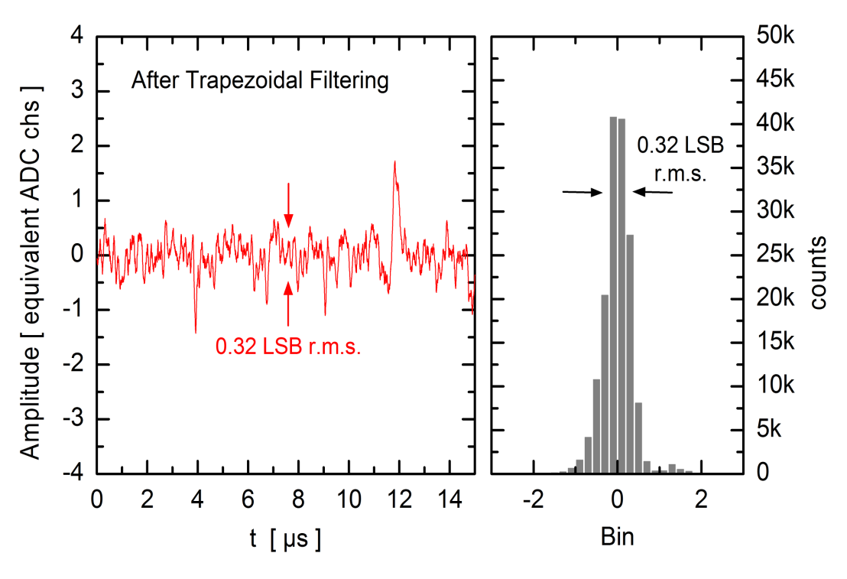
Effect of trapezoidal filter on noise
The noise seen on the preamplifier waveform is
1.89 LSB r.m.s.
with detector connected
The noise seen after the trapezoidal filter (height normalized) is
0.32 LSB r.m.s.
i.e. about six times less !
This yields a bit gain of ~2.6

Slide 14
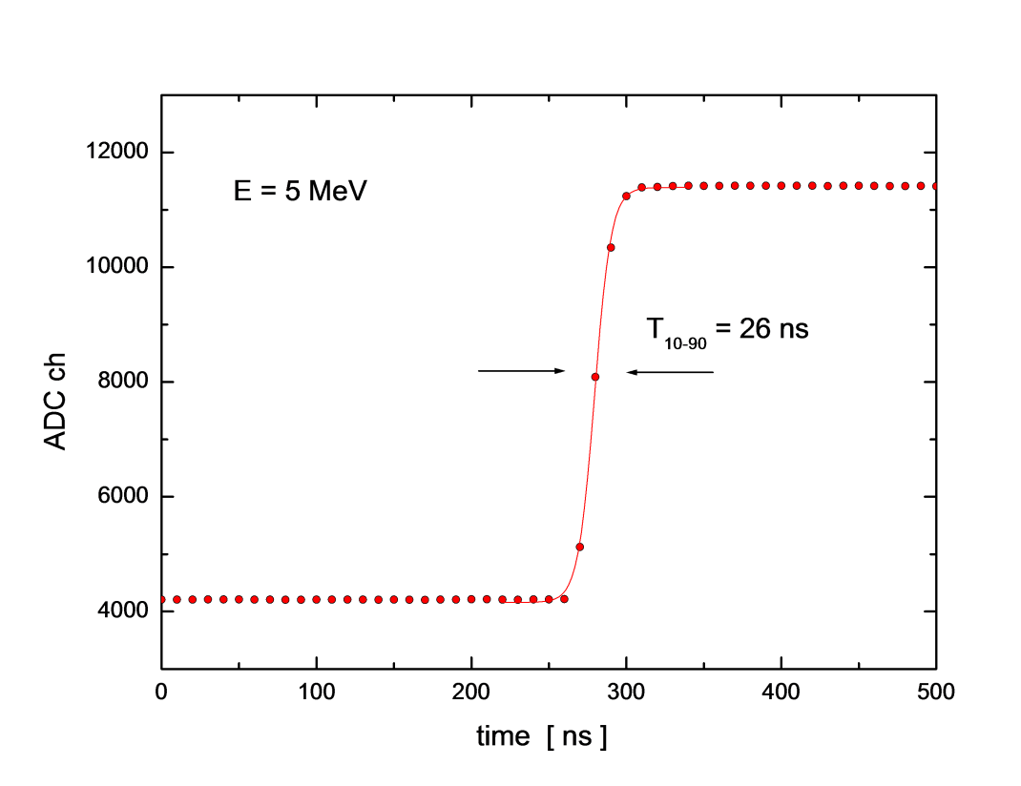
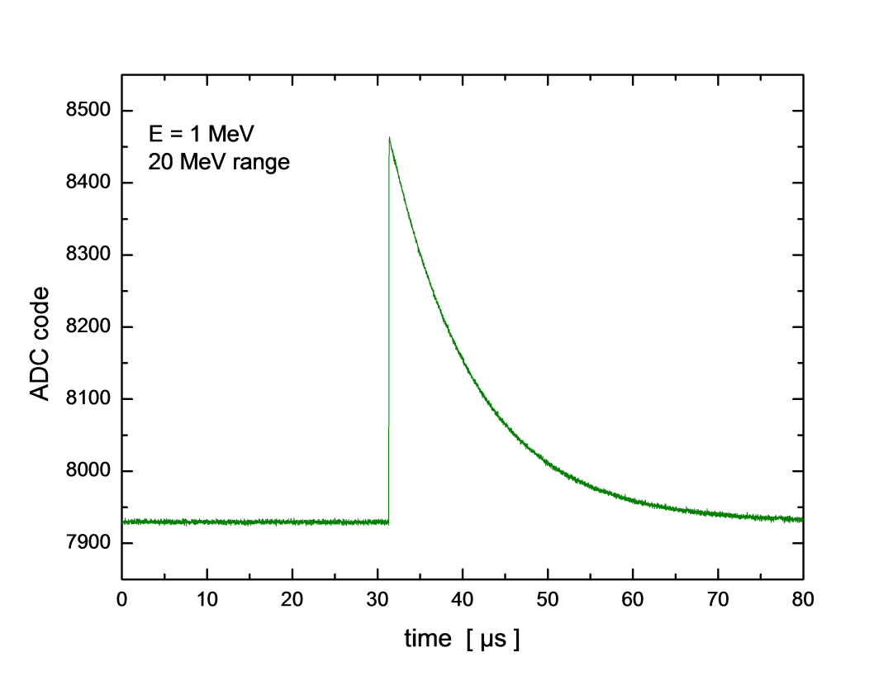
Measurements – bandwidth and pulse shape
Anti-aliasing filter is set for a 26ns risetime in step-response
Exponential decay signal (1 MeV equivalent)

Slide 15
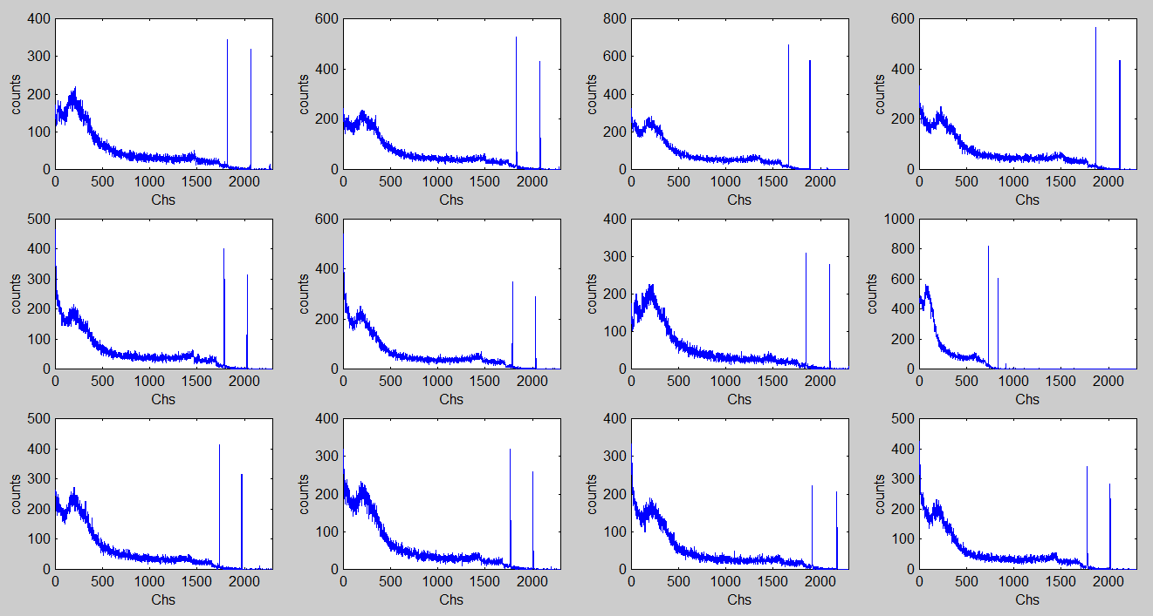
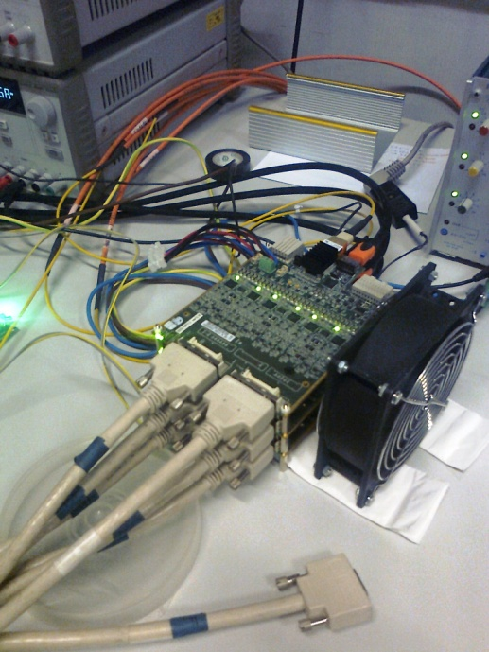
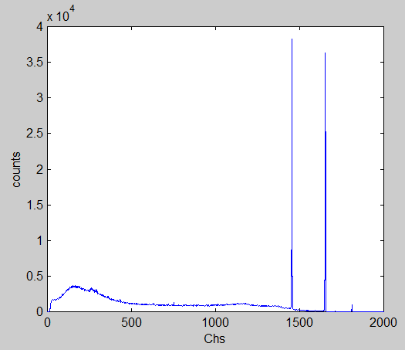
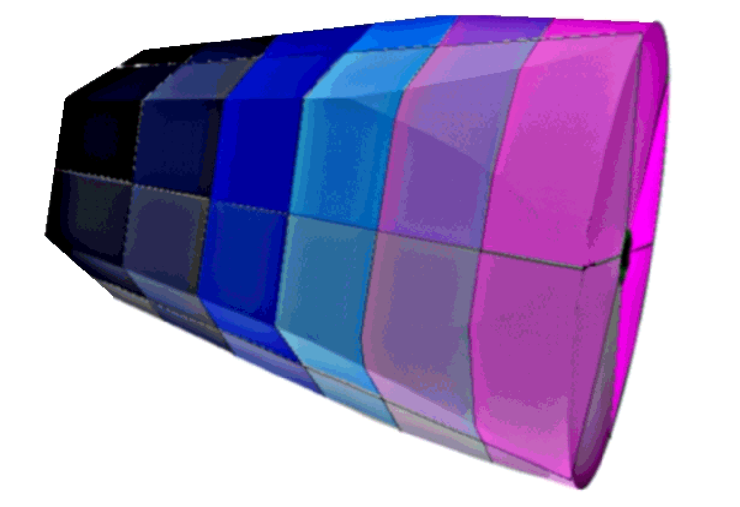
Spectra of ⁶⁰Co from AGATA crystal
Spectra collected at LNL in July 2013
20 MeV range
Segments
⁶⁰Co spectrum of core
7 MeV range selected for all shown segments but one in 20 MeV range
Core

Slide 16


Spectra of ⁶⁰Co from AGATA crystal
Energy resolution:
2.55 keV fwhm @ 1.33 MeV for core
2.06 keV fwhm @ 1.33 MeV for segment
Segment on ch “a”
Core

Slide 17


Spectrum from small front electrode of MARS detector
Detector “MARS” has 25 segments and one core

Slide 18
Specifications
Details in white paper: “DIGI-OPT12: 12-channel 14/16-bit 100/125-MS/s Digitizer with Optical Output for AGATA/GALILEO” version 1.8 (or later)
ADC | 14 or 16* bit, 100MS/s with JESD204A (8b/10b) and SER interface
Channels | 12 per card
Analog input | Differential, MDR connectors as specified in AGATA preamp white paper v. 3.2
Configurations | “Segment mode” (default, 12 chs) or “Core mode” by insertion of passive piggyback PCB (3 chs + spares)
Clock input | Differential LVPECL through mini-HDMI or backplane
Sync and test pattern input | Single-ended LVCMOS with static toggle through e-SATA connector
Control input | I2C and 3-wire SPI through mini-HDMI (HDMI type C) connector
Output | Optical, 1 fiber each digitized channel (see datasheet of ReflexPhotonics SN-T12-C00601 SNAP12)
Power Supply | 3.3V @ 2.5A and 2.0V @ 0.6A
Power cons | ~ 9.7W per card
Size of card | 120mm x 160mm
Range control | Remotely controlled range selection: (a) “20 MeV range” (with 25% offset displacement) and (b) “7 MeV range”
Offset control | Remotely controlled within +-30% of full swing
ADC param control | Remotely controlled full set of ADC and JESD204A parameters (see datasheet of NXP ADC1413D)
Clock param control | Remotely controlled full set of clock-distribution parameters, includind switching on the embedded PLL for zero-delay option (see datasheet of AD9522-3)
Pulser param control | Remotely controlled full set of pulser parameters in “Core mode” (see AGATA preamp white paper v. 3.2)
Options | Interleaved mode (e.g. 6 equivalent channels @ 200MS/s), single-ended analog inputs, built-in clock generation
*Pin-to-pin compatible ADC, mod. ADC1613D, is available with a maximum sampling frequency of 125 MHz

Slide 19






Time calibration by Damiano/Diego algorithm
Our approach to stochastic latency of the ADC’s brought about by JESD204A encoding
Divider
Detector signal
Fast
Amplifier
+
Antialias
ADC
Laser
Offset
Regulation
Ch by ch latency distribution due to JESD204A
Low
Low
SPI
Sync test signal
I2C
Damiano & Diego algorithm
I2C I/O
The time calibration feature has been optimized and fully qualified in 2012/13 @ LNL by Diego Barrientos

Slide 20



New pin-to-pin compatible ADC available
In 2012 IDT has commercialized a new ADC chip: ADC1443D
Original
*
New
*
*ADC chips designed and made in France for IDT (previously NXP)
(1.8V, 3.0V) PS → single 1.8V PS with 44% less power consumption (!)
Pin-to-pin compatible to ADC1413D
Integrated JESD204B → deterministic latency
Total power of DIGI-OPT12 card:
presently: 9.7 W
with new ADC: 6.8 W
Using the new ADC1443D the power would go down to 0.57W/ch including the laser !!!

Slide 21
Road map
✓ April - June 2011
ADC1413D semi-qualified @ Padova
Damiano algorithm for cancellation of random latencies of ADC/state machine
✓ June 2011
Schematic diagram completed (in Orcad Capture)
✓ July - September 2011
Translation of schematics in other CADs (Zuken Cadstar)
✓ September - December 2011
Layout synthesis
✓ Spring 2012
First prototypes ready for testing
✓ Spring-summer-autumn 2012
Tests, qualification, preproduction for GALILEO
✓ Spring-summer 2013
Development of firmware and open-source software for acceptance tests
Production and acceptance of 57 cards for 14 crystals of AGATA
✓ Autumn 2013
Design, production and test of routing cards for core version of DIGI-OPT12
✓ January 2014
Test of analog trigger circuitry for ancillaries (in core version only)

