Slide 1
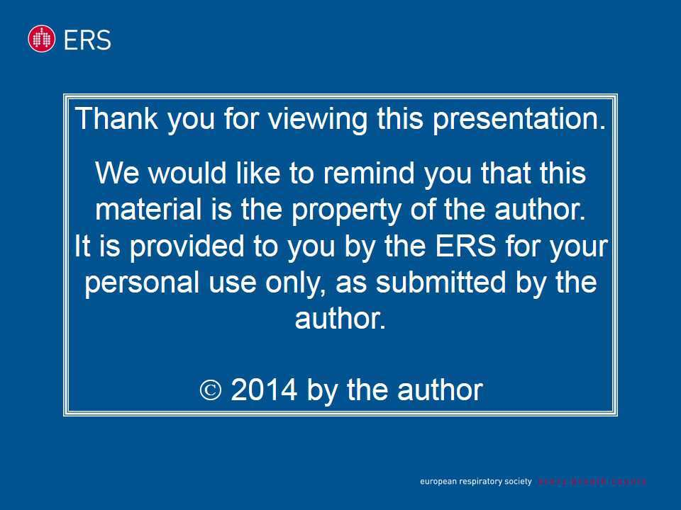
Thank you for viewing this presentation.
We would like to remind you that this material is the property of the author.
It is provided to you by the ERS for your personal use only, as submitted by the author.
2014 by the author

Slide 2

Stefano Aliberti*
Letizia Morlacchi
Fabio Giuliani
Paula Peyrani
Tim Wiemken,
Vincenzo Valenti
Lisa Pancini
Antonio Voza
Elena Parazzini
Paolo Rossi,
Daiana Stolz
Delfino Legnani
Elena Magni
Luca Richeldi
Riccardo Fantini
Valter Monzani
Roberto Cosentini
Giulia Bonaiti
Giulia Suigo,
Paola Faverio
Alberto Pesci
Julio Ramirez
Francesco Blasi
Plaque-related vs. plaque-unrelated cardio and cerebrovascular events in hospitalized patients with
CAP: preliminary results from the FAILCAP study
(ClinicalTrials: NCT01143155)
Health Science Department, Respiratory Unit, University of Milan Bicocca, AO San Gerardo, Milan, Italy; Department of Pathophysiology and Transplantation, University of Milan, IRCCS Fondazione Cà Granda Policlinico, Milan, Italy; Division of Infectious Diseases, University of Louisville, Louisville, KY, United States; Dipartimento di Scienze Biomediche per la Salute, University of Milan, IRCCS Policlinico di San Donato Milanese, Milan, Italy; Emergency medicine Department, Istituto Clinico Humanitas, Rozzano (MI), Italy; Internal medicine department, Santa Maria della Misericordia Hospital, Udine, Italy; Department of Biomedicine, University Hospital Basel, Basel, Switzerland; Respiratory Unit, University of Milan, Ospedale "Luigi Sacco", Milan, Italy; Pulmonary Department, University of Modena and Reggio Emilia, Policlinico di Modena, Modena, Italy and Emergency medicine department, IRCCS Fondazione Cà Granda Policlinico, Milan, Italy.

Slide 3
No Disclosures

Slide 4
INTRODUCTION
METHODS
RESULTS
CONCLUSIONS
Pneumonia and cardiac events
Patient with Pneumonia
Notes:
While mortality for community-acquired pneumonia (CAP) decreased sharply after the introduction of antibiotics in the 1940s, the overall mortality has either remained stable or increased since 1950. Thus, there is a clear need to explore new approaches and test strategies to reduce mortality by reducing complications related to pneumonia.

Slide 5
INTRODUCTION
METHODS
RESULTS
CONCLUSIONS
Pneumonia and cardiac events
Patient with Pneumonia
Cardiac Events
Prevalence
10-30%
Short-term Mortality
15-36%
Corrales-Medina VF. Circulation. 2012; 125: 773
Aliberti S. Curr Opin Infect Dis. 2014; 27:295
Notes:
Current literature indicates that cardiovascular events (CVE) may happen in patients with pneumonia both during hospitalization and after discharge, with an absolute rate of events varying broadly from 10% to 30% across different cohorts. CVE have a strong impact on patients’ outcomes with an increase of both short-term, with percentage ranging from 15% to 36%, and long-term mortality

Slide 6
INTRODUCTION
METHODS
RESULTS
CONCLUSIONS
Pneumonia and cardiac events
Patient with Pneumonia
Potential Pneumonia Triggers for Cardiac Events
Hypoxemia
Thrombocytosis
Increased Pro-Inflammatory Cytokines
Activation of
Pro-Coagulant Factors

Slide 7
INTRODUCTION
METHODS
RESULTS
CONCLUSIONS
Pneumonia and cardiac events
Patient with Pneumonia
Potential Pneumonia Triggers for Cardiac Events
Hypoxemia
Thrombocytosis
Increased Pro-Inflammatory Cytokines
Activation of
Pro-Coagulant Factors
Cardiac Events: Pathophysiology

Slide 8
INTRODUCTION
METHODS
RESULTS
CONCLUSIONS
Pneumonia and cardiac events
Patient with Pneumonia
Potential Pneumonia Triggers for Cardiac Events
Hypoxemia
Thrombocytosis
Increased Pro-Inflammatory Cytokines
Activation of
Pro-Coagulant Factors
Cardiac Events: Pathophysiology
Coronary Artery Atheroma
No Coronary Artery Atheroma

Slide 9
INTRODUCTION
METHODS
RESULTS
CONCLUSIONS
Pneumonia and cardiac events
Patient with Pneumonia
Potential Pneumonia Triggers for Cardiac Events
Hypoxemia
Thrombocytosis
Increased Pro-Inflammatory Cytokines
Activation of
Pro-Coagulant Factors
Cardiac Events: Pathophysiology
Coronary Artery Atheroma
No Coronary Artery Atheroma
Myocardial Cell Ischemia
Myocardial Infarction

Slide 10
INTRODUCTION
METHODS
RESULTS
CONCLUSIONS
Pneumonia and cardiac events
Patient with Pneumonia
Potential Pneumonia Triggers for Cardiac Events
Hypoxemia
Thrombocytosis
Increased Pro-Inflammatory Cytokines
Activation of
Pro-Coagulant Factors
Cardiac Events: Pathophysiology
Coronary Artery Atheroma
No Coronary Artery Atheroma
Myocardial Cell Ischemia
Myocardial Cell Dysfunction
Myocardial Infarction
Cardiac Arrhythmia
Heart Failure

Slide 11
INTRODUCTION
METHODS
RESULTS
CONCLUSIONS
Pneumonia and cardiac events
Patient with Pneumonia
Potential Pneumonia Triggers for Cardiac Events
Hypoxemia
Thrombocytosis
Increased Pro-Inflammatory Cytokines
Activation of
Pro-Coagulant Factors
Cardiac Events: Pathophysiology
Coronary Artery Atheroma
No Coronary Artery Atheroma
Myocardial Cell Ischemia
Myocardial Cell Dysfunction
Myocardial Infarction
Cardiac Arrhythmia
PLAQUE-RELATED EVENTS
Heart Failure

Slide 12
INTRODUCTION
METHODS
RESULTS
CONCLUSIONS
Pneumonia and cardiac events
Patient with Pneumonia
Potential Pneumonia Triggers for Cardiac Events
Hypoxemia
Thrombocytosis
Increased Pro-Inflammatory Cytokines
Activation of
Pro-Coagulant Factors
Cardiac Events: Pathophysiology
Coronary Artery Atheroma
No Coronary Artery Atheroma
Myocardial Cell Ischemia
Myocardial Cell Dysfunction
Myocardial Infarction
Cardiac Arrhythmia
PLAQUE-RELATED EVENTS
Heart Failure
PLAQUE-UNRELATED EVENTS

Slide 13
INTRODUCTION
METHODS
RESULTS
CONCLUSIONS
Pneumonia and neurological events
Patient with Pneumonia
Potential Pneumonia Triggers for Neurological Events
Hypoxemia
Thrombocytosis
Increased Pro-Inflammatory Cytokines
Activation of
Pro-Coagulant Factors
Neurological Events: Pathophysiology
Carotid Artery Atheroma
No Carotid Artery Atheroma

Slide 14
INTRODUCTION
METHODS
RESULTS
CONCLUSIONS
Pneumonia and neurological events
Patient with Pneumonia
Potential Pneumonia Triggers for Neurological Events
Hypoxemia
Thrombocytosis
Increased Pro-Inflammatory Cytokines
Activation of
Pro-Coagulant Factors
Neurological Events: Pathophysiology
Carotid Artery Atheroma
No Carotid Artery Atheroma
Neuronal Cell Ischemia
Stroke

Slide 15
INTRODUCTION
METHODS
RESULTS
CONCLUSIONS
Pneumonia and neurological events
Patient with Pneumonia
Potential Pneumonia Triggers for Neurological Events
Hypoxemia
Thrombocytosis
Increased Pro-Inflammatory Cytokines
Activation of
Pro-Coagulant Factors
Neurological Events: Pathophysiology
Carotid Artery Atheroma
No Carotid Artery Atheroma
Neuronal Cell Ischemia
Neuronal Cell Dysfunction
Stroke
Epilepsy
Delirium

Slide 16
INTRODUCTION
METHODS
RESULTS
CONCLUSIONS
Pneumonia and neurological events
Patient with Pneumonia
Potential Pneumonia Triggers for Neurological Events
Hypoxemia
Thrombocytosis
Increased Pro-Inflammatory Cytokines
Activation of
Pro-Coagulant Factors
Neurological Events: Pathophysiology
Carotid Artery Atheroma
No Carotid Artery Atheroma
Neuronal Cell Ischemia
Neuronal Cell Dysfunction
Stroke
Epilepsy
PLAQUE-RELATED EVENTS
Delirium
PLAQUE-UNRELATED EVENTS

Slide 17
INTRODUCTION
METHODS
RESULTS
CONCLUSIONS
Objective
To define the prevalence, characteristics, risk factors and impact on clinical outcomes of plaque-related vs. plaque-unrelated cardiovascular events (CVE) in hospitalized patients with community-acquired pneumonia

Slide 18
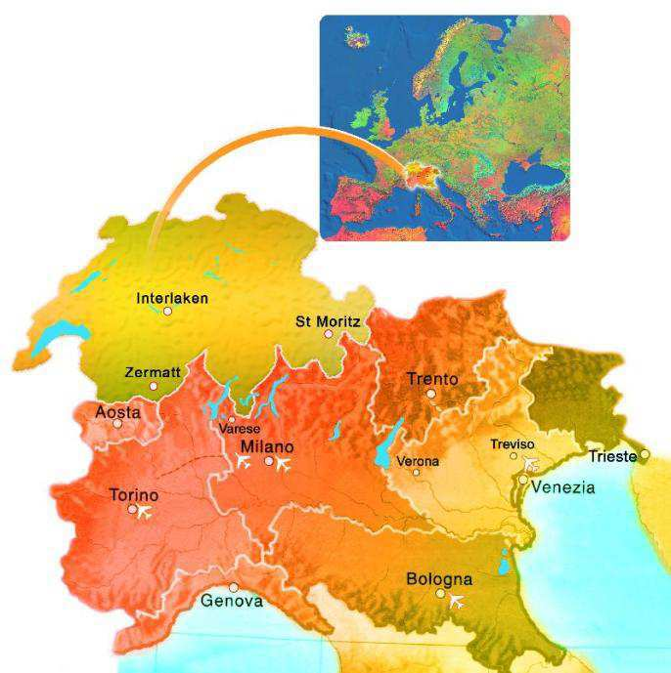
INTRODUCTION
METHODS
RESULTS
CONCLUSIONS
Study population
International, multicenter, observational, prospective, cohort study
Consecutive patients hospitalized with a diagnosis of CAP
Eight acute care hospitals in Italy and Switzerland
From October 2009 to October 2012

Slide 19
INTRODUCTION
METHODS
RESULTS
CONCLUSIONS
Cardiovascular events
Notes:
All of the enrolled patients were evaluated on admission and every day during hospitalization to identify those undergoing CVE.
All of the enrolled patients were evaluated on admission and every day during hospitalization to identify those undergoing CVE. If a patient was diagnosed on admission to the hospital as having both CAP and a CVE, the latter was defined to be on hospital admission. Each case of cardiovascular event was presented and discussed to a clinical review committee in each center, composed of at least three physicians, one of whom was a cardiologist. Electrocardiogram and Troponin T or I were performed for the enrolled patients on hospital admission, and at every moment when clinicians had a clinical suspicion of the presence of a cardiovascular event. Troponin T or I determinations were performed with 3 set (every 6 hours) during the first 24 hours after hospital admission and if a suspicion of AMI was present during the hospital course. Chest radiograph was performed during hospital course if a suspicion of ACPE was present. Computed tomography (CT) of the chest was performed on admission and every time during the hospital course if a suspicion of pulmonary embolism was present. Head CT was performed on admission and every time during the hospital course if a suspicion of CVA was present.

Slide 20
INTRODUCTION
METHODS
RESULTS
CONCLUSIONS
Cardiovascular events
PLAQUE-RELATED EVENTS
Acute myocardial infarction
Thrombotic cerebrovascular accident (CVA)
PLAQUE-UNRELATED EVENTS
Acute cardiogenic pulmonary edema
New arrhythmia
Acute worsening of a long-term arrhythmia
Embolic or hemorrhagic CVA
Pulmonary embolism
Notes:
All of the enrolled patients were evaluated on admission and every day during hospitalization to identify those undergoing CVE.
All of the enrolled patients were evaluated on admission and every day during hospitalization to identify those undergoing CVE. If a patient was diagnosed on admission to the hospital as having both CAP and a CVE, the latter was defined to be on hospital admission. Each case of cardiovascular event was presented and discussed to a clinical review committee in each center, composed of at least three physicians, one of whom was a cardiologist. Electrocardiogram and Troponin T or I were performed for the enrolled patients on hospital admission, and at every moment when clinicians had a clinical suspicion of the presence of a cardiovascular event. Troponin T or I determinations were performed with 3 set (every 6 hours) during the first 24 hours after hospital admission and if a suspicion of AMI was present during the hospital course. Chest radiograph was performed during hospital course if a suspicion of ACPE was present. Computed tomography (CT) of the chest was performed on admission and every time during the hospital course if a suspicion of pulmonary embolism was present. Head CT was performed on admission and every time during the hospital course if a suspicion of CVA was present.

Slide 21
INTRODUCTION
METHODS
RESULTS
CONCLUSIONS
Cardiovascular events
PLAQUE-RELATED EVENTS
Acute myocardial infarction
Thrombotic cerebrovascular accident (CVA)
PLAQUE-UNRELATED EVENTS
Acute cardiogenic pulmonary edema
New arrhythmia
Acute worsening of a long-term arrhythmia
Embolic or hemorrhagic CVA
Pulmonary embolism
Either on hospital admission or during hospitalization
Each case of cardiovascular event was presented and discussed to a clinical review committee in each center, composed of at least three physicians, one of whom was a cardiologist.
Notes:
All of the enrolled patients were evaluated on admission and every day during hospitalization to identify those undergoing CVE.
All of the enrolled patients were evaluated on admission and every day during hospitalization to identify those undergoing CVE. If a patient was diagnosed on admission to the hospital as having both CAP and a CVE, the latter was defined to be on hospital admission. Each case of cardiovascular event was presented and discussed to a clinical review committee in each center, composed of at least three physicians, one of whom was a cardiologist. Electrocardiogram and Troponin T or I were performed for the enrolled patients on hospital admission, and at every moment when clinicians had a clinical suspicion of the presence of a cardiovascular event. Troponin T or I determinations were performed with 3 set (every 6 hours) during the first 24 hours after hospital admission and if a suspicion of AMI was present during the hospital course. Chest radiograph was performed during hospital course if a suspicion of ACPE was present. Computed tomography (CT) of the chest was performed on admission and every time during the hospital course if a suspicion of pulmonary embolism was present. Head CT was performed on admission and every time during the hospital course if a suspicion of CVA was present.

Slide 22
INTRODUCTION
METHODS
RESULTS
CONCLUSIONS
Study groups and outcomes
Three study groups
1. Patients without CVE (Group A)
2. Patients with at least one plaque-unrelated CVE (Group B)
3. Patients with at least one plaque-related CVE ( (Group C)
Patients experiencing both a plaque-related and -unrelated CVE were included in Group C
Notes:
All of the enrolled patients were evaluated on admission and every day during hospitalization to identify those undergoing CVE.
All of the enrolled patients were evaluated on admission and every day during hospitalization to identify those undergoing CVE. If a patient was diagnosed on admission to the hospital as having both CAP and a CVE, the latter was defined to be on hospital admission. Each case of cardiovascular event was presented and discussed to a clinical review committee in each center, composed of at least three physicians, one of whom was a cardiologist. Electrocardiogram and Troponin T or I were performed for the enrolled patients on hospital admission, and at every moment when clinicians had a clinical suspicion of the presence of a cardiovascular event. Troponin T or I determinations were performed with 3 set (every 6 hours) during the first 24 hours after hospital admission and if a suspicion of AMI was present during the hospital course. Chest radiograph was performed during hospital course if a suspicion of ACPE was present. Computed tomography (CT) of the chest was performed on admission and every time during the hospital course if a suspicion of pulmonary embolism was present. Head CT was performed on admission and every time during the hospital course if a suspicion of CVA was present.

Slide 23
INTRODUCTION
METHODS
RESULTS
CONCLUSIONS
Study groups and outcomes
Three study groups
1. Patients without CVE (Group A)
2. Patients with at least one plaque-unrelated CVE (Group B)
3. Patients with at least one plaque-related CVE ( (Group C)
Patients experiencing both a plaque-related and -unrelated CVE were included in Group C
Study outcomes
Clinical failure
In-hospital mortality
30-day mortality
30-day combined outcome
Notes:
All of the enrolled patients were evaluated on admission and every day during hospitalization to identify those undergoing CVE.
All of the enrolled patients were evaluated on admission and every day during hospitalization to identify those undergoing CVE. If a patient was diagnosed on admission to the hospital as having both CAP and a CVE, the latter was defined to be on hospital admission. Each case of cardiovascular event was presented and discussed to a clinical review committee in each center, composed of at least three physicians, one of whom was a cardiologist. Electrocardiogram and Troponin T or I were performed for the enrolled patients on hospital admission, and at every moment when clinicians had a clinical suspicion of the presence of a cardiovascular event. Troponin T or I determinations were performed with 3 set (every 6 hours) during the first 24 hours after hospital admission and if a suspicion of AMI was present during the hospital course. Chest radiograph was performed during hospital course if a suspicion of ACPE was present. Computed tomography (CT) of the chest was performed on admission and every time during the hospital course if a suspicion of pulmonary embolism was present. Head CT was performed on admission and every time during the hospital course if a suspicion of CVA was present.

Slide 24
INTRODUCTION
METHODS
RESULTS
CONCLUSIONS
Cardiovascular events
905 patients
Median age: 76 yrs
59% males

Slide 25
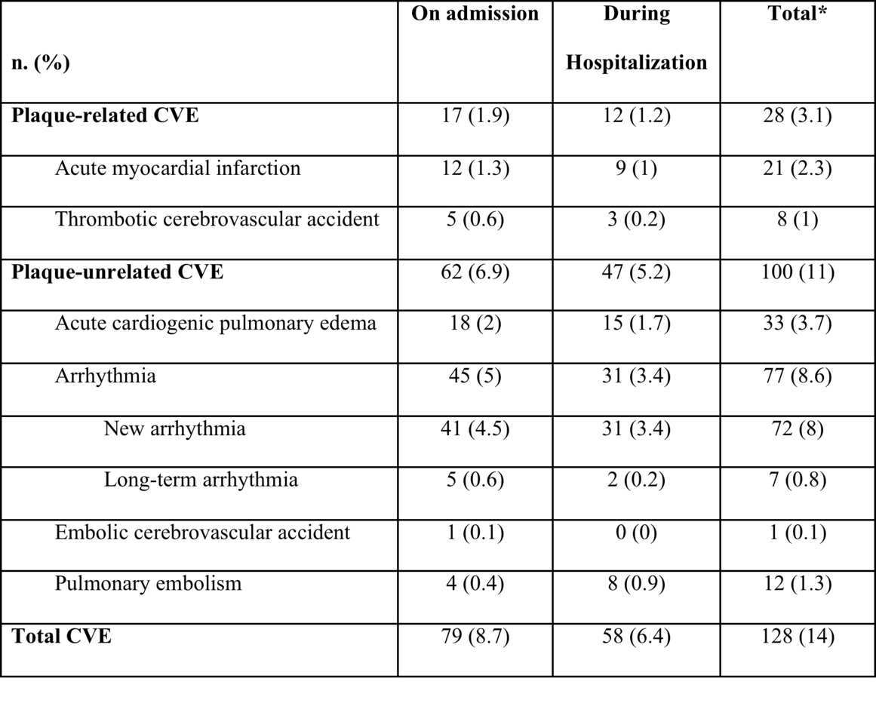
INTRODUCTION
METHODS
RESULTS
CONCLUSIONS
Cardiovascular events
905 patients
Median age: 76 yrs
59% males
Nine patients (1%) experienced a CVE both on admission and during hospitalization

Slide 26
INTRODUCTION
METHODS
RESULTS
CONCLUSIONS
Cardiovascular events
905 patients
Median age: 76 yrs
59% males
Nine patients (1%) experienced a CVE both on admission and during hospitalization

Slide 27
INTRODUCTION
METHODS
RESULTS
CONCLUSIONS
Cardiovascular events
905 patients
Median age: 76 yrs
59% males
Nine patients (1%) experienced a CVE both on admission and during hospitalization

Slide 28
INTRODUCTION
METHODS
RESULTS
CONCLUSIONS
Study groups
11%
3%

Slide 29
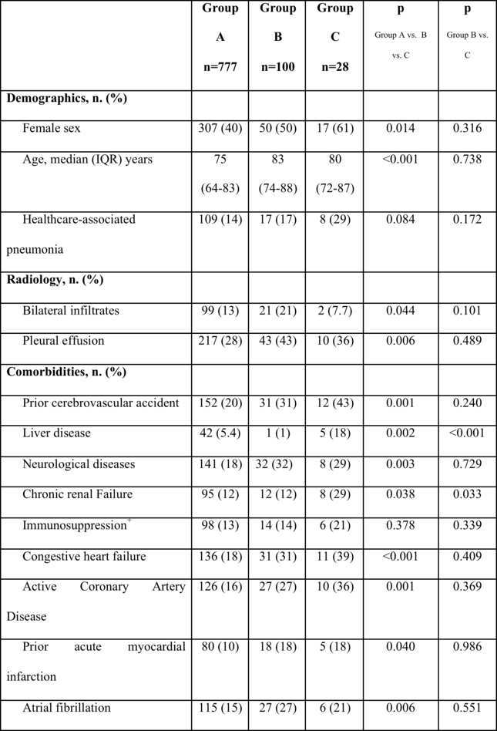
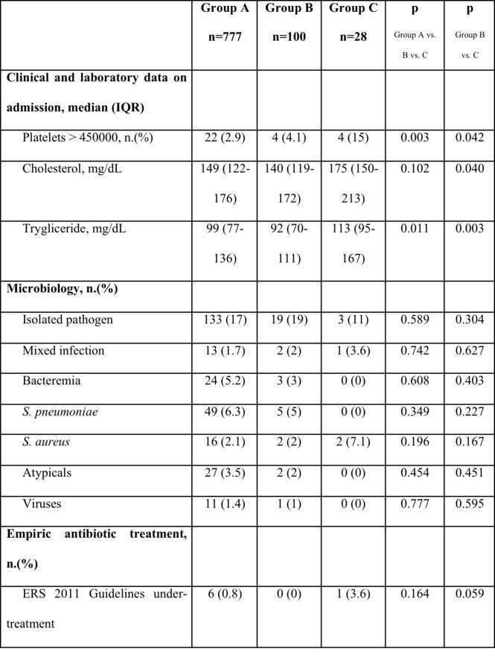
INTRODUCTION
METHODS
RESULTS
CONCLUSIONS
Characteristics of the study groups

Slide 30
INTRODUCTION
METHODS
RESULTS
CONCLUSIONS
Plaque related vs. unrelated CVE and severity of the disease

Slide 31
INTRODUCTION
METHODS
RESULTS
CONCLUSIONS
Plaque related vs. unrelated CVE and severity of the disease

Slide 32
INTRODUCTION
METHODS
RESULTS
CONCLUSIONS
Plaque related vs. unrelated CVE and severity of the disease

Slide 33
INTRODUCTION
METHODS
RESULTS
CONCLUSIONS
Plaque related vs. unrelated CVE and severity of the disease
ARF and SS

Slide 34
INTRODUCTION
METHODS
RESULTS
CONCLUSIONS
Independent predictors for plaque-related vs. unrelated CVE

Slide 35
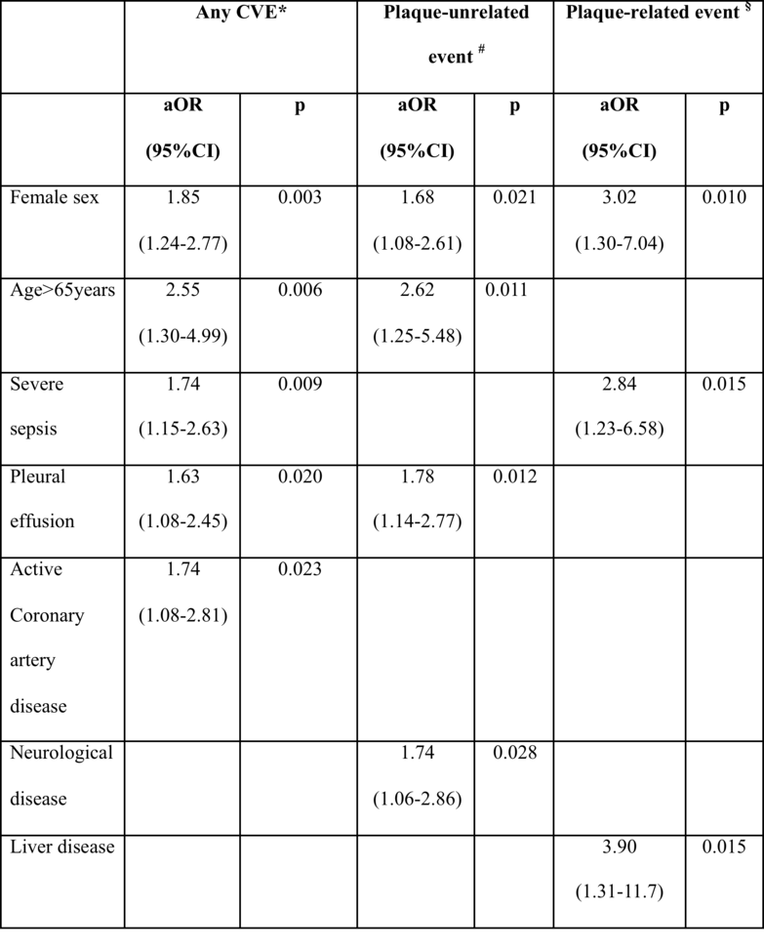
INTRODUCTION
METHODS
RESULTS
CONCLUSIONS
Independent predictors for plaque-related vs. unrelated CVE

Slide 36
INTRODUCTION
METHODS
RESULTS
CONCLUSIONS
Independent predictors for plaque-related vs. unrelated CVE

Slide 37
INTRODUCTION
METHODS
RESULTS
CONCLUSIONS
Independent predictors for plaque-related vs. unrelated CVE

Slide 38
INTRODUCTION
METHODS
RESULTS
CONCLUSIONS
Plaque-related vs. unrelated CVE and outcomes

Slide 39
INTRODUCTION
METHODS
RESULTS
CONCLUSIONS
Plaque-related vs. unrelated CVE and outcomes
No CVE
Plaque-Unrelated CVE
Plaque-related CVE
No CVE, n. (%)
Plaque-Unrelated CVE, n. (%)
Plaque-related CVE, n. (%)

Slide 40
INTRODUCTION
METHODS
RESULTS
CONCLUSIONS
Independent predictors 30-day mortality

Slide 41
INTRODUCTION
METHODS
RESULTS
CONCLUSIONS
Independent predictors 30-day mortality

Slide 42
INTRODUCTION
METHODS
RESULTS
CONCLUSIONS
Independent predictors 30-day mortality

Slide 43
INTRODUCTION
METHODS
RESULTS
CONCLUSIONS

Slide 44
INTRODUCTION
METHODS
RESULTS
CONCLUSIONS
Plaque-related CVE are less prevalent (3%) in CAP patients in comparison to plaque-unrelated events (11%) but account for a significantly higher in-hospital (39%) and 30-day mortality (48%).

Slide 45
INTRODUCTION
METHODS
RESULTS
CONCLUSIONS
Plaque-related CVE are less prevalent (3%) in CAP patients in comparison to plaque-unrelated events (11%) but account for a significantly higher in-hospital (39%) and 30-day mortality (48%).
Among patients with plaque-unrelated events, in-hospital mortality still rises up to 21% and 30-day mortality up to 28%.

Slide 46
INTRODUCTION
METHODS
RESULTS
CONCLUSIONS
Plaque-related CVE are less prevalent (3%) in CAP patients in comparison to plaque-unrelated events (11%) but account for a significantly higher in-hospital (39%) and 30-day mortality (48%).
Among patients with plaque-unrelated events, in-hospital mortality still rises up to 21% and 30-day mortality up to 28%.
The occurrence of a plaque-related CVE in CAP patients increases 5 times the risk of death within 30-days, while plaque-unrelated events almost 3 times.

Slide 47
INTRODUCTION
METHODS
RESULTS
CONCLUSIONS
Plaque-related CVE are less prevalent (3%) in CAP patients in comparison to plaque-unrelated events (11%) but account for a significantly higher in-hospital (39%) and 30-day mortality (48%).
Among patients with plaque-unrelated events, in-hospital mortality still rises up to 21% and 30-day mortality up to 28%.
The occurrence of a plaque-related CVE in CAP patients increases 5 times the risk of death within 30-days, while plaque-unrelated events almost 3 times.
A different approach for plaque-related vs. unrelated CVE could be suggested especially from a research point of view to plan interventional studies on cardioprotective medications.

Slide 48
Thank you
stefano.aliberti@unimib.it

Slide 49
INTRODUCTION
METHODS
RESULTS
CONCLUSIONS
Plaque related vs. unrelated CVE and severity of the disease

