Slide 1

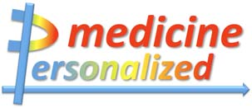
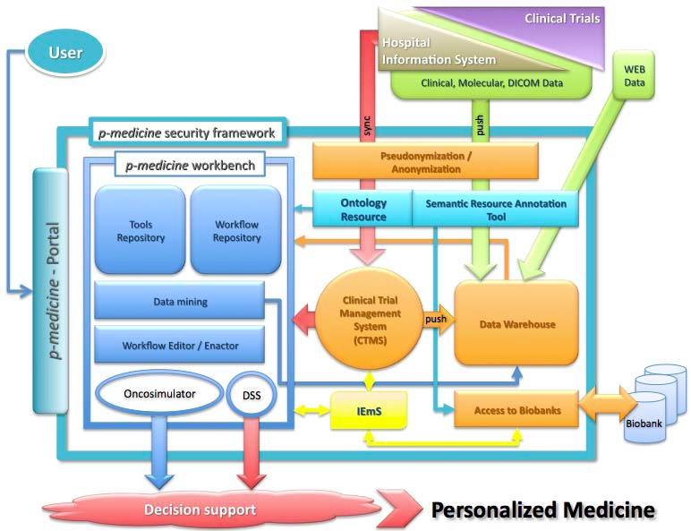
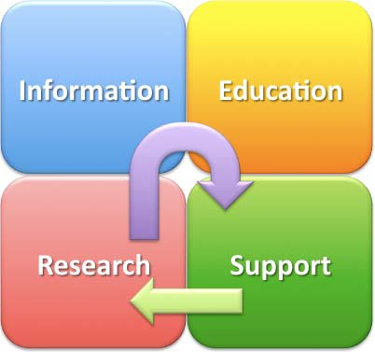
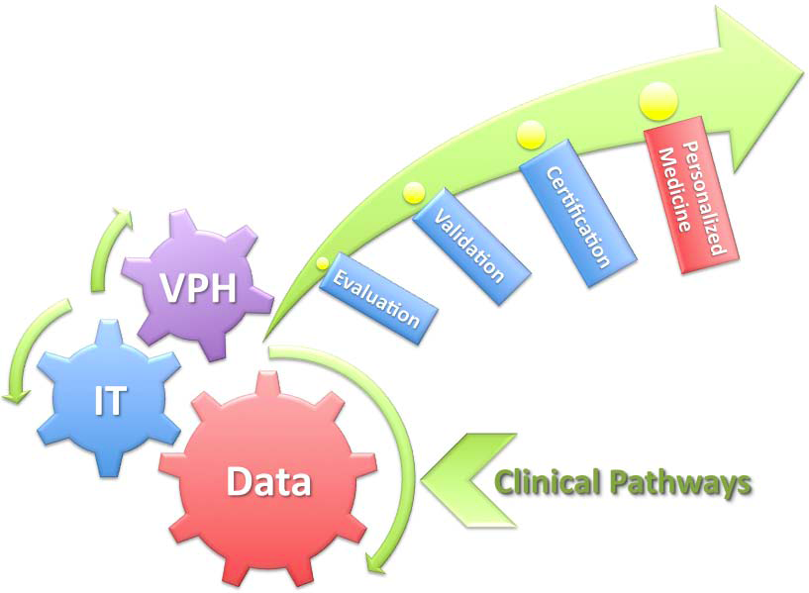
The P-medicine project:
A new personalized approach to the medical decision process
Alessandra Gorini^{1*}, Gordon McVie², Gabriella Pravettoni¹
¹ Interdisciplinary Research Center on Decision Processes (IRIDe), Università degli Studi di Milano, Milan, Italy
² Ecancermedicalscience & European Institute of Oncology (IEO) Milan, Italy
Therapeutic processes are characterized by the continuous necessity to take decisions. Due to the complexity of the medical discipline, decisions are often subject to biases and errors that can endanger the patient’s life.
Aim of the project
The p-medicine project proposes a personalized approach for the treatment of cancer diseases that includes the development of automated decision-making tools for clinical routine that, starting from data obtained from single patients, run simulation workflows in support of efficient and unbiased clinical decision making processes.
Methods
Three multiscale simulation models of clinical tumor response to treatment will be developed: one for nephroblastoma, one for breast cancer and one for acute lymphoblastic leukaemia, based on the principles that have been shown to be most appropriate for the clinical trial context.
These three models will constitute the simulation core of the p-medicine oncosimulator which will provide an integrated platform for simulating, investigating and exploring the natural phenomenon of cancer and ‐ after successful validation ‐ an integrated decision support tool for treatment.
Regarding patients, they are typically seen just as the recipients of care. Another important ideal of p-medicine is to better enable them to be participants and guides in their own health care.
Patients will be educated and informed about the therapeutic processes in which they are involved. Only by using this information, shared decision support is possible. Transparency in data handling, augmentation of the patient’s knowledge and participation as an active partner in a shared decision process increases trust in the Health Care System including data handling and demands for more research by patients allowing the use of his/her individual data to solve his/her personal medical problems.
Conclusions
We argue that sophisticated tools such as the oncosimulator and the automated decision support tools can efficiently assist and improve the medical decision processes both from the side of therapists and patients.
Decision Tools
A decision tool is an active knowledge resource that uses patient clinical and psychological data to generate case-specific advice which supports decision making about individual patients by health professionals, the patients themselves and others concerned about them.
Aim is to develop tools that are able to support the clinicians to effectively access all relevant data and infer knowledge necessary to reach the most accurate diagnosis and prescribe the most suitable personalized treatment.
Proper implementation and use of clinical decision support systems is regarded as an important recommendation for reducing the frequency and consequences of errors in medical care.
Cognitive psychology can contribute to give rise to more practical and effective decision tools, while cognitive theories on decision making make it possible to accomplish a schematic architecture of an ideal decision support tool.
Interactive Empowerment Service
IEmS
Empowerment + Decision Making = IEmS
IEmS will be developed with the aim to give patients the right to decide about the usage of their own data and biomaterial by explaining the medical data and statements, technical concepts and legal and ethical considerations in a language they understand.
IEmS offers the following benefits:
  Patient can understand his medical documentation
  Empower patients to make informed choices
  Patients needs are different so empowerment efforts must be customized to different patient groups.
This process implies that patients are able to understand medical statements, as well as legal and ethical considerations. Thus, the empowerment tool has to both represent data in a convenient format, and data must also be translated into language that is understandable to the patient. This does not only entail the wording of the information, but the data needs to be organized in a manner that makes it easier for the patient to decide what is of interest to him/her at the moment. This provides a patient with the chance to make an informed choice which satisfies the second goal of an empowerment tool.
Providing patients with „consent management“ offers a dual benefit:
Direct empowerment aspect of controlling ones own data
Facilitation of interaction with patients to ask for new consent (for new trials, secondary use of data). This both increases efficiency and involves the patient actively. All these features need a scientific evaluation and validation before an effective use. To reach this goal, a series of experimental tests will be performed on individuals classified by age, computer skills and specific expertise through empirical user‐based tests.
Patient Empowerment
An important aspect of personalized medicine is to empower patients by including them more actively in the health care decision process and in clinical research, and to better enable them to be participants and guides in their own health care.
By letting the patient decide what kind of research is allowed to be done with their data and biomaterial, transparency in healthcare system can be enhanced and patients can be convince to let their data be utilized for research purposes.
Patient empowerment leads to trust in health care system (data handling, demands for more research by patients allowing the use of his individual data to solve his personal medical problem).
For patients, giving them access to better communication tools and allowing them to query electronically about health choices will result in a new doctor-patient relationship which strengthens patient empowerment.
Overall this will lead to:
  fewer side effects and better efficacy of treatment
  engage patients in personalized treatment as well as management plans
  increase patient’s responsibility in control of their own health care
  assemble health care information also by patients
  support physicians by tools to better guide patients in choices
Development of IEmS
One of the key features of IEmS is interactivity - the possibility for a patient to view data organized according to her/his perception of the domain, to retrieve patient‐understandable information and, to state decisions. IEmS will put people in control over the use of their data. Control in this case means the possibility given to a patient to type texts, state decisions, upload and consult video
materials.
Alessandra Gorini (Presenter)
Via Conservatorio, 7. 20122 Milano, Italy
Email: alessandra.gorini@unimi.it
Contact Information

