Slide 1



Symmetry-constrained Monte Carlo
to predict the experimental crystal structures
of small organic molecules
Giovanni Macetti, Luca Sironi, Leonardo Lo Presti
giovanni.macetti@unimi.it
Dipartimento di Chimica, Università degli Studi di Milano
50th AIC congress, Bologna (Italy) - 6th September 2023
Notes:
Good morning everyone.
First of all, I would like to thanks Prof. X for the nice introduction and of course all the organizers of the congress for giving me the opportunity to give a talk today.
Today I will talk you about our latest advancements on a project I am working on the last few months in the field of the crystal structure prediction of small organic molecules, where we are developping a symmetry-constrained montecarlo method.

Slide 2

Table of Contents
Introduction – the prediction of the crystalline phase
Methods
  The symmetry-constrained Monte Carlo method
Results
  Acrolein
  Benzoic Acid
Conclusions and Outlooks
1

Slide 3
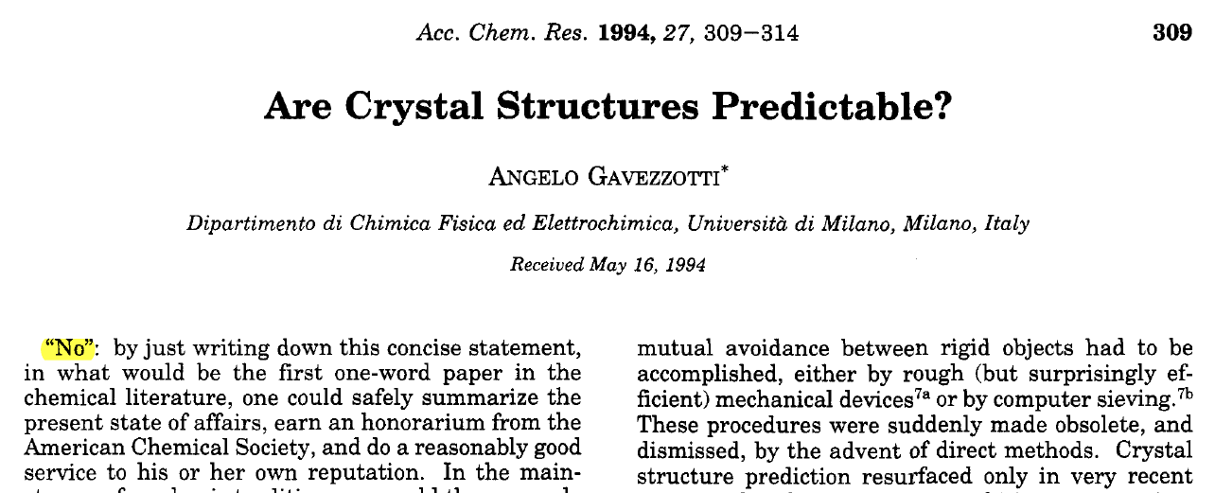
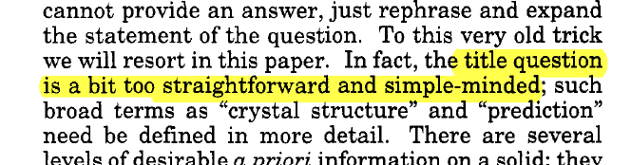
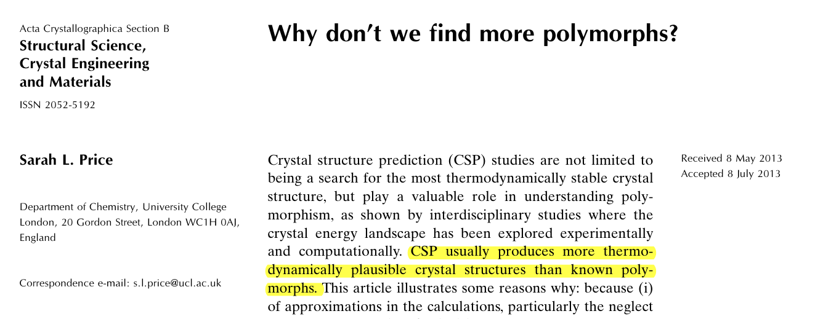
Introduction – The Three Q
1. Why the prediction of the crystalline phase is important?
Bottom-up design of materials featuring the desired properties
2. Are crystal structures predictable?
3. Why don't we find more polymorphs?
2
Notes:
So I would like to start with three big questions concerning the prediction of the crystalline structures.
The first question is of course why we want to predict these structures. Well, there are several possible answers and reasons, but in our case we are trying to do this because we aim to design advanced materials with specific properties and functions. And we all know that the crystal phase is very important in this.
2. The second question is quite a famous one since 1994, and it is "are crystal structures predictable"? Prof. Gavezzotti gave a solid answer to this question NO: fortunally for us this answer was not … and Gavezzotti also precised that "the question and therefore the answer is more complex than this".
3. And the last big question of the crystal prediction is from Prof. Price who ask to the community "why don't we find more polymorphs". Also in this case the answer is not easy and there are a lot of discussion about this, but this is not the place to discuss this.
The summary of these question is the following: predicting the experimental polymorph given the pure chemical formula is, as I bet you already know, quite an effort.

Slide 4
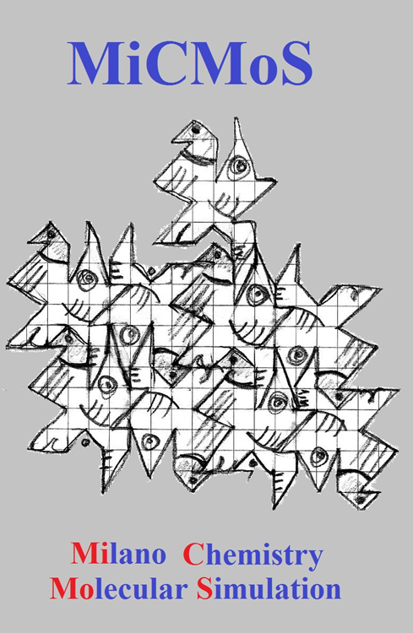

Methods – The MiCMoS
4. What is our goal?
Exploit the potentiality of the MiCMoS software to predict the crystalline phase of (small) organic molecules
Main feature of MiCMoS:
Monte Carlo and Molecular Dynamics simulations
Ideal for small organic molecules in condensed phase from a crystallographic point of view
Focuses on intermolecular interactions, solvation and molecular-molecular recognition.
Two force fields calibrated upon the sublimation and vaporization enthalpies of condensed phases.
https://sites.unimi.it/xtal_chem_group/index.php/research/5-cmimos
3
1. A. Gavezzotti, L. Lo Presti and S. Rizzato, CrystEngComm, 2022,24, 922-930 (https://doi.org/10.1039/D1CE01360B)
Notes:
So we arrive to the next and last question: what do we want to do?
The answer is that we want to try to exploit the main feature of the MiCMoS platform to detect if we can give some contribution into the CSP field.
I will not spend much time here talking about MiCMoS, interest people can find more info online. However, you only need to know that it is a program we develop in Milan that is specifically calibrated to work with crystalline or in general more condensed phases. It can perform classical MD and MC calculations

Slide 5
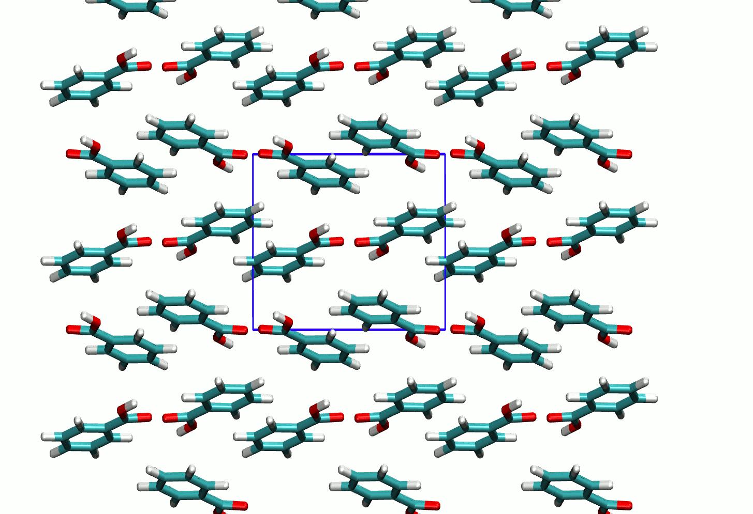
The Symmetry-Constrained Monte Carlo (SC-MC)
Molecular connectivity
Space group(s)
IN
Symmetry-constrained Monte Carlo (SC-MC)
OUT
Set of plausible crystal structures
A POSTERIORI
MiCMoS force fields (LJC and CLP)
Guess structures are generated by brute force approach, then MC and simulated annealing are performed
Symmetry is kept fixed throughout the MC trajectory, only the DOFs of the asymmetric unit are optimized
Molecular Dynamics
Quantum mechanical calculations
The method is cheap and can be run on a laptop
4
Notes:
So starting from the idea to exploit the MiCMos feature, we developed a new stand-alone program to generate possible crystal structures given the molecular connectivity of the molecule. This program exploits as I already said the main properties of MiCMoS, but moreover it does generate structures using (for the moment) a brute force approach to generate the starting guess. A monte carlo trajectory is then run for each structure, with the peculiarity that the symmetry elements are kept fixed along the whole calculation. We decided to to this in order to fully exploit the properties of the crystal and to speed up the calculations, since we can then only focus on the degrees of freedom of the asymmetric unit in the unit cell instead.
Da stressare a voce che non esiste una cosa simile in letteratura (a quanto ne so)

Slide 6
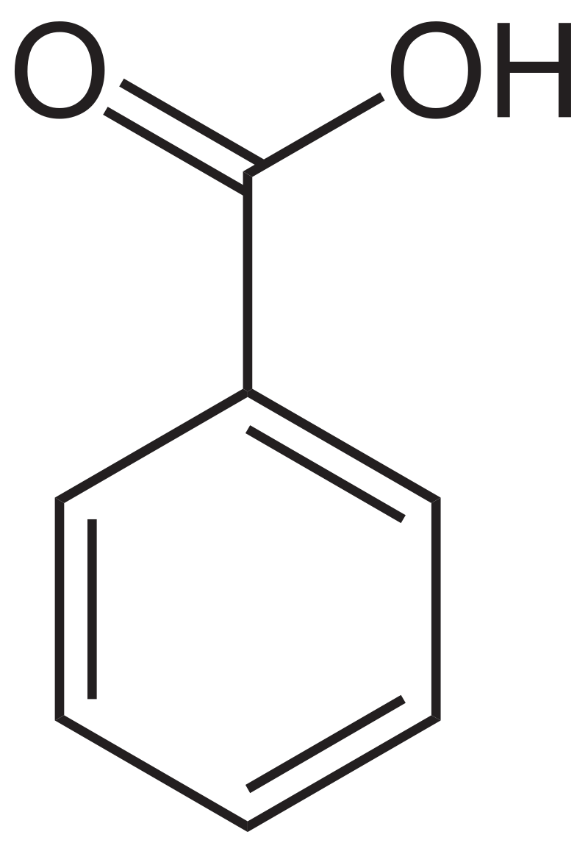
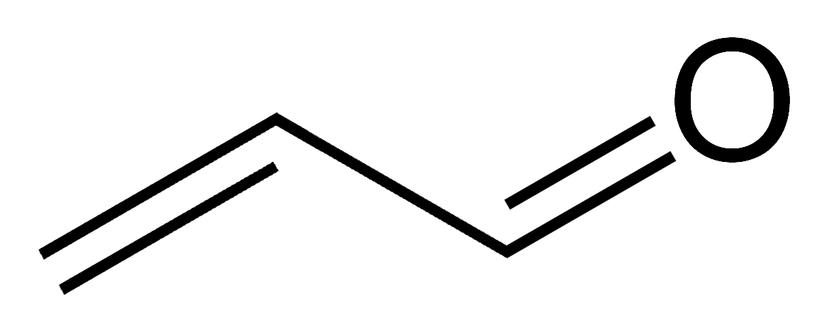
Methods
Two test cases: (1) acrolein and (2) benzoic acid
Pipeline:
1. Structures generation
  Symmetry constraint: ON
  T-fixed MC followed by simulated annealing minimization
  Selected space groups: 2 (P-1), 4 (P2₁), 14 (P2₁/c), 15 (C₂/c), 19 (P2₁2₁2₁), 61 (Pbca)
  1000 seeds/space group
Refcode: AXOSOW
SG = Pbca (No 61)
T = 133 K
Lattice Parameter:
a = 7.134(8) Å
b = 9.694(11) Å
c = 9.930(10) Å
Refcode: BENZAC02
SG = P2₁/c (No 14)
T = 300K
Lattice Parameter:
a = 5.4996(5) Å
b = 5.1283(5) Å
c = 21.950(2) Å
β = 97.37(1) °
2. Dynamic relaxation
  Symmetry constraint: OFF
  Molecular Dynamics (MD) on top ranking polymorphs to introduce dynamic effects
  Force field: Lennard-Jones-Coulomb (LJC)
  Total time: 200 ps; Δt = 0.002 ps
  T = T experimental
5
Notes:
That was a general overview of the method, now we go a little deep into details about the results I will present today.
We tested 2 molecules: (nome e particolarità del cristallo)
The computational strategy we adopted was the following:
Use of brute force approach to generate structures (some details if I have time. Stress the symmetry constrain)
Relaxation removing symmetry with MD to introduce dynamic effects

Slide 7
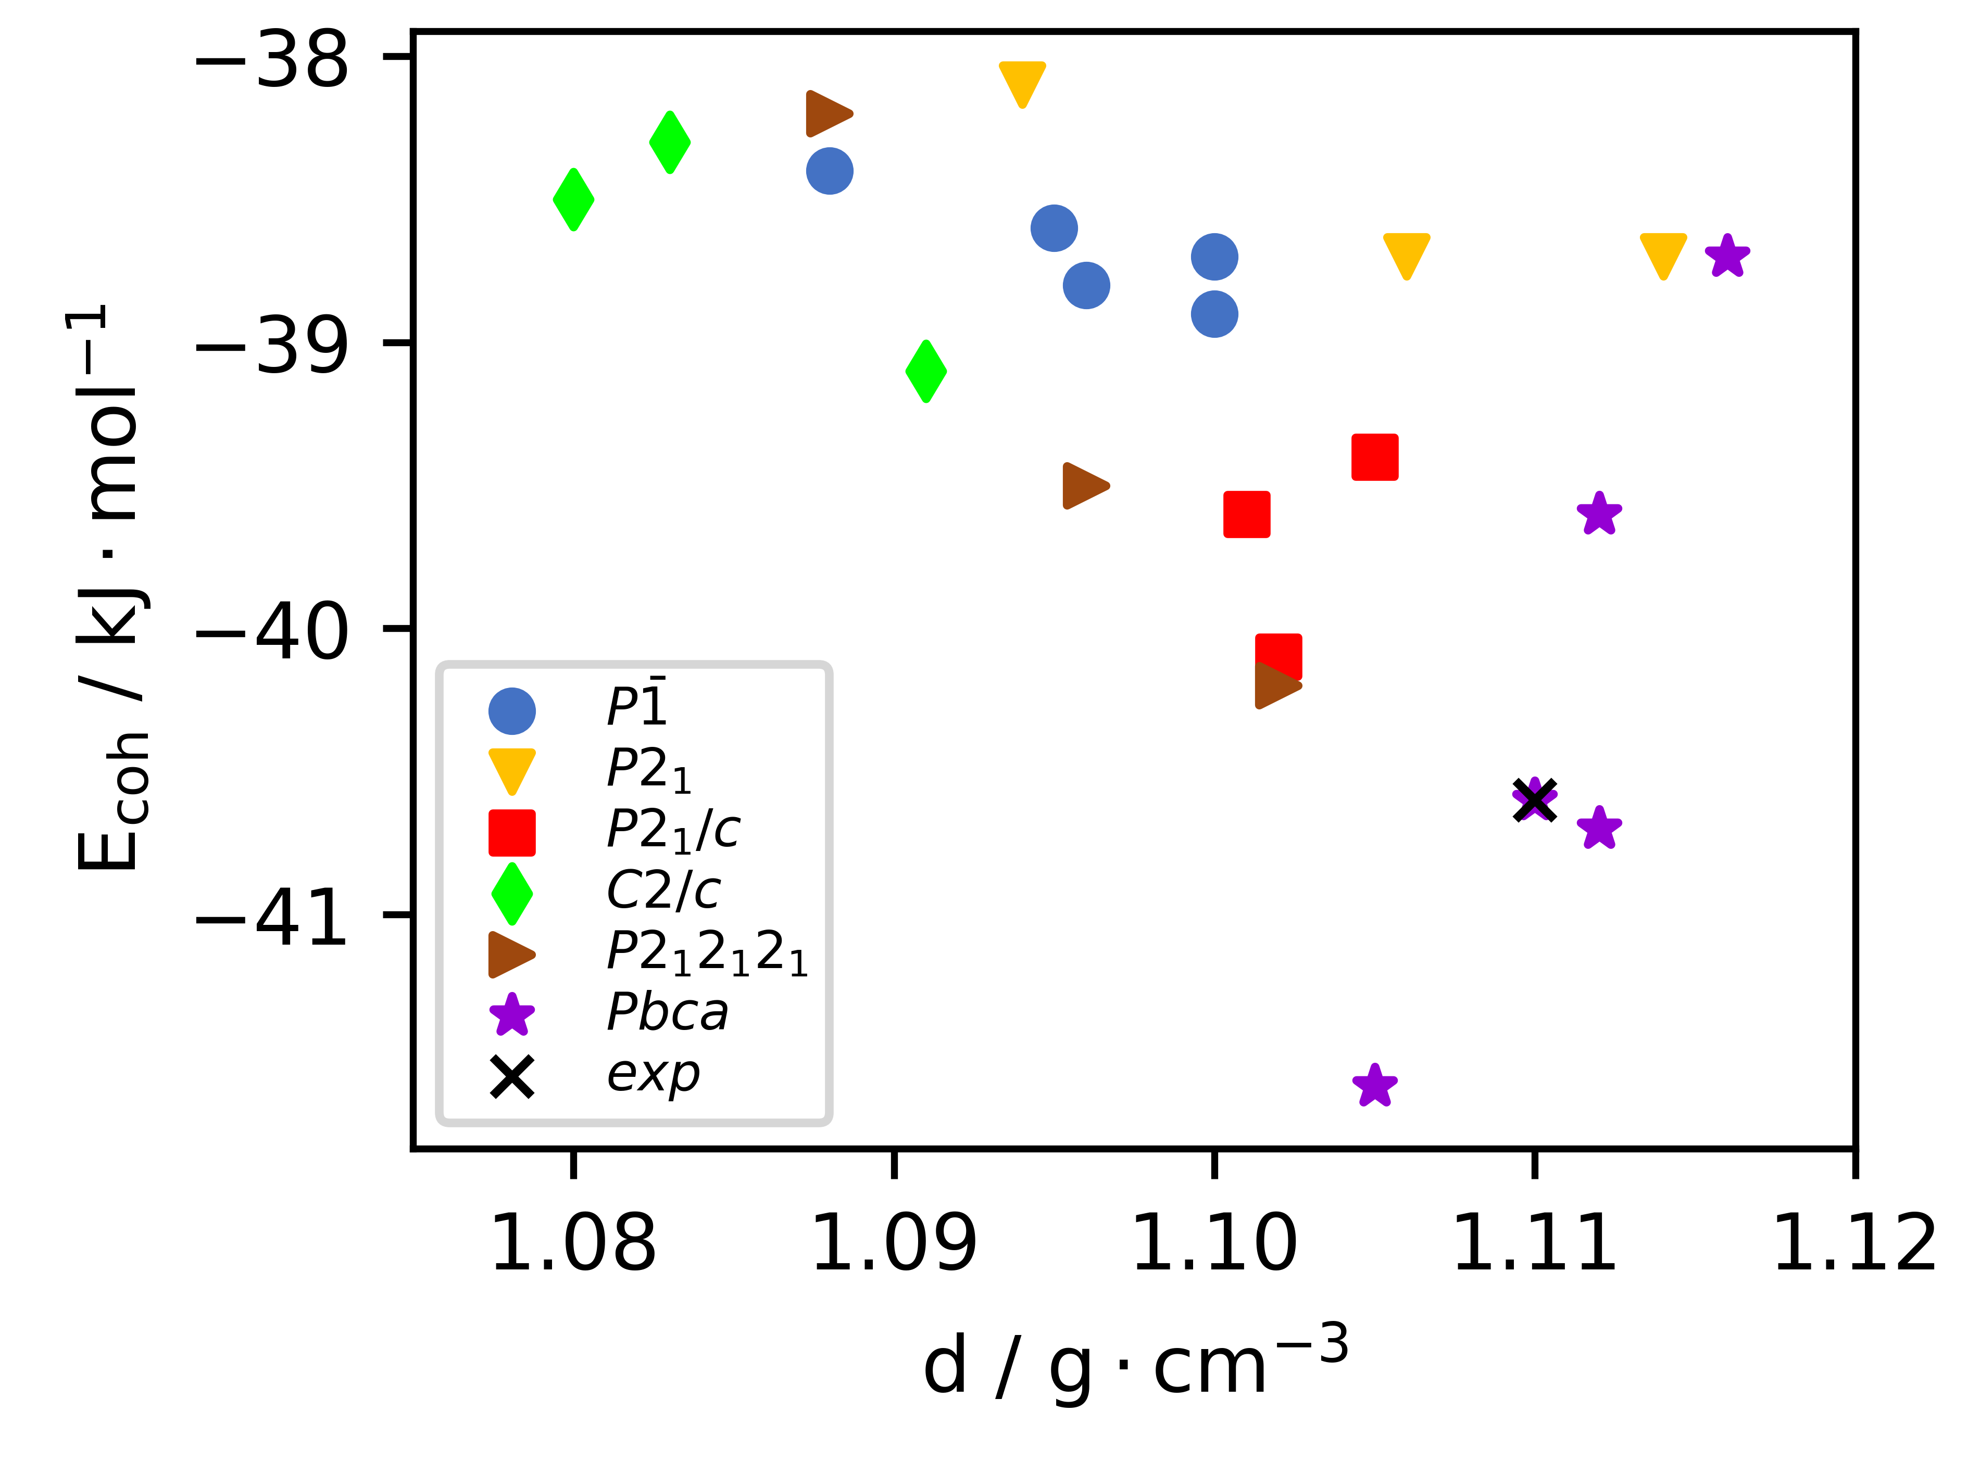
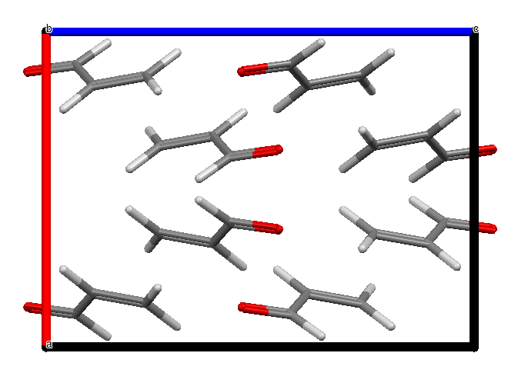
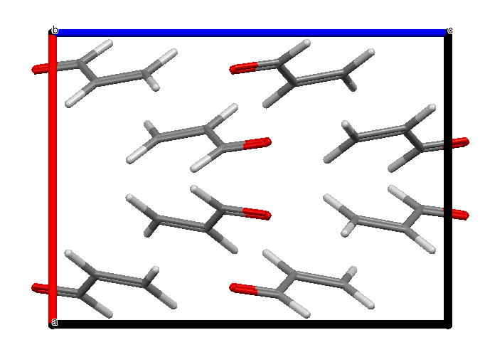
Results – Acrolein
Cohesive energy vs density
No strong intermolecular interactions
Pbca (61) is the best space group among the tested ones (low cohesive energy, high density)
Experimental structure is found as the 3rd best ranked structure -> the method is fairly accurate.
experimental
predicted
6
Notes:
Acrolein:
We sho here the cohesiv energy vs density plot of acrolein. As said, no strong interactions in this crystal.
Two results:
Pbca best space group
Experimental structure found as 3rd best structure
Here the program seems to work

Slide 8
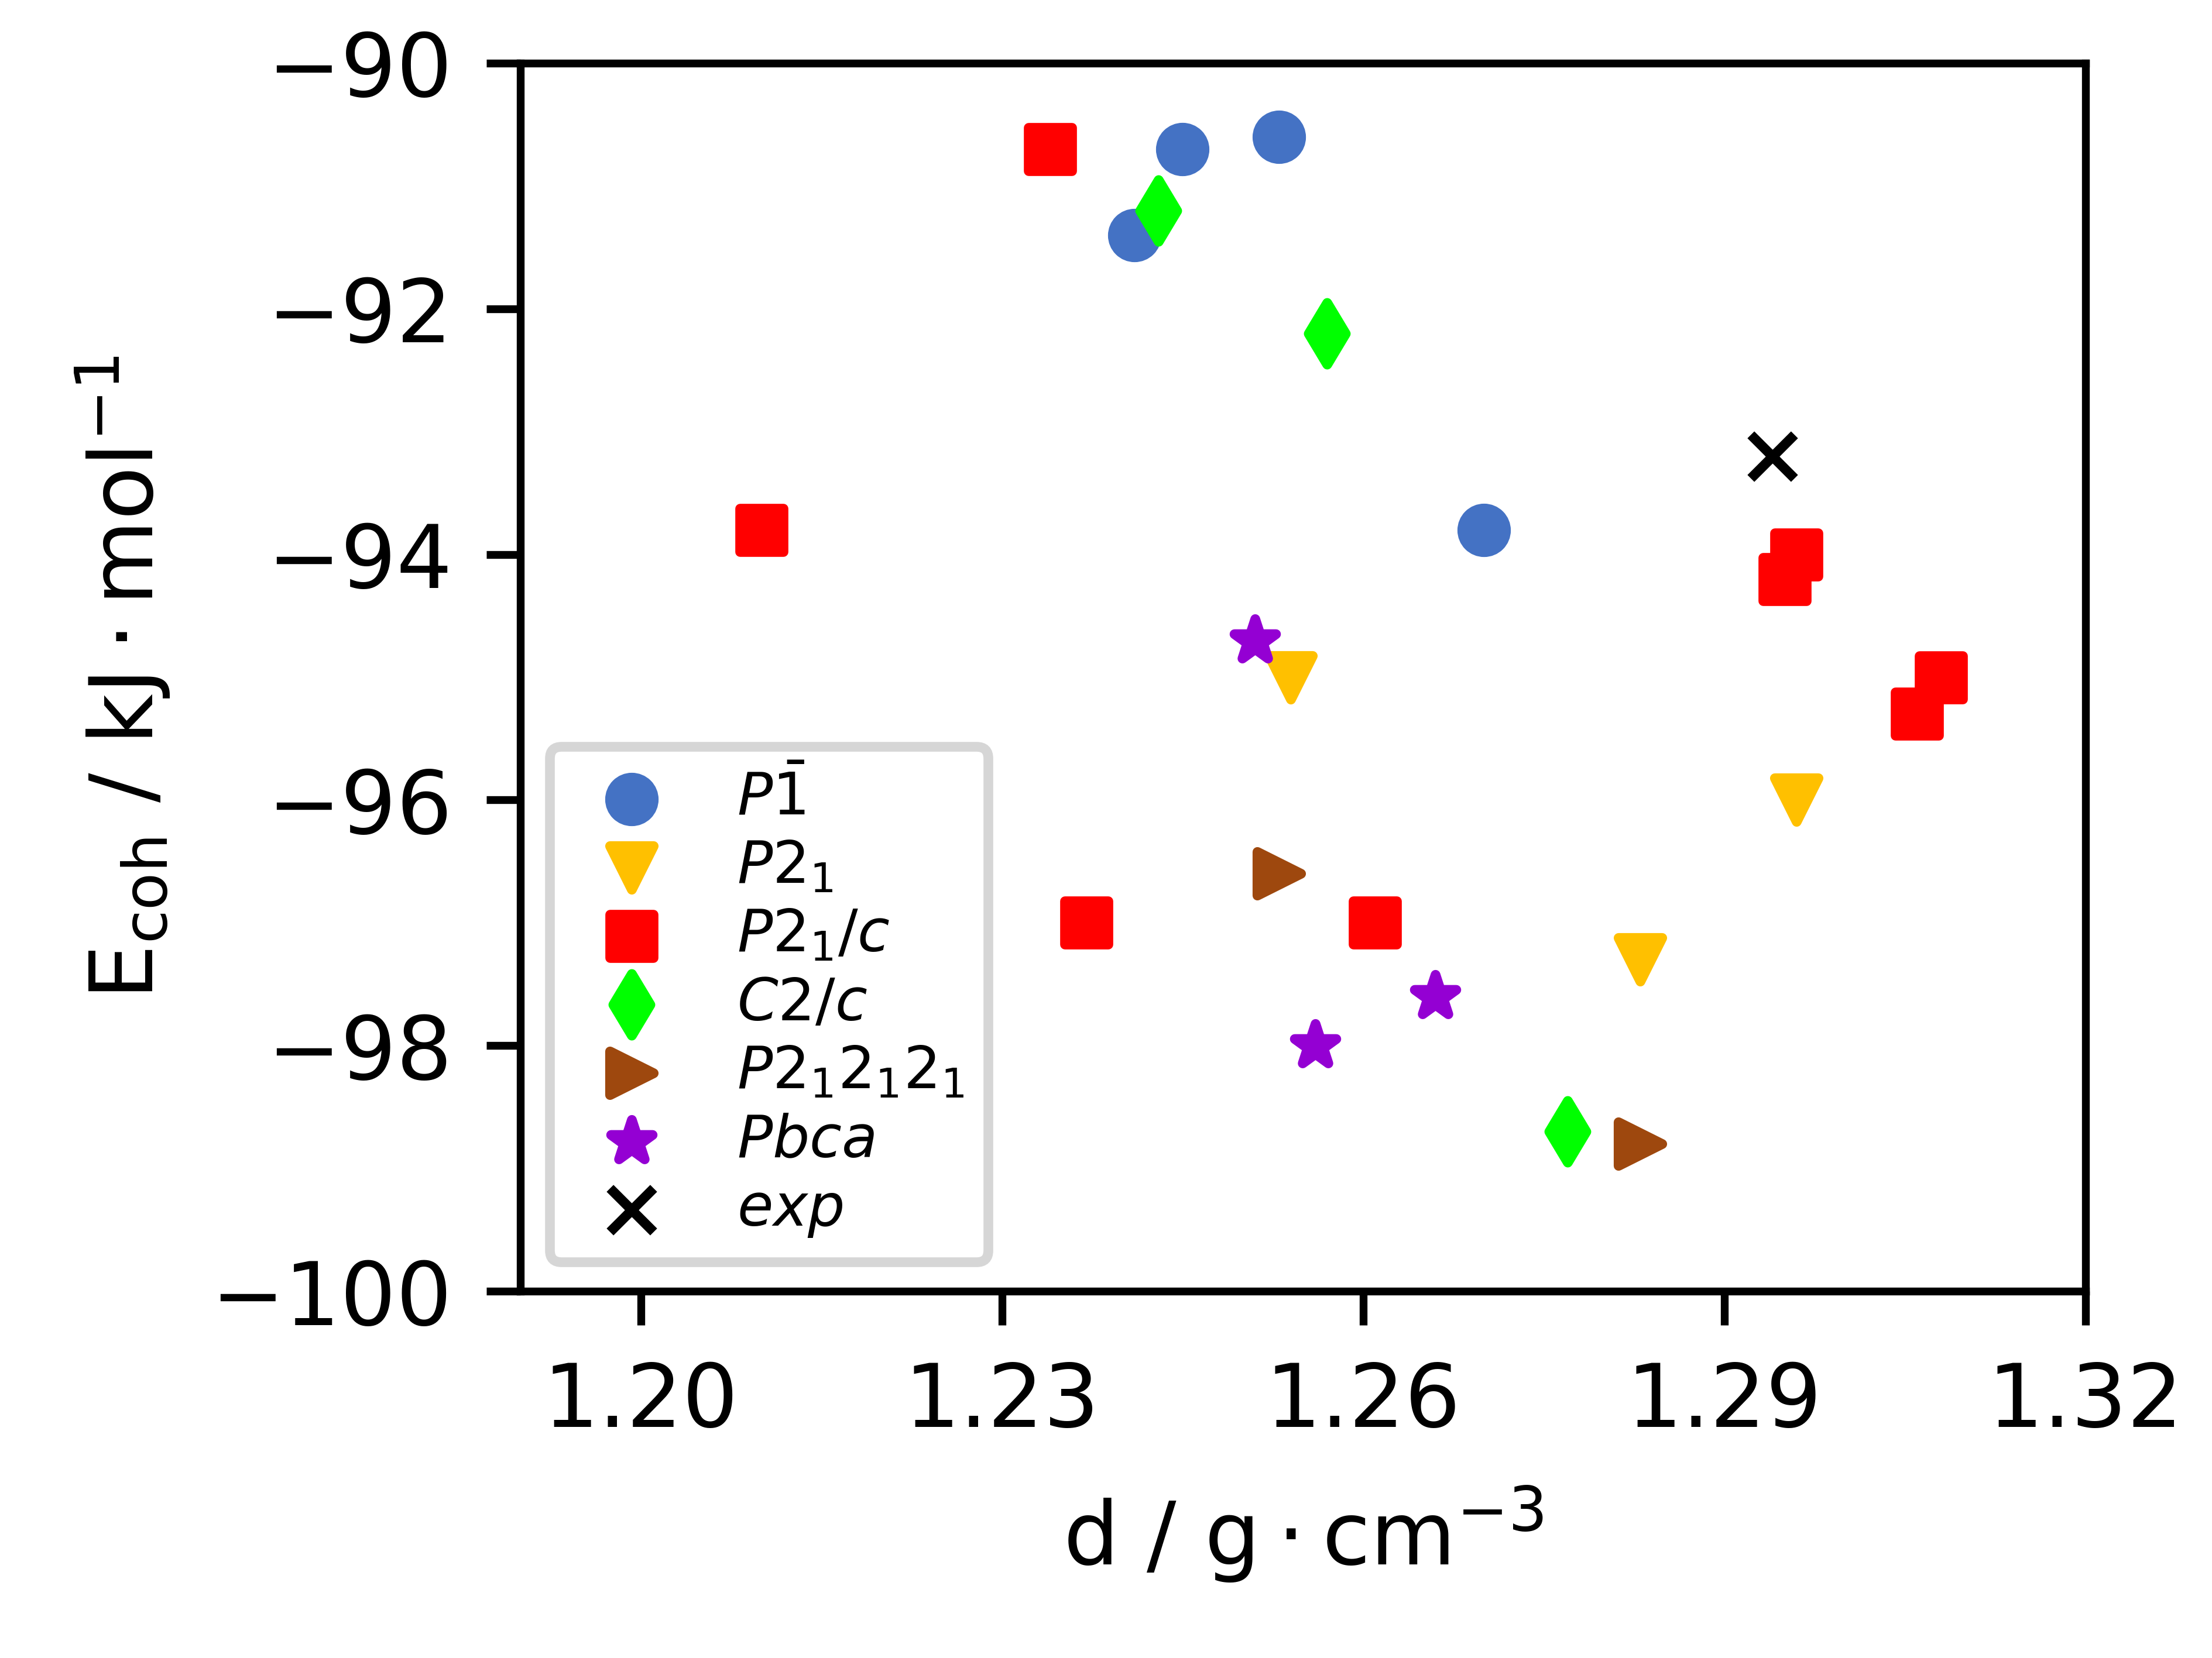
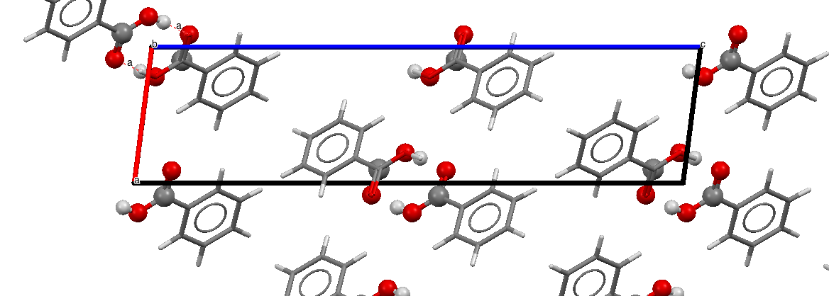
Results – Benzoic Acid
Cohesive energy vs density
Strong H-bond interactions in the experimental structure -> Dimers
The experimental structure is not in the best ranked structures
Several structures with lower energy
No preferred space group: P21/c (experimental SG) is higher in energy than others
7
Notes:
Moving on the other side on the benzoic acid, the situation is more complicated.
FIrst of all, the BA forms strong intermolecular interaction (hydrogen bond)
Results
As you can see from the picture, the experimental energy is not the best ranked structure. A lot of polymorphs are present here.
No preferred space group
Question: is then a symptom of failure for our method?

Slide 9
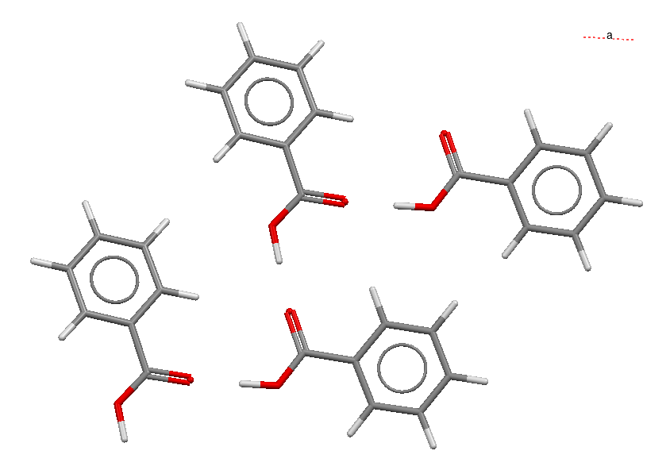
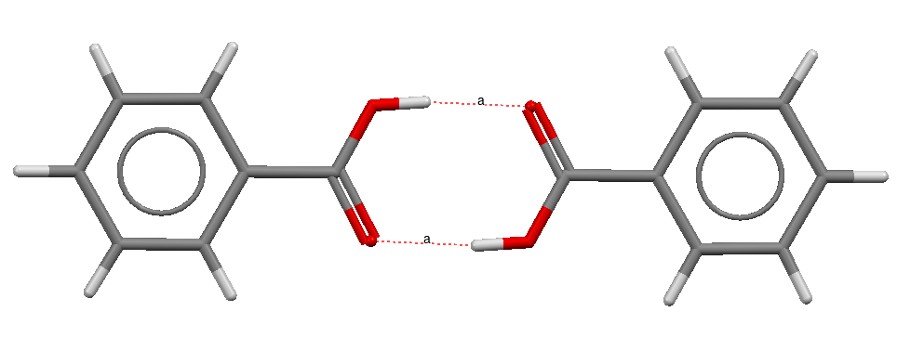
Benzoic Acid – Two modes of self-recognition
Benzoic acid is a tricky case: possible intrinsic disorder/tunneling effects related to the position of the carboxylic hydrogen atom
Two different modes of self-recognition: Dimers and Catemers.
Dimers
Present in the experimental structure
Catemers
Not found experimentally
High energy​
Low energy​
8
Notes:
We then go deeper into details and have a look of the found structures.
We found that all the obtained structures have two different self-recognition mode
Dimers, where two BA acid form a cyclic dimer. This is what is found experimentally
Catemers: these structures are not found experimentally, but according to our simulation they have a lower energy than the dimeric forms.

Slide 10
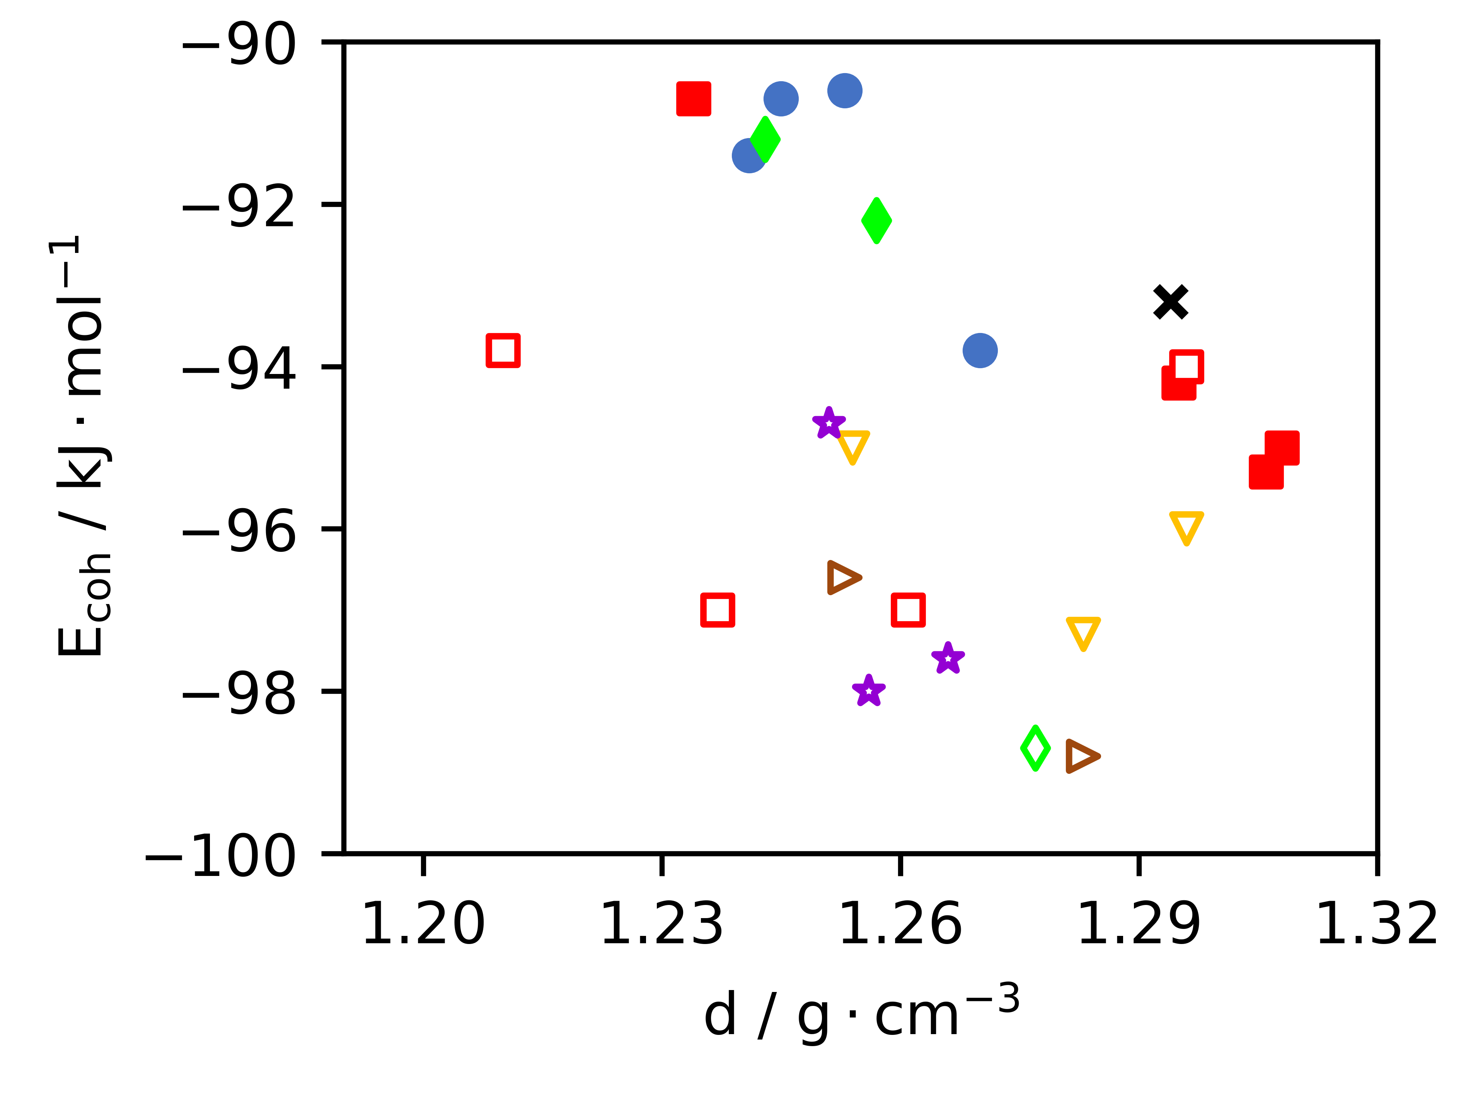

Benzoic Acid – Catemers have more negative cohesive energy
Most of the structures below this line are catemers
The method fails if we only look at the energy landscape.
Why we do not find an experimental catemer form for benzoic acid?
9
Notes:
In fact, if we look now at the same picture before but discriminating between catemers (white filling) and dimers (color) we see that almost all the structures with lower energy are catemers.
Two conclusions:
The method fails if we only consider energy and density (in this case)
Question: why we don't see any catemers from an experimental point of view?

Slide 11
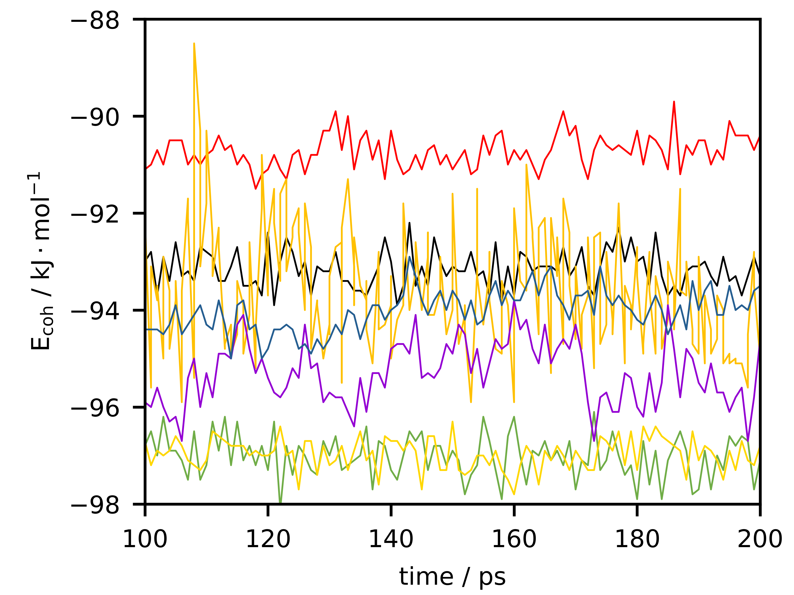
Benzoic Acid – Mechanical stability of polymorphs
Cohesive energy vs time
Space group: P2₁/c (14)
Presence of oscillations for some structures
This can be a symptom of time-instability of the structure
Mechanical/dynamical stability should be considered in the process of polymorph ranking
10
Notes:
A partial solution of the question and conclusion before can be drawn looking at the dynamic behaviour of the simulated crystal along time.
Here I depicted only the energy profile of the P21/c space group structure, but similar results are observed for the other space groups.
As you can see, some of the predicted polymorphs have big oscillations of energy. This is a symptom that the structures are metastables and that, possibily, they can evolve in something different if the dynamics is run for more time.
Conclusion:
Mechanical stability (dynamical stability) is an important parameter to take into consideration

Slide 12
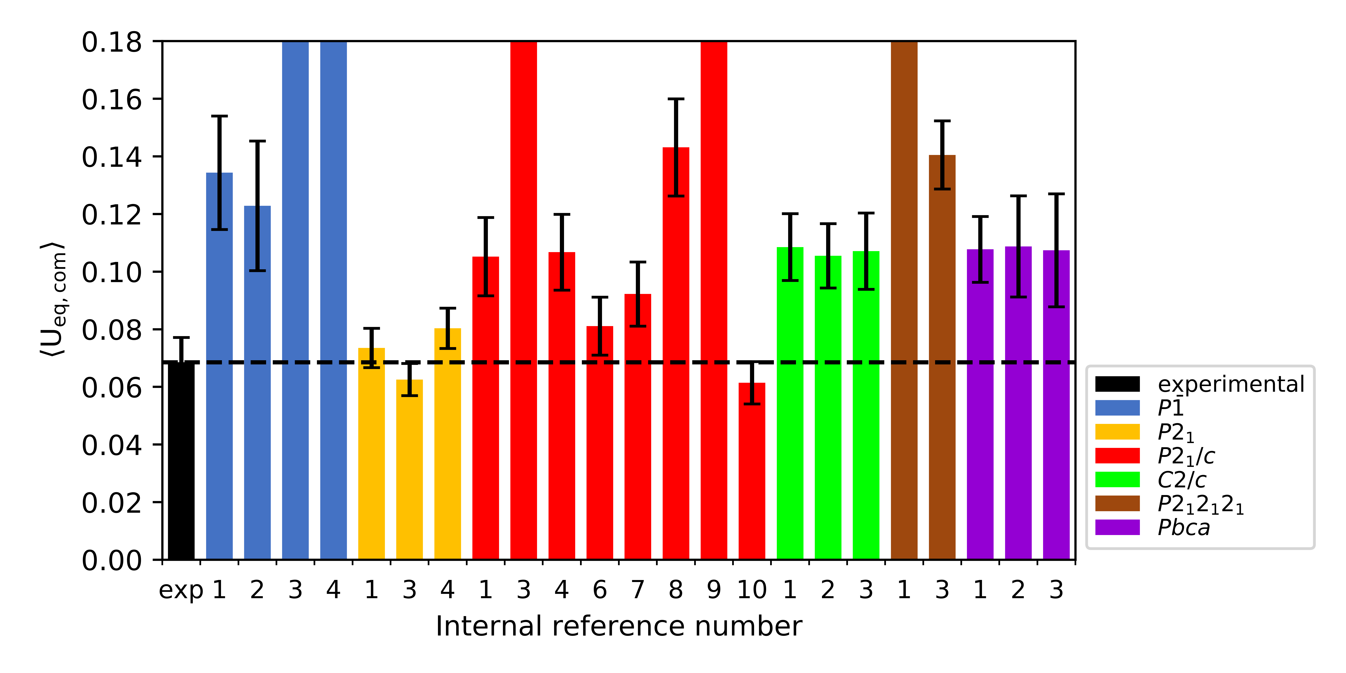
Benzoic Acid – Mechanical stability of polymorphs
Average U_{eq} of the center of mass (com) of the molecules in the crystal
Most stable
11
Notes:
To evaluate

Slide 13
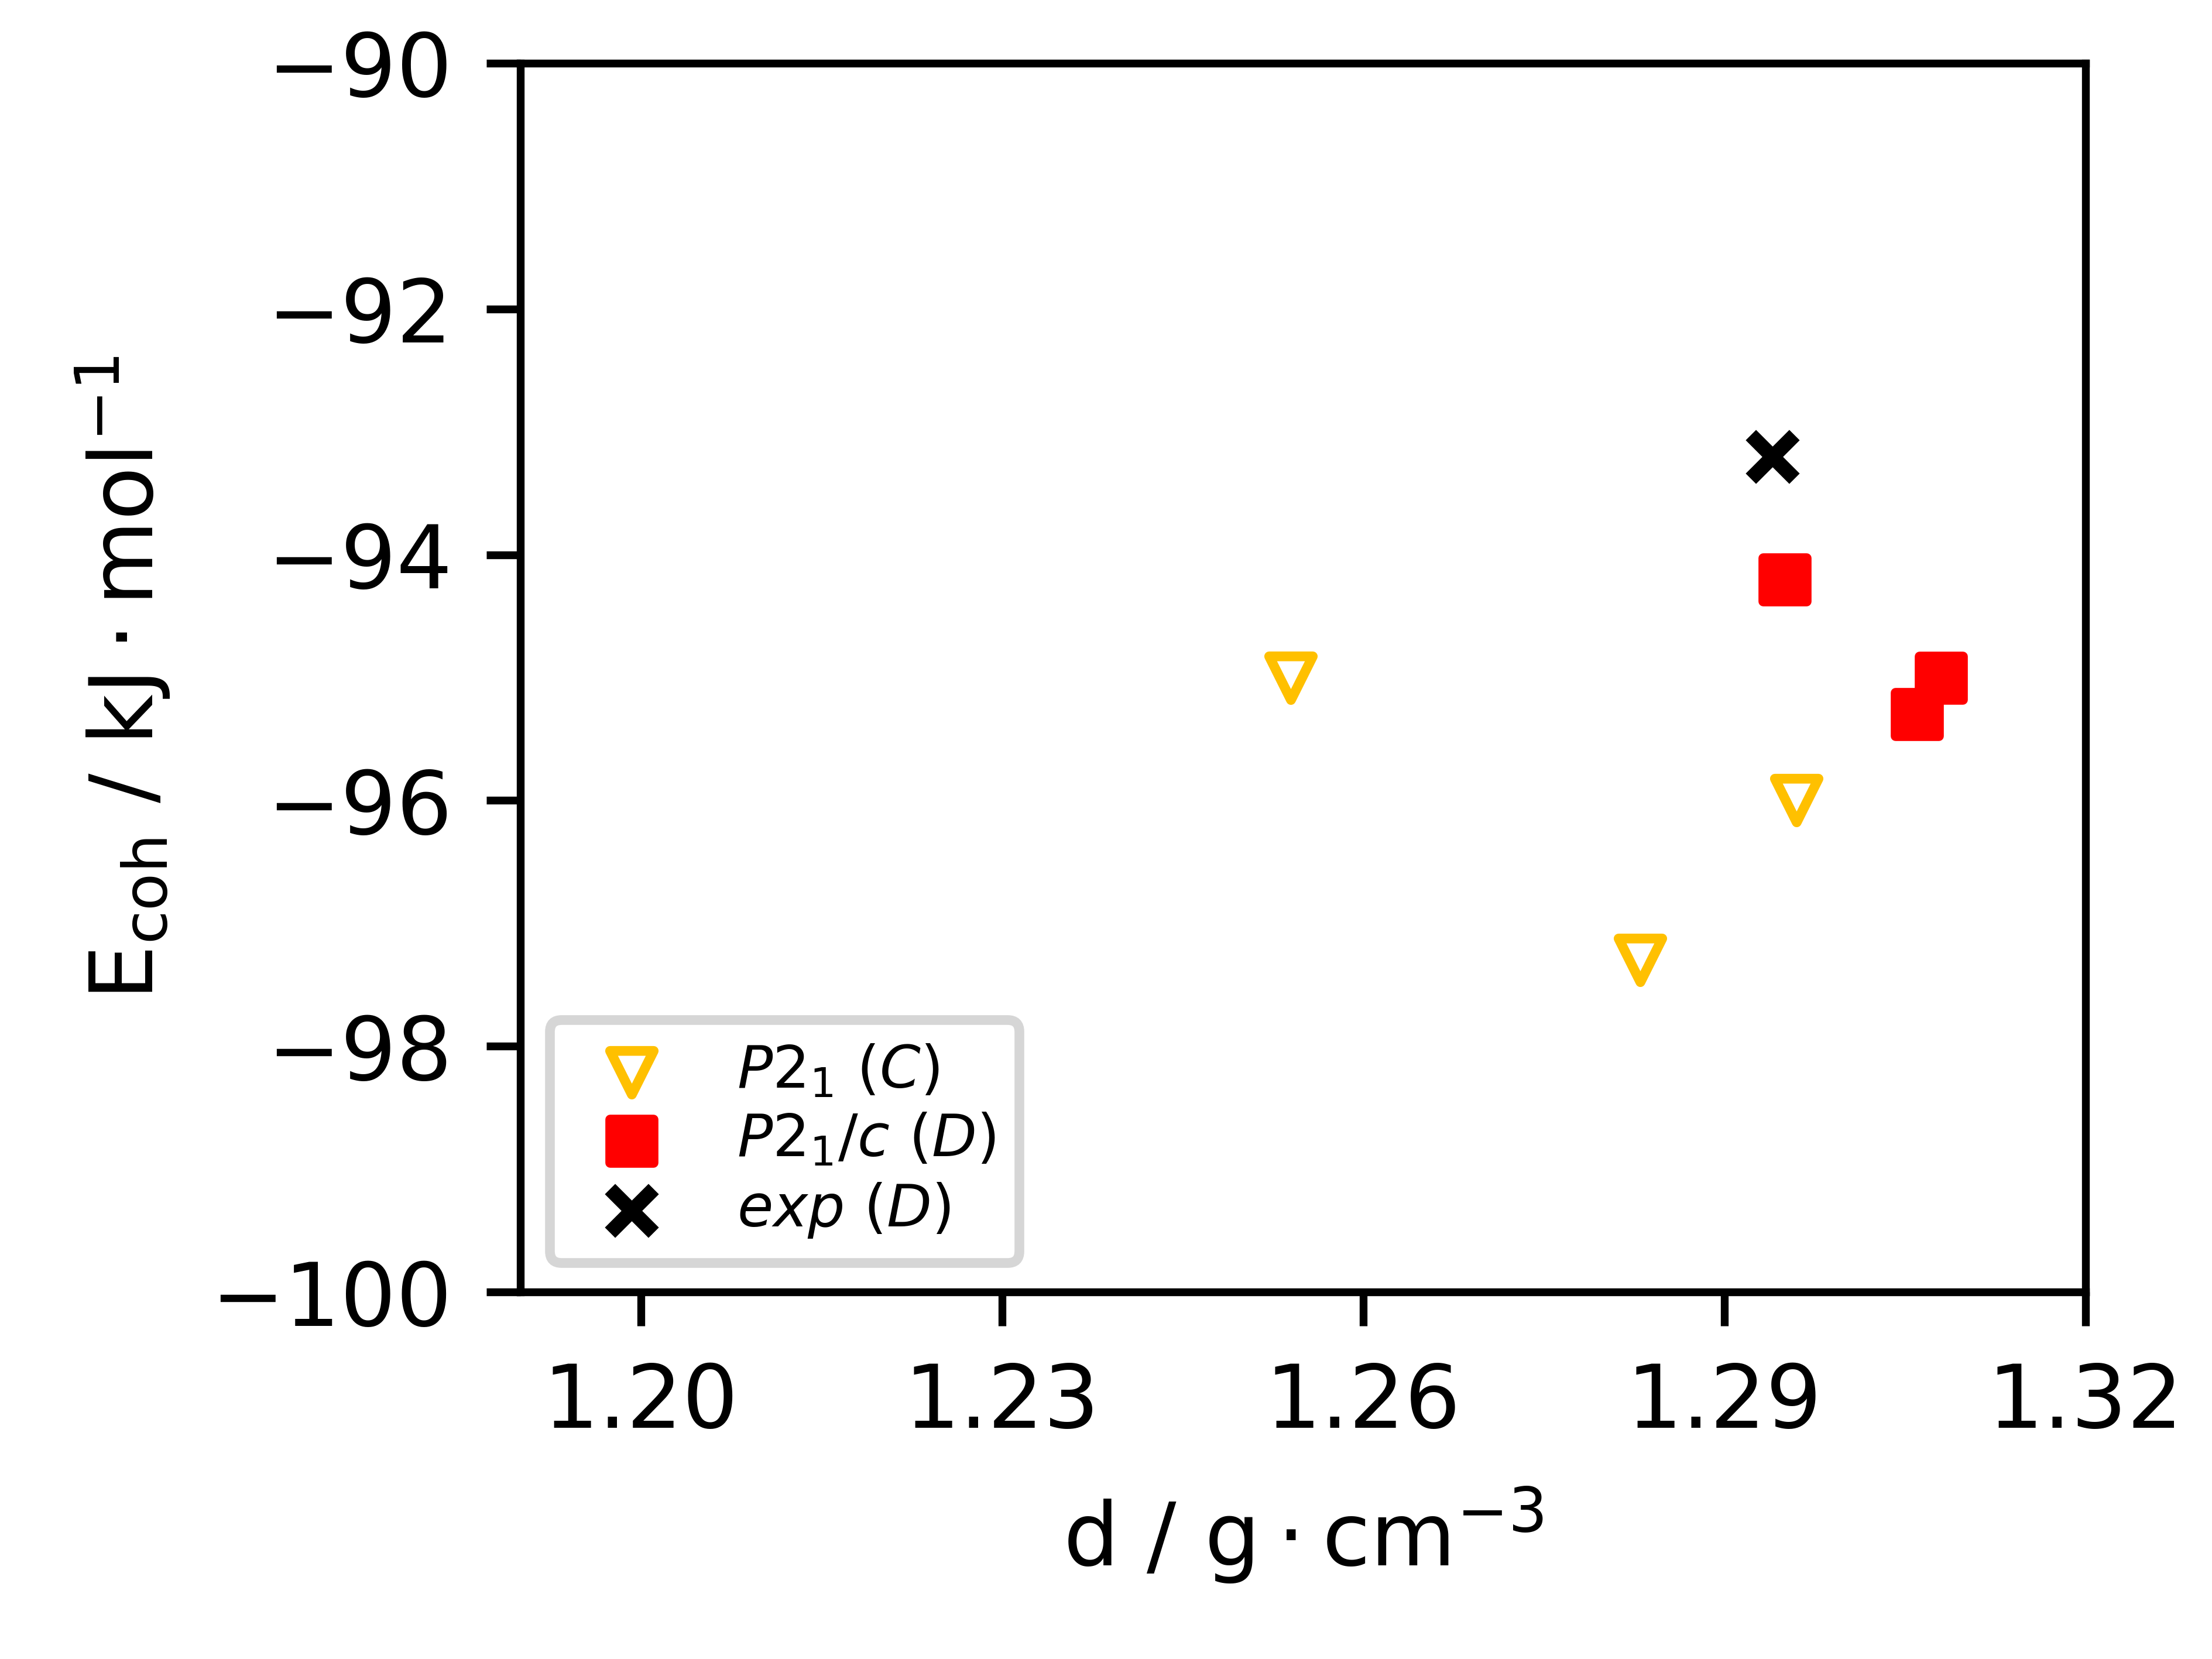
Benzoic Acid – Only few catemers are mechanically stable
Cohesive energy vs density
Most of the predicted polymorphs are not mechanically/dynamically stable
The structures with the best geometrical agreement with the experiment are mechanically stable
The catemers in the P2₁ space group look stable both from energetic and mechanical point of view
Are they experimentally accessible?
* (C) = catemer; (D) = dimer
12

Slide 14
Conclusions & Outlooks
Conclusions
We developed a new symmetry-constrained Monte Carlo method for the cheap generation of plausible crystal structures;
We propose the introduction of the mechanical/dynamical stability parameter for the prediction of polymorphs stability;
If our prediction is true (TBC), the dimeric form of the benzoic acid is metastable.
In the future
Define a functional for the ranking that take into consideration energy, geometry and mechanical stability;
Increase the number of test cases with other reference molecules;
Comparisons of our results with other available crystal structure predictor;
Try to crystallize the catemeric form.
13

Slide 15
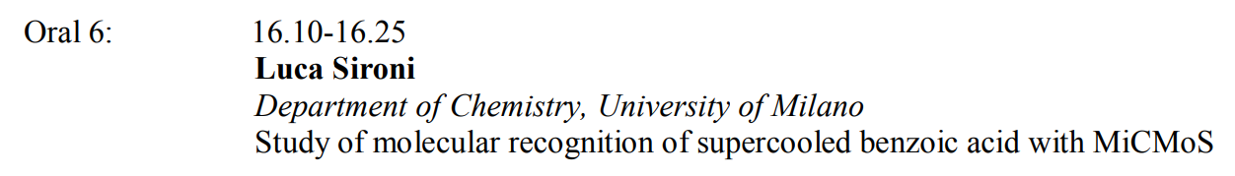

Few more reminders...
To download MiCMoS:
To know more about MiCMoS:
MS7: giovani cristallografi
Thursday 7 September (tomorrow)
https://sites.unimi.it/xtal_chem_group/index.php/research/5-cmimos
14

Slide 16
Thank you
for your attention!

Slide 18
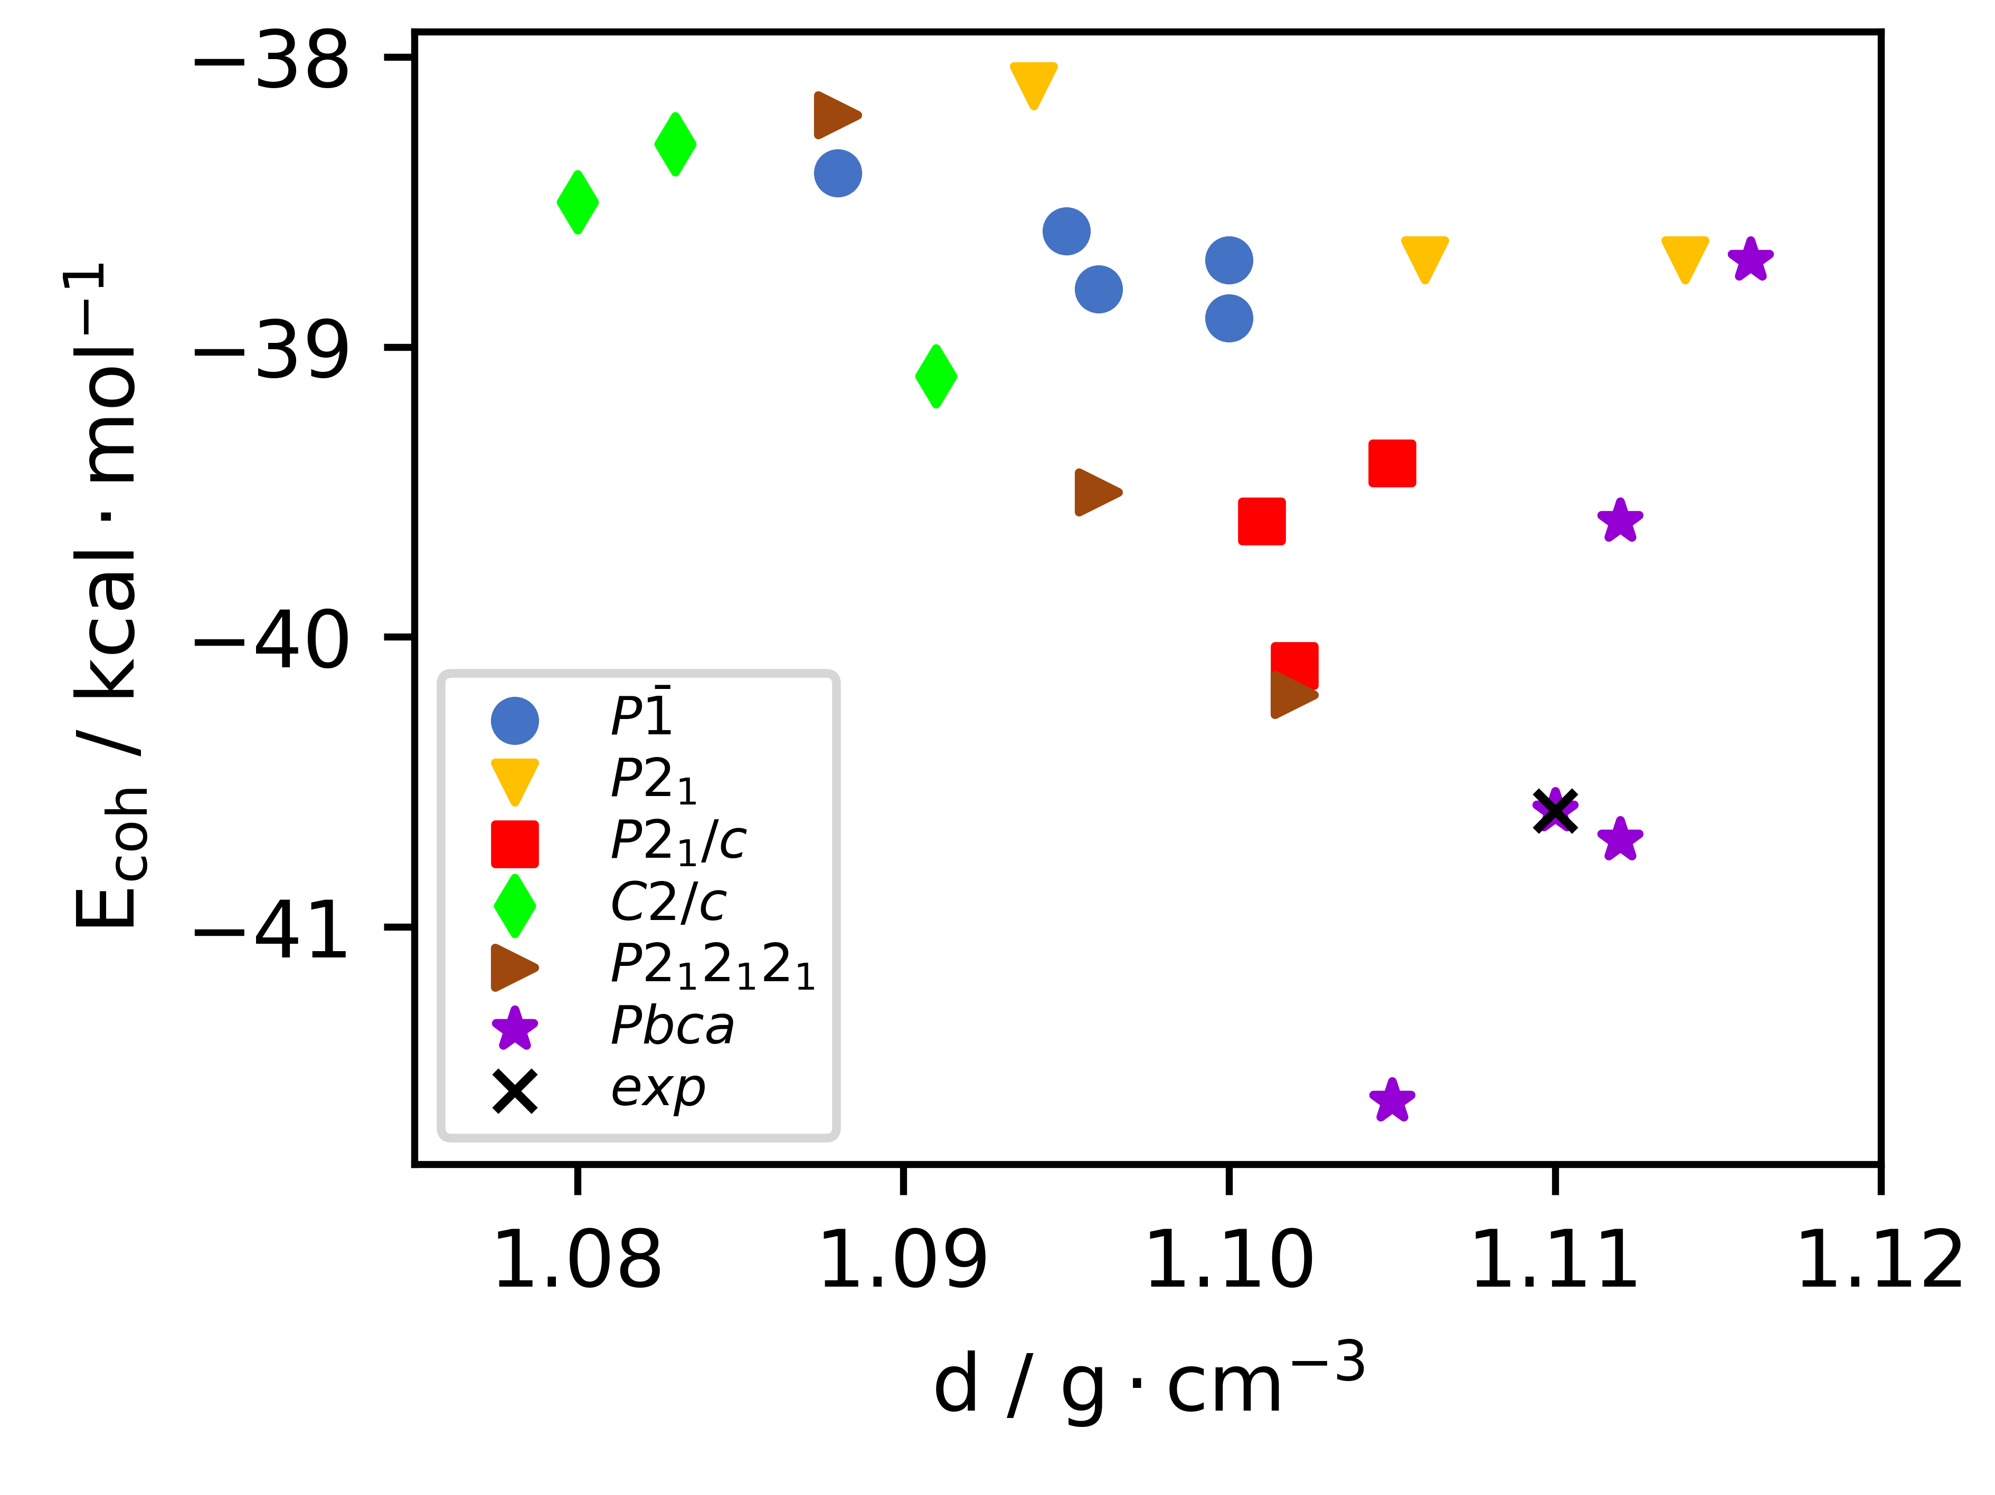
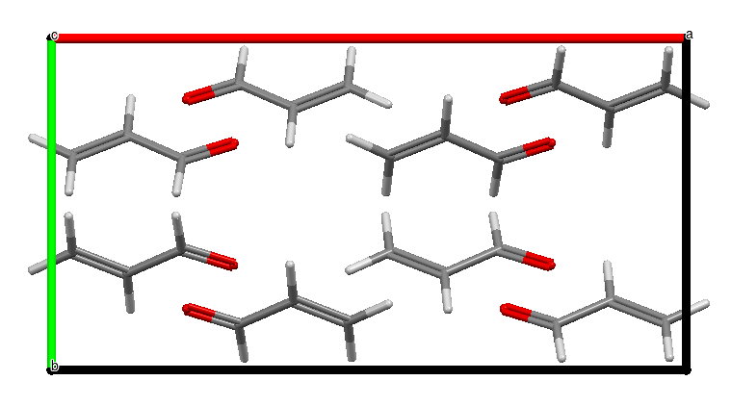
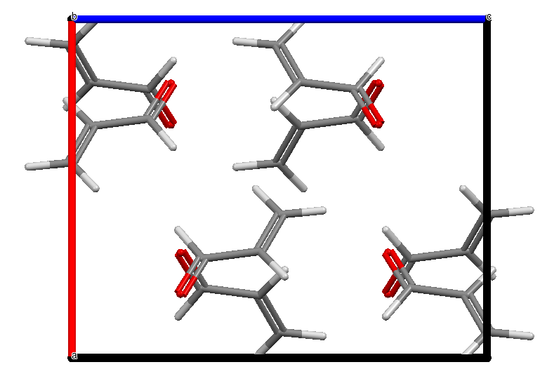
Acrolein
experimental
1
a = 7.1139 (7) Å
b = 9.7620 (13) Å
c = 9.6518 (13) Å
a = 7.1186 (6) Å
b = 9.7604 (11) Å
c = 9.6546 (11) Å
1
3
3
2
experimental
2
a = 13.7429 (14) Å
b = 7.1843 (8) Å
c = 6.8305 (11) Å
a = 8.5019 (9) Å
b = 7.5783 (7) Å
c = 10.4127 (7) Å

