Slide 1


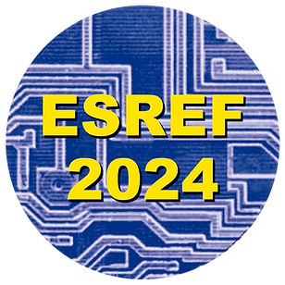
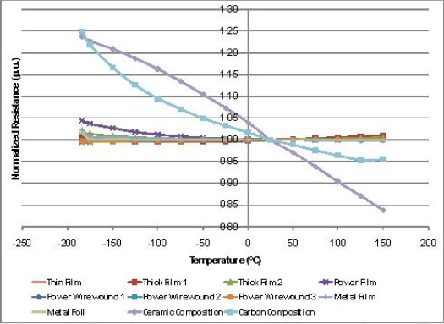
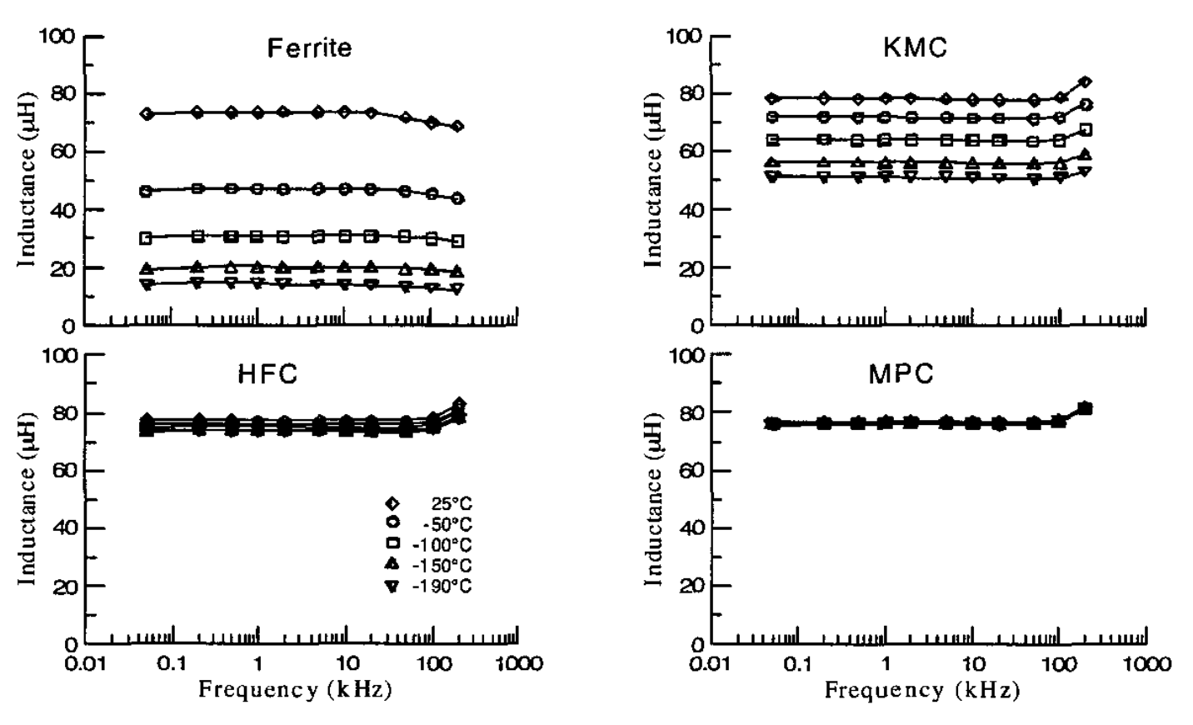
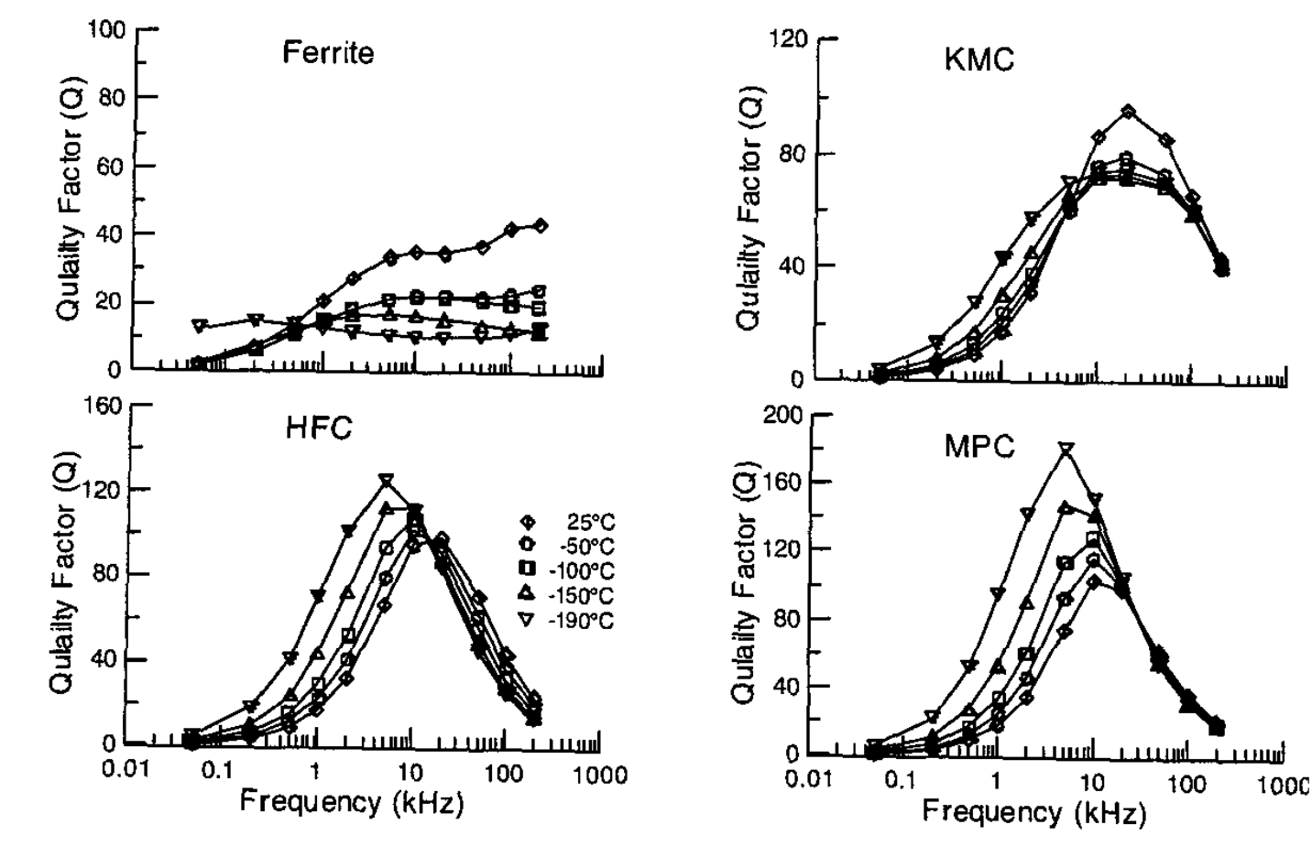
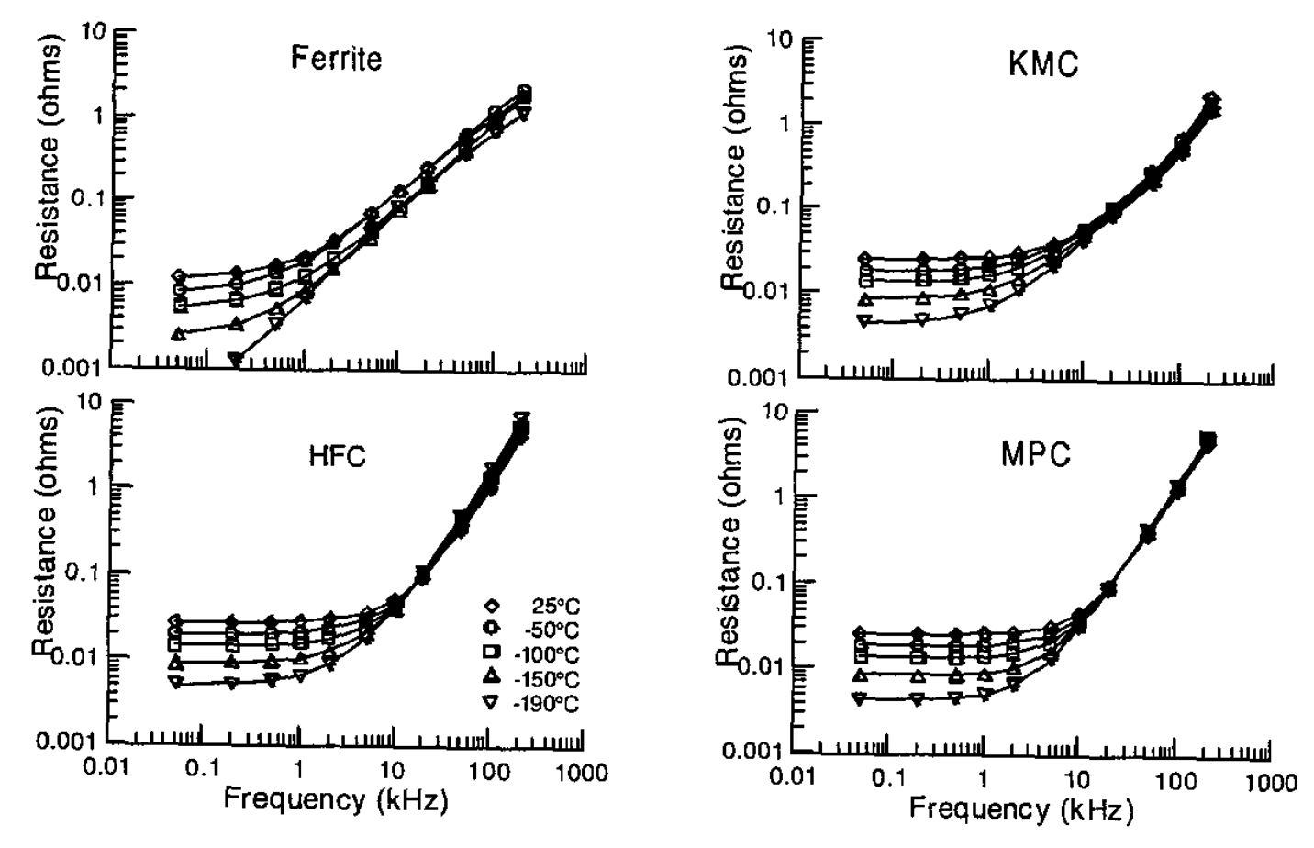
Issues of electronic devices in hostile environment
A. Andreaniª, M. Lazzaroni^{a,b}, A. Riminucciª, D. Santoro^{b},c, V. Trabattoni^{a,b}, A. Zani^{b}
ªUniversità degli Studi di Milano; ^{b}INFN Milano
ASBTRACT
The operation of electronic devices in hostile environment has been investigated. Issues due to Extremely Low Temperature (i.e., Cryogenic temperature) and operation in cryogenics liquids (liquid argon, LAr, or liquid nitrogen, LN2) are presented and discussed. Both passive and active electronics components have been considered and their troubles at cryogenics temperature have been presented.
INTRODUCTION
Operation in cryogenic environment aims at enhance the intrinsic efficiency of detectors used in astrophysics, particle physics, and nuclear physics. Electronics must function at 87 K for extended periods of time (many years) with minimal power dissipation, as even a small amount of bubbling in the liquid can disrupt detector operation. Recent R&D suggests placing photon detectors on very high voltage surfaces (up to -300 kV, in DUNE), making standard copper cables impractical for power and signal transmission. For this reason, implementing a Power over Fiber (PoF) technology at cryogenic temperatures is being explored.
Although some electronic components can operate at cryogenic temperature, every commercial technology must be tested and characterized beforehand.
Inductors: Inductors are constructed as windings of conductive wires around ferromagnetic cores. The inductance value is contingent on the materials employed, the geometry and the number of turns in the winding around the core of the device itself.
Studies on inductors at cryogenic temperatures have primarily focused on investigating the structure of the magnetic core and the winding. A study on copper wires found that more windings are needed to maintain the same inductance as temperature decreases. Other studies examined the response of windings using superconductors, with tests conducted at fixed temperatures or as a function of varying temperatures.
As a result, nanocrystalline materials stand out as the best choice for magnetic cores of inductors (see Fig. 2): these materials exhibit limited degradation at low temperatures compared to other materials, despite having the highest cost.
In contrast, ferrite cores offer the best balance between performance and cost.
Fig. 1: Trend of resistance value, normalized to nominal value, as a function of temperature.
PRELIMINARY CONSIDERATIONS
In the late 30 years, many studies were made to characterize the behavior of electronic components in hostile environments. In particularly, here we focus on the use of electronics at cryogenic temperature (below -75 °C) for applications such as modern detectors in applied particle physics.
We discuss about components characterization, issues related to the interfaces between components and Printed Circuit Boards (PCBs) are not investigate in this paper.
SEMICONDUCTOR DEVICES
Research on semiconductors has revealed that they exhibit improved electrical properties at lower temperatures, extending down to the temperature of liquid nitrogen. Lower temperatures also lead to significant enhancements in the thermal conductivity of device materials and substrates, simplifying thermal management and enhancing overall reliability. At cryogenic temperatures, both conduction losses and switching losses of power devices decrease, leading to increased power conversion efficiency.
Diodes: Diodes are non-linear passive components made from doped semiconductors, allowing current to flow in only one direction. Operating with a threshold mechanism, diodes, to a first approximation, prevent current flow until the applied voltage at their ends surpasses a specific value. Once this threshold is exceeded, they can facilitate current flow without any restriction. This characteristic makes them ideal for constructing rectifier circuits.
The study conducted on diodes examined how their characteristics, including junction voltage, breakdown voltage, and reverse current losses, change with temperature variations. Specifically, breakdown voltage and reverse current losses decrease with temperature, whereas junction voltage increases. All these observed phenomena can be attributed to the freezing effect of charges at low temperatures.
Germanium diodes exhibit favorable behavior at cryogenic temperatures. A diode that enhanced its characteristics at low temperatures, specifically at 4 K has been developed. Studies were focused on Schottky diodes in GaAs. These diodes possess interesting characteristics such as a low threshold voltage, low resistance in the active region, and strong rectification performance. The study encompassed a temperature range from 20 K to 300 K.
a: Variation of inductance as a function of temperature and frequency.
PASSIVE COMPONENTS
Resistors: A primary categorization of resistors can be based on their assembly type. In literature, there is a lack of studies focused only on their behavior at cryogenic temperatures. However, several papers discuss this topic for different applications. In general, resistor properties remain stable even at low temperatures (Fig. 1). Exceptions are observed for certain resistor types, specifically thick-film resistors, metal oxide resistors, and ceramic and carbon composition resistors. These devices exhibit a slight deviation in resistance values after undergoing a cooling cycle, rendering them less suitable for use in cryogenic conditions.
Capacitors: The capacitance value of a capacitor is influenced by its dielectric material and geometry. Various types of capacitors, all Surface Mount Device, have been examined in the literature, in particular ceramic and polymer capacitors. Capacitor characterization comes in different flavors: in some instances, measurements were conducted at well-defined temperatures, such as 300 K and 77 K, or at 300 K, 77 K, and 4K. In other cases, capacitance as a function of temperature was studied. In all cases, measurements were performed at room temperature after cooling, to ensure survival after the cycle. The measurements were taken at various frequencies to analyze the behavior of capacitance and current losses across different frequency ranges. Specifically, the frequencies investigated consistently fell within the range of 50 Hz to 100 kHz.
These studies reveal that for certain capacitor types, including polymer capacitors (polypropylene, polyester, PPS, polycarbonate), NPO ceramic capacitors, and mica capacitors, the capacitance values remain relatively constant, with only small variations of 10% or less as detailed in the finale paper. Additionally, these capacitors exhibit low ohmic losses and low dissipation, which either remain constant or decrease as the temperature decreases.
In the only study carried out at temperatures below 77 K, polymer capacitors exhibited a decrease in capacitance values at 4 K, whereas the capacitance value for NPO capacitors remained approximately constant. Various other ceramic capacitors display a stronger dependence on temperature, with variations exceeding 50% in capacitance values. Tantalum capacitors not only exhibit variations of 20% or more, but also demonstrate a pronounced dependency on operating frequency.
Capacitor selection therefore is fundamental and must match the range of cryogenic temperatures and operative.
b: Variation of quality factor as a function of temperature and frequency.
c: Variation of resistance as a function of temperature and frequency.
Fig. 2: Comparison of ferrite and powder cores.
Transistors: Transistors are three-pole electronic components, typically crafted from doped semiconductors. Their versatile structure, which can vary significantly based on construction methods, makes them capable of operating under different conditions, making them fundamental components for computational operations. Transistors play a crucial role in Resistor Transistor Logic (RTL) and are used for logic gates in digital electronics. One study investigated MOS-FETs parameters between 300 and 77 K, focusing on: on-state resistance (RON), drain-source breakdown voltages (Vdsmax), and initial turn-on voltages through their integrated reverse diodes (Vdiode).
It is apparent that RON exhibits a minimum which occurs when the maximum electron mobility coincides with the minimum freezing effect of the charge carriers. As for Vdsmax and Vdiode, they demonstrate linear correlations with temperature, particularly with directly and inversely proportional trends, respectively.
An investigation was conducted on RON at a fixed temperature (77K) while varying the drain current (ID). In this case as well, a minimum value is observed at high currents, attributed to internal heating of the transistor resulting from current flow. So, the practical operating voltage must be within the reduced Vdsmax at cryogenic temperature. Furthermore, despite the observed increase in on-state resistance at temperatures below 130 K, the study of the relationship between RON and ID suggests that MOS-FET transistors can be effectively utilized at low temperatures while enhancing their performance, especially for high-current applications.
Antimony-based HEMTs were also examined in literature, comparing their properties at room temperature and at 77 K. Additionally, dedicated studies on HEMTs in GaN and MOS-FETs in SiC have been conducted, investigating the characteristics of these devices under varying temperature conditions.
Systems: Among the various systems examined, there are oscillator, Pulse Width Modulated controllers and DC- DC converters and so on. Due to space constrain, these aspects will be discussed in the finale paper.
CONCLUSIONS
The operation of electronic devices in hostile environment has been discussed highlighting how low temperature influences the behavior of electronic devices.
Notes:
A0 → 1189 x 841 mm^2 circa 1 m^2
* Quoted 42 phe/keV theoretical from NaI(Tl). In which geometry? SABRE’s one from MC?

