Slide 1
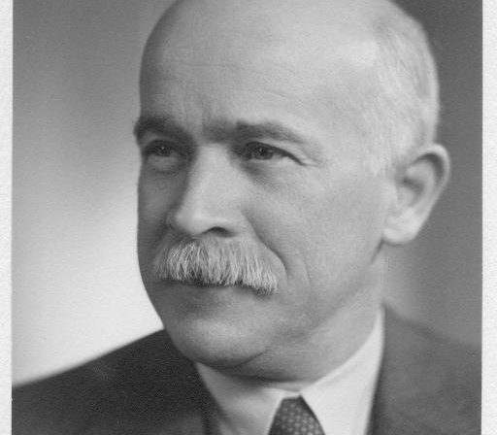


OPERATING AMIDST THORNY INTERNATIONAL RELATIONS: THE MEDIATING ROLE OF COMIT LONDON’S BRANCH, 1935-1940
Federico Castelli
PhD student in Historical Studies, University of Milan
LEREPS, University of Toulouse II
(federico.castelli@unimi.it)

Slide 2
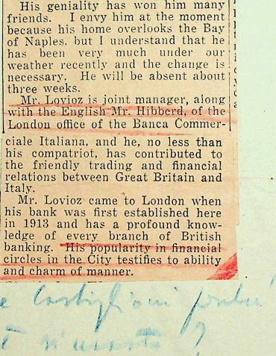
AIMS OF THIS WORK
Leading up the analysis of a bank from its periphery (with respect to Milan head office.
Explaining how Comit-London financed the Fascist dictatorship through acceptance credits.
Highlighting the mediating role of the branch, of its director, Carlo Lovioz, and Raffaele Mattioli (Comit’s managing director).
Historical archive of Intesa Sanpaolo, archival heritage of Banca Commerciale Italiana (Asi-Bci), fond “Carte di Raffaele Mattioli” (CM), folder 159, dossier 2, no. 43/a (Financial Times article, March 7th, 1940).

Slide 3
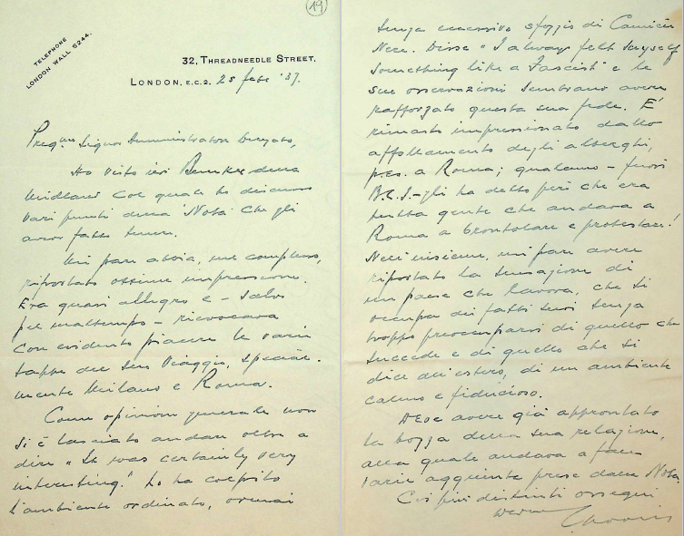
« The position of Italian Bank agencies in London is particularly unenviable; their difficulties are viewed with sympathy by the whole banking community » ¹.
ECONOMIC SANCTIONS BY LEAGUE OF NATIONS
Acceptance credits suspension at the expense of Italian banks
CITY ECHOES
Lovioz’s efforts to reopen acceptances, once sanctions have been removed
DEEDS TAKEN BY COMIT MANAGERS
Lovioz’s meetings with Clearing banks foreign branch managers
Raffaele Mattioli’s aid on the issue
Cooling down of Anglo-Italian trading relationships
Banking elites solidarity towards Comit branches
¹ Asi-Bci, CM 154, f. 1, no. 60/all. 4, Financial Times’ article, November 1st 1935.
² Asi-Bci, CM 155, f. 3, no. 19.
²

Slide 4
FIRST CZECHOSLOVAKIAN CRISIS
– MUNICH AGREEMENT
Convincing risk of a war outbreak
Midland Bank agreed acceptance credits only against cash
Positive Lovioz and Mattioli’s talks with Midland’s managers
Midland reversing its decision

Slide 5
THE SCENARIO DURING WARTIME DEFENCE FINANCE REGULATIONS (AFTER SEPTEMBER 1st 1939)
COMIT LONDON
Keeping up of acceptances business
Italian hemp credits
Cooperation with Bank of England
Strong ties with Italian and British companies
Isotta Fraschini (Caproni Agency group), British Italian Trading
Monopolio Carboni e Metalli, Federtessili

Slide 6
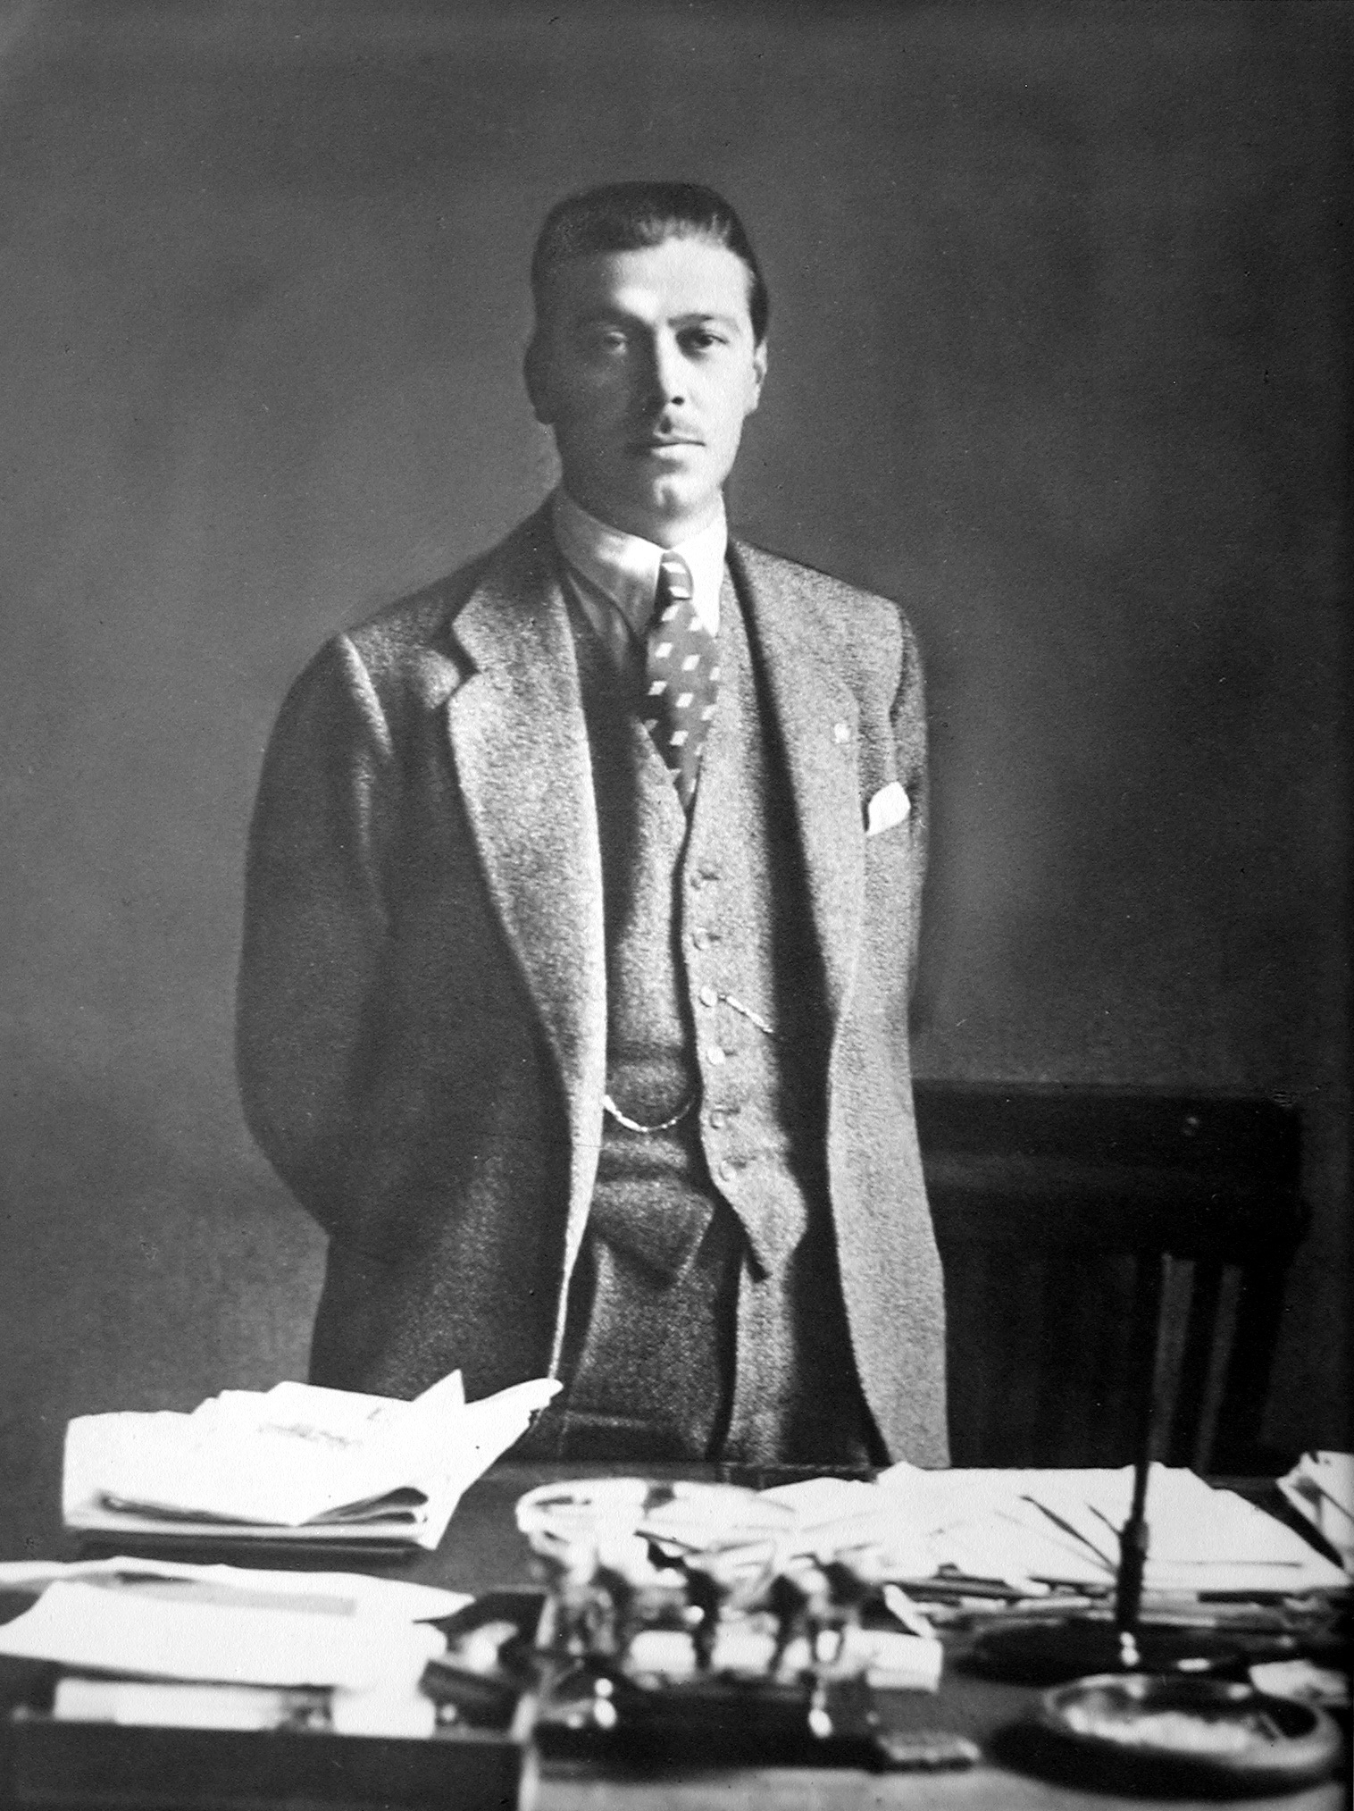
THE IMPORTANCE OF CAPRONI AGENCY’S CREDIT TAKEN BY COMIT-LONDON
Caproni Agency
Diamond tip of the Italian military aircraft industry;
Prospero Gianferrari
Caproni’s manager;
Strong tie with Comit-London
Ability of the branch to succeed in obtaining the acceptance credit.
in search of raw materials.
in London also on behalf of Italian Aircraft Manufacturers Group.
¹
¹ Official portrait of Prospero Gianferrari, Prospero Gianferrari Archive, 1929-1933.

Slide 7
SUMMARY AND CONCLUSIONS
This work hopefully will show:
a first glimpse on acceptances business through Comit-London point of view;
how Comit presence in the City allowed Fascist dictatorship to keep economic relations open with the most important financial world centre, despite the Anglo-Italian constant political rifts.
how the UK’s banking élites kept on giving credit to the Fascist dictatorship, until the last minute and despite everything.

Slide 8
REFERENCES
Archival sources:
Prospero Gianferrari Archive.
Intesa Sanpaolo historical archive, archival heritage of Banca Commerciale Italiana, fond:
“Carte di Raffaele Mattioli”, folders 155, 157, 159, 161;
“Personale, matricola”, dossier Carlo Lovioz.
Bibliography:
E. Di Nolfo, Storia delle relazioni internazionali I. Dalla pace di Versailles alla conferenza di Potsdam 1919-1945, Roma, Laterza, 2015;
R. Di Quirico, Building on borrowed bricks. The internationalisation of Italian banking system, Firenze, European Press Academic Publishing, 2008;
G. Farese, Dare Credito all’autachia. L’IMI di Azzolini e il governo dell’economia negli anni Trenta, Napoli, Editoriale Scientifica, 2009:
E. Green, Calling London, travels by British bankers, 1904-63, Croydon, Threadgold Press, 2017;
G. Montanari, F. Pino, F. Brambilla, 11 dicembre 1911. Lo sbarco a Londra, Milano, Nexo, 2011;
F. Pino, F. Gaido, eds, Dalla crisi allo sviluppo. Scritti per la riorganizzazione delle filiali Comit 1934-1935, Torino, Nino Aragno Editore, 2010;
F. Pino, F. Gaido, eds, Uscire dalla crisi. Comunicazioni interne sul salvataggio della Banca Commerciale Italiana 1933-1934, Torino, Nino Aragno Editore, 2010;
F. Salsano, Cesare Sacerdoti, Italian Biographical Dictionary, Volume 89, 2017;
G. Tattara, An example of countertrade: the Anglo-Italian clearing, «Rivista di Storia Economica», vol. 2, 1985, pp. 115-154.

Slide 9
Thank you
federico.castelli@unimi.it

