Slide 1


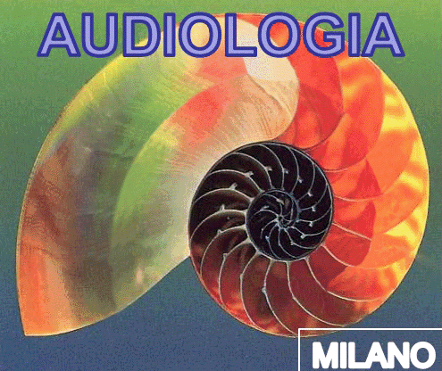
24 OCTOBER 2025
SESSION II
Hearing loss in children: diagnosis, treatment and rehabilitation
14.15-15.30
Lecture & Free Papers (FP3)
Chairs: V. de Maio - L. Malafronte - A. M. Varricchio
Moderators: G. Chiarella - L. D' Ascanio - M. Patscheider
Chairman: Antonio Della Volpe
The assessment diagnostic protocol of
central auditory processing disorder
Federica Di Berardino
S.S.D. Audiologia (audiologia@policlinico.mi.it) – Diego Zanetti
Dip.to di Chirurgia, IRCCS Fondazione Ospedale Maggiore Policlinico, Mangiagalli e Regina Elena, Via Pace 9 MILANO - Milano
Corso di laurea in Tecniche audiometriche – Corso di laurea in Tecniche audioprotesiche
Dip.to di Scienze cliniche e di comunità, Università degli Studi di Milano
Notes:
Il gentile invito e per avermi Assegnato questo I tema con cui ci confrontiamo spesso nella pratica clinica

Slide 2
Sullivan, M. D. (1976). Central Auditory Processing Disorders. - University of Nebraska Medical Centre. Omaha, NE.
Terminology
Helmer Myklebust (1954) firstly defined APD as a separate entity from learning and language difficulties
«Auditory processing disorder, defined here as a deficit in the way sounds are analyzed by the brain, has remained a controversial topic within audiology for decades»
HIDDEN
sensorineural hearing loss
Auditory neuropathy
Auditory Processing Disorders
«What we do with what we hear» (Kats, 1992)
Confusion is produced by the lack of the audiological evaluation!

Slide 3
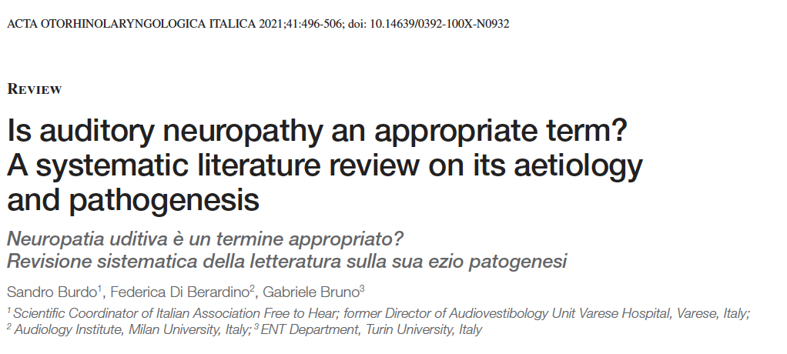
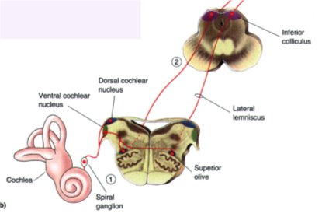
2021
Inner ear disease
CCI or synapses
Auditory neuropathy
Central
Auditory Processing Disorders
Prevalence in children is around 2-3%
M:F= 2:1
Chermak & Musiek, 1997; Palfery & Duff, 2007

Slide 4
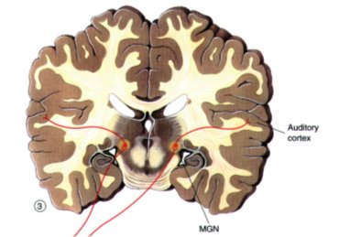
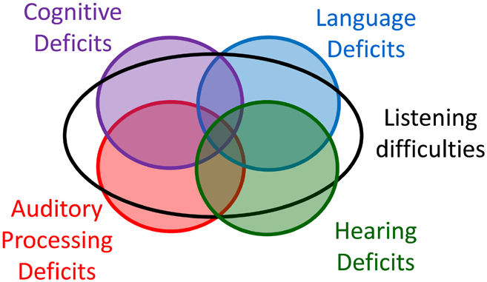
2021
Inner ear disease
CCI or synapses
BUT
«a similar deficit has not to be observed in
response to stimuli in another sensory modality, such as vision»
(Cacace & McFarland 1998)
Central auditory processing
deficit

Slide 5

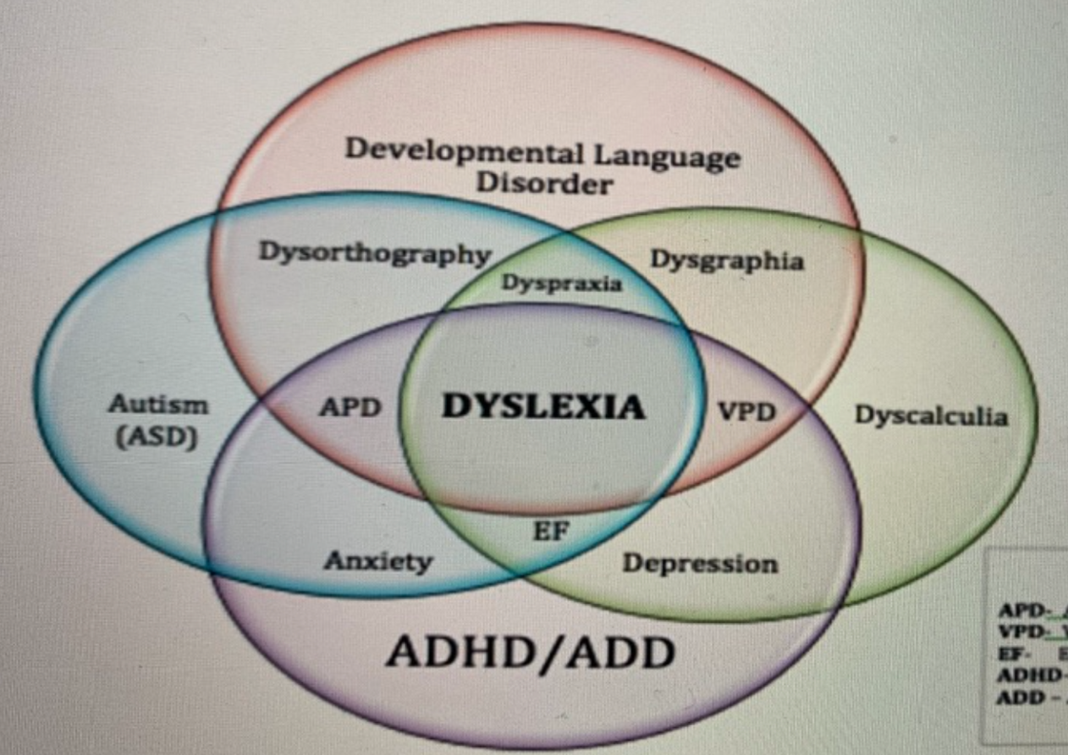
Central Auditory Processing Disorders (cAPD) is a quantitative and/or qualitative disorder in auditory processing abilities in normal hearing children
Atypical difficulty in understanding speech or other auditory stimuli, often for unknown reasons
Dawes & Bishop 2010; Moore 2012; Ankmnal-Veeranna et al. 2019;
Boothalingam et al. 2019; Moore et al. 2020a
Central auditory processing disorder
replaced by the term
LISTENING DIFFICULTIES
APD: Auditory Processing Disorders
VPD: Visual Processing Disorders
EF: Executive Functions
ADHD: Attention Hyperactivity Disorder
ADD: Attention Deficit Disorder
Moore, D. R. (2018). Challenges in diagnosing auditory processing disorder. Hear J, 71, 32–34
American Speech-Language-Hearing Association. (Central) auditory processing disorders, technical report: Working group on auditory processing disorders. Retrieved January 3, 2018, from https://www.asha.org/policy/TR2005-00043/

Slide 6

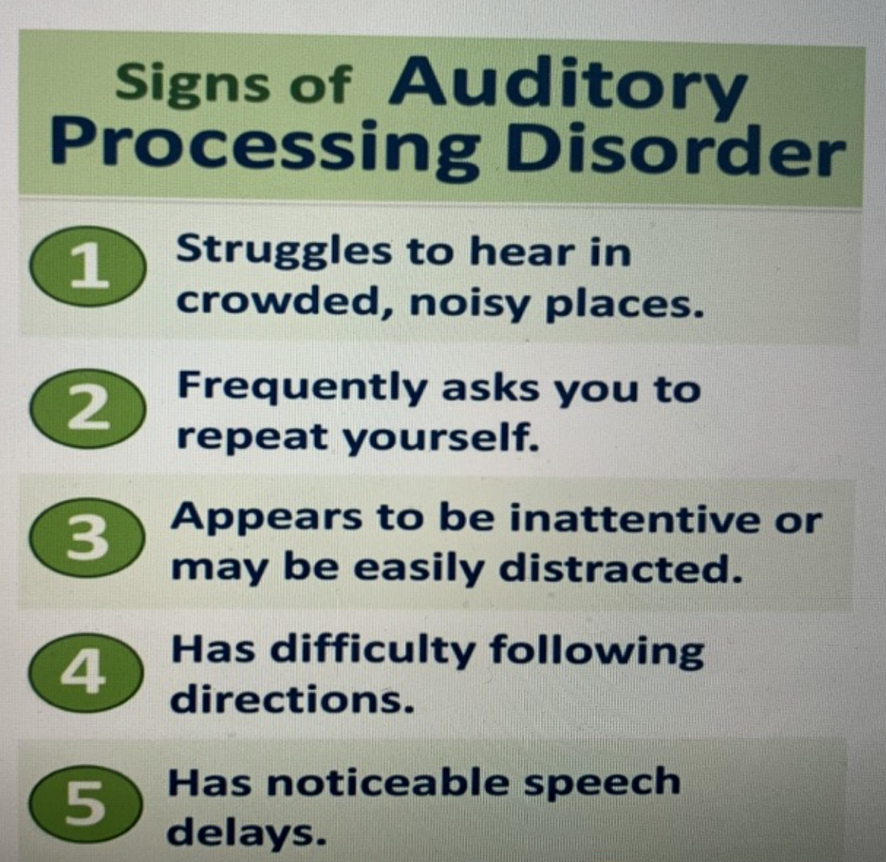
Staggered Spondaic Word (SSW) test
Staggered Spondaic Word (SSW) test
The assessment diagnostic protocol of cAPD
PTA vs SPEECH in quiet (WRS- SDS)
Low values at SPEECH IN NOISE tests compared to normal peers
BINAURAL CUES:
    Localization test
    Dichotic digit test
LINGUISTIC, PHONENIC and TEMPORAL patterns
    Discrimination, comprehension and executive functions
    Staggered spondaic word test
    Frequency and duration pattern, gap in noise (GIN) test
Acoustic evoked potentials (ABR – SVR – phoneme)
Notes:
It works by presenting two-syllable words (spondees) where the first half is in one ear and the second half is in the other, in a staggered fashion, to test how well the brain can process and integrate auditory information from both ears
The Gaps In Noise (GIN)© test is an auditory processing disorder test for ages 7 and older using non-verbal stimuli. It is designed to measure temporal resolution. Temporal resolution refers to the ability to detect changes either in the duration of an auditory stimulus and/or the time intervals or gaps of silence embedded within an auditory stimulus. The ability to detect small silent intervals is an important factor in speech perception. This GIN test is a valuable test for the evaluation of this ability.
The GIN test is composed of a series or lists of noise bursts which contain various intervals of silence. The recording consists of four forms called lists plus a shorter practice list to ensure the patient understands the task. The silent intervals vary from 0 (i.e. no gap) to 20 msec. The gaps, or periods of silence, are 2, 3, 4, 5, 6, 8, 10, 12, 15 or 20 msec. There are a total of 60 randomized gaps (6 of each gap) in each list (series). Administration time is approximately 35 minutes. To facilitate accurate scoring the recording is two channels, one being the test track, the other, for the examiner, indicates with a brief tone when the gap occurs in the other (test) track.

Slide 7
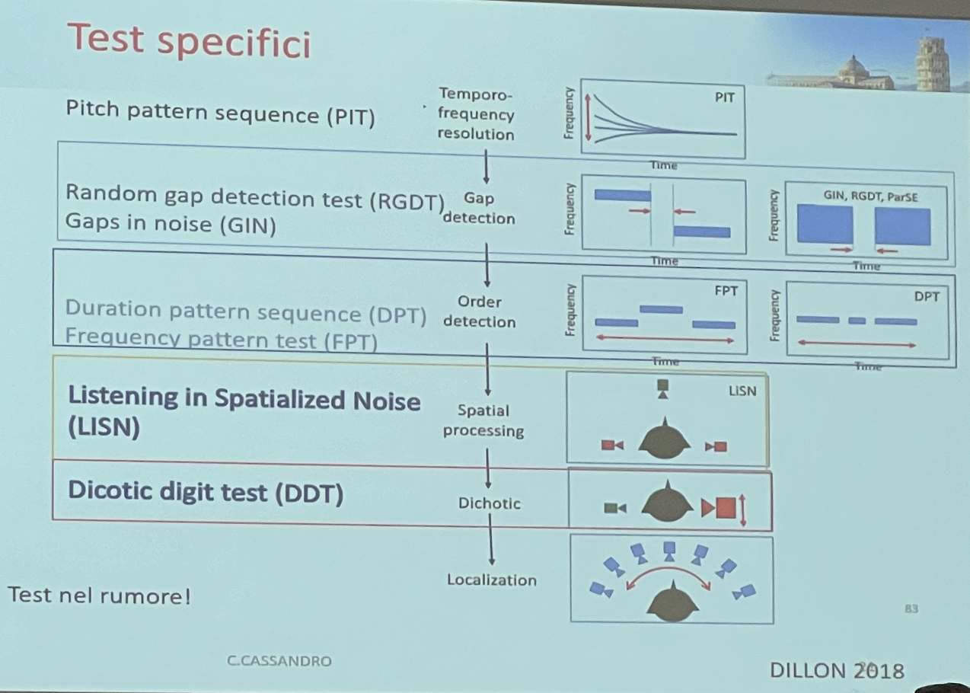
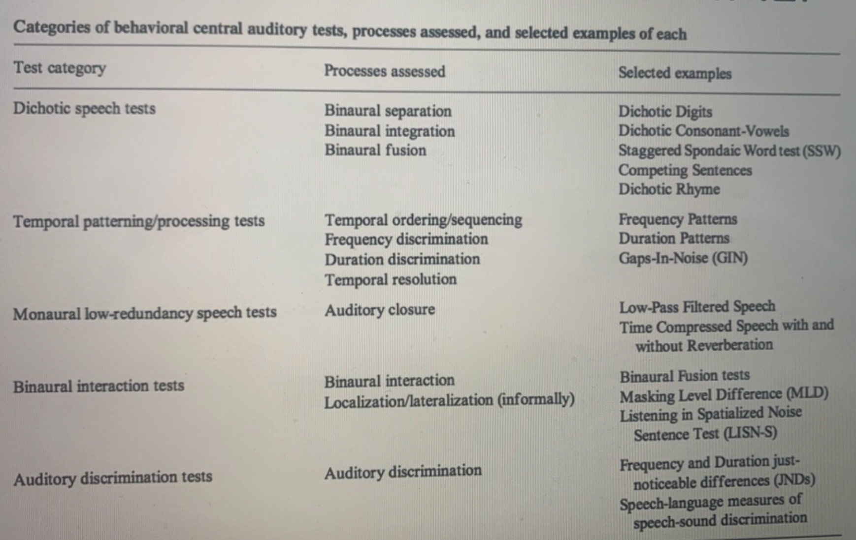
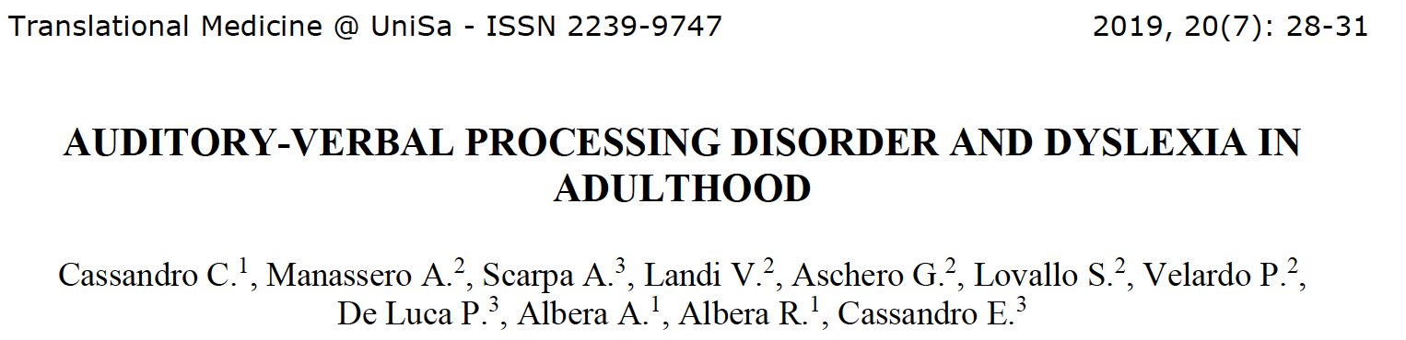
SIAF 2023 – Cassandro C.
SRT/PTA dissociation (Matrix at least 3 dB or more than expected)
Repetition of nonwords without lip reading
Spelling speed < 4th percentile
Fusion test < 5th percentile

Slide 8
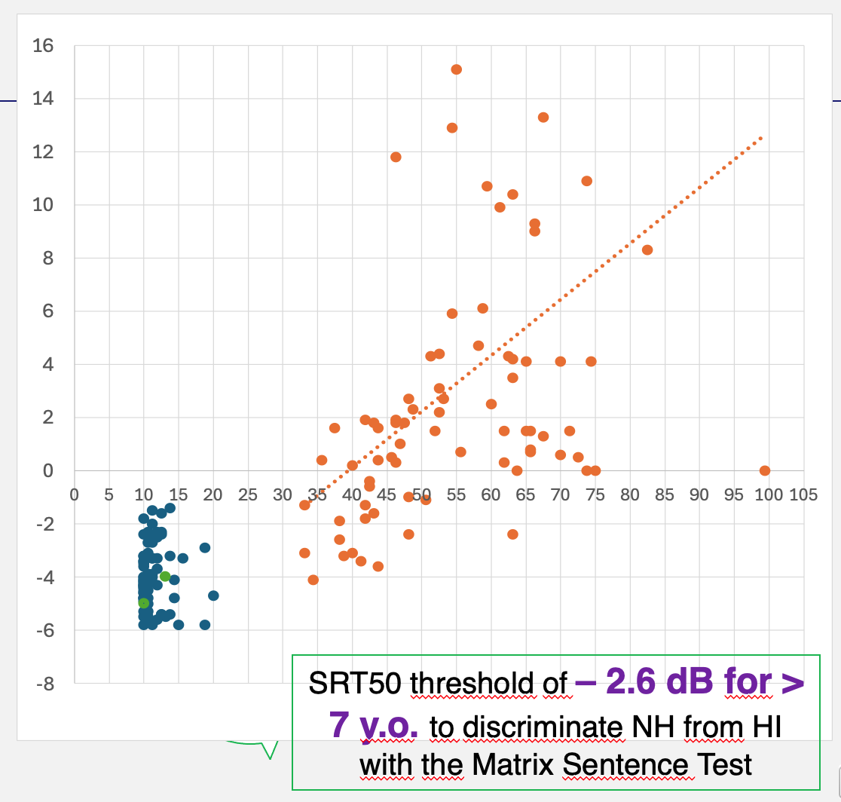
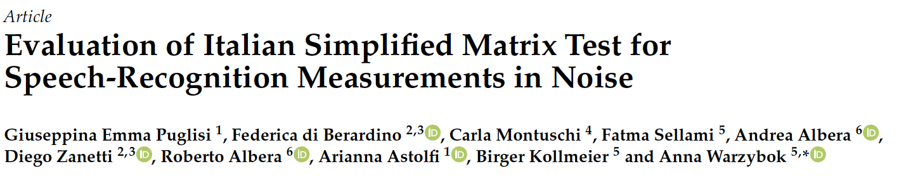
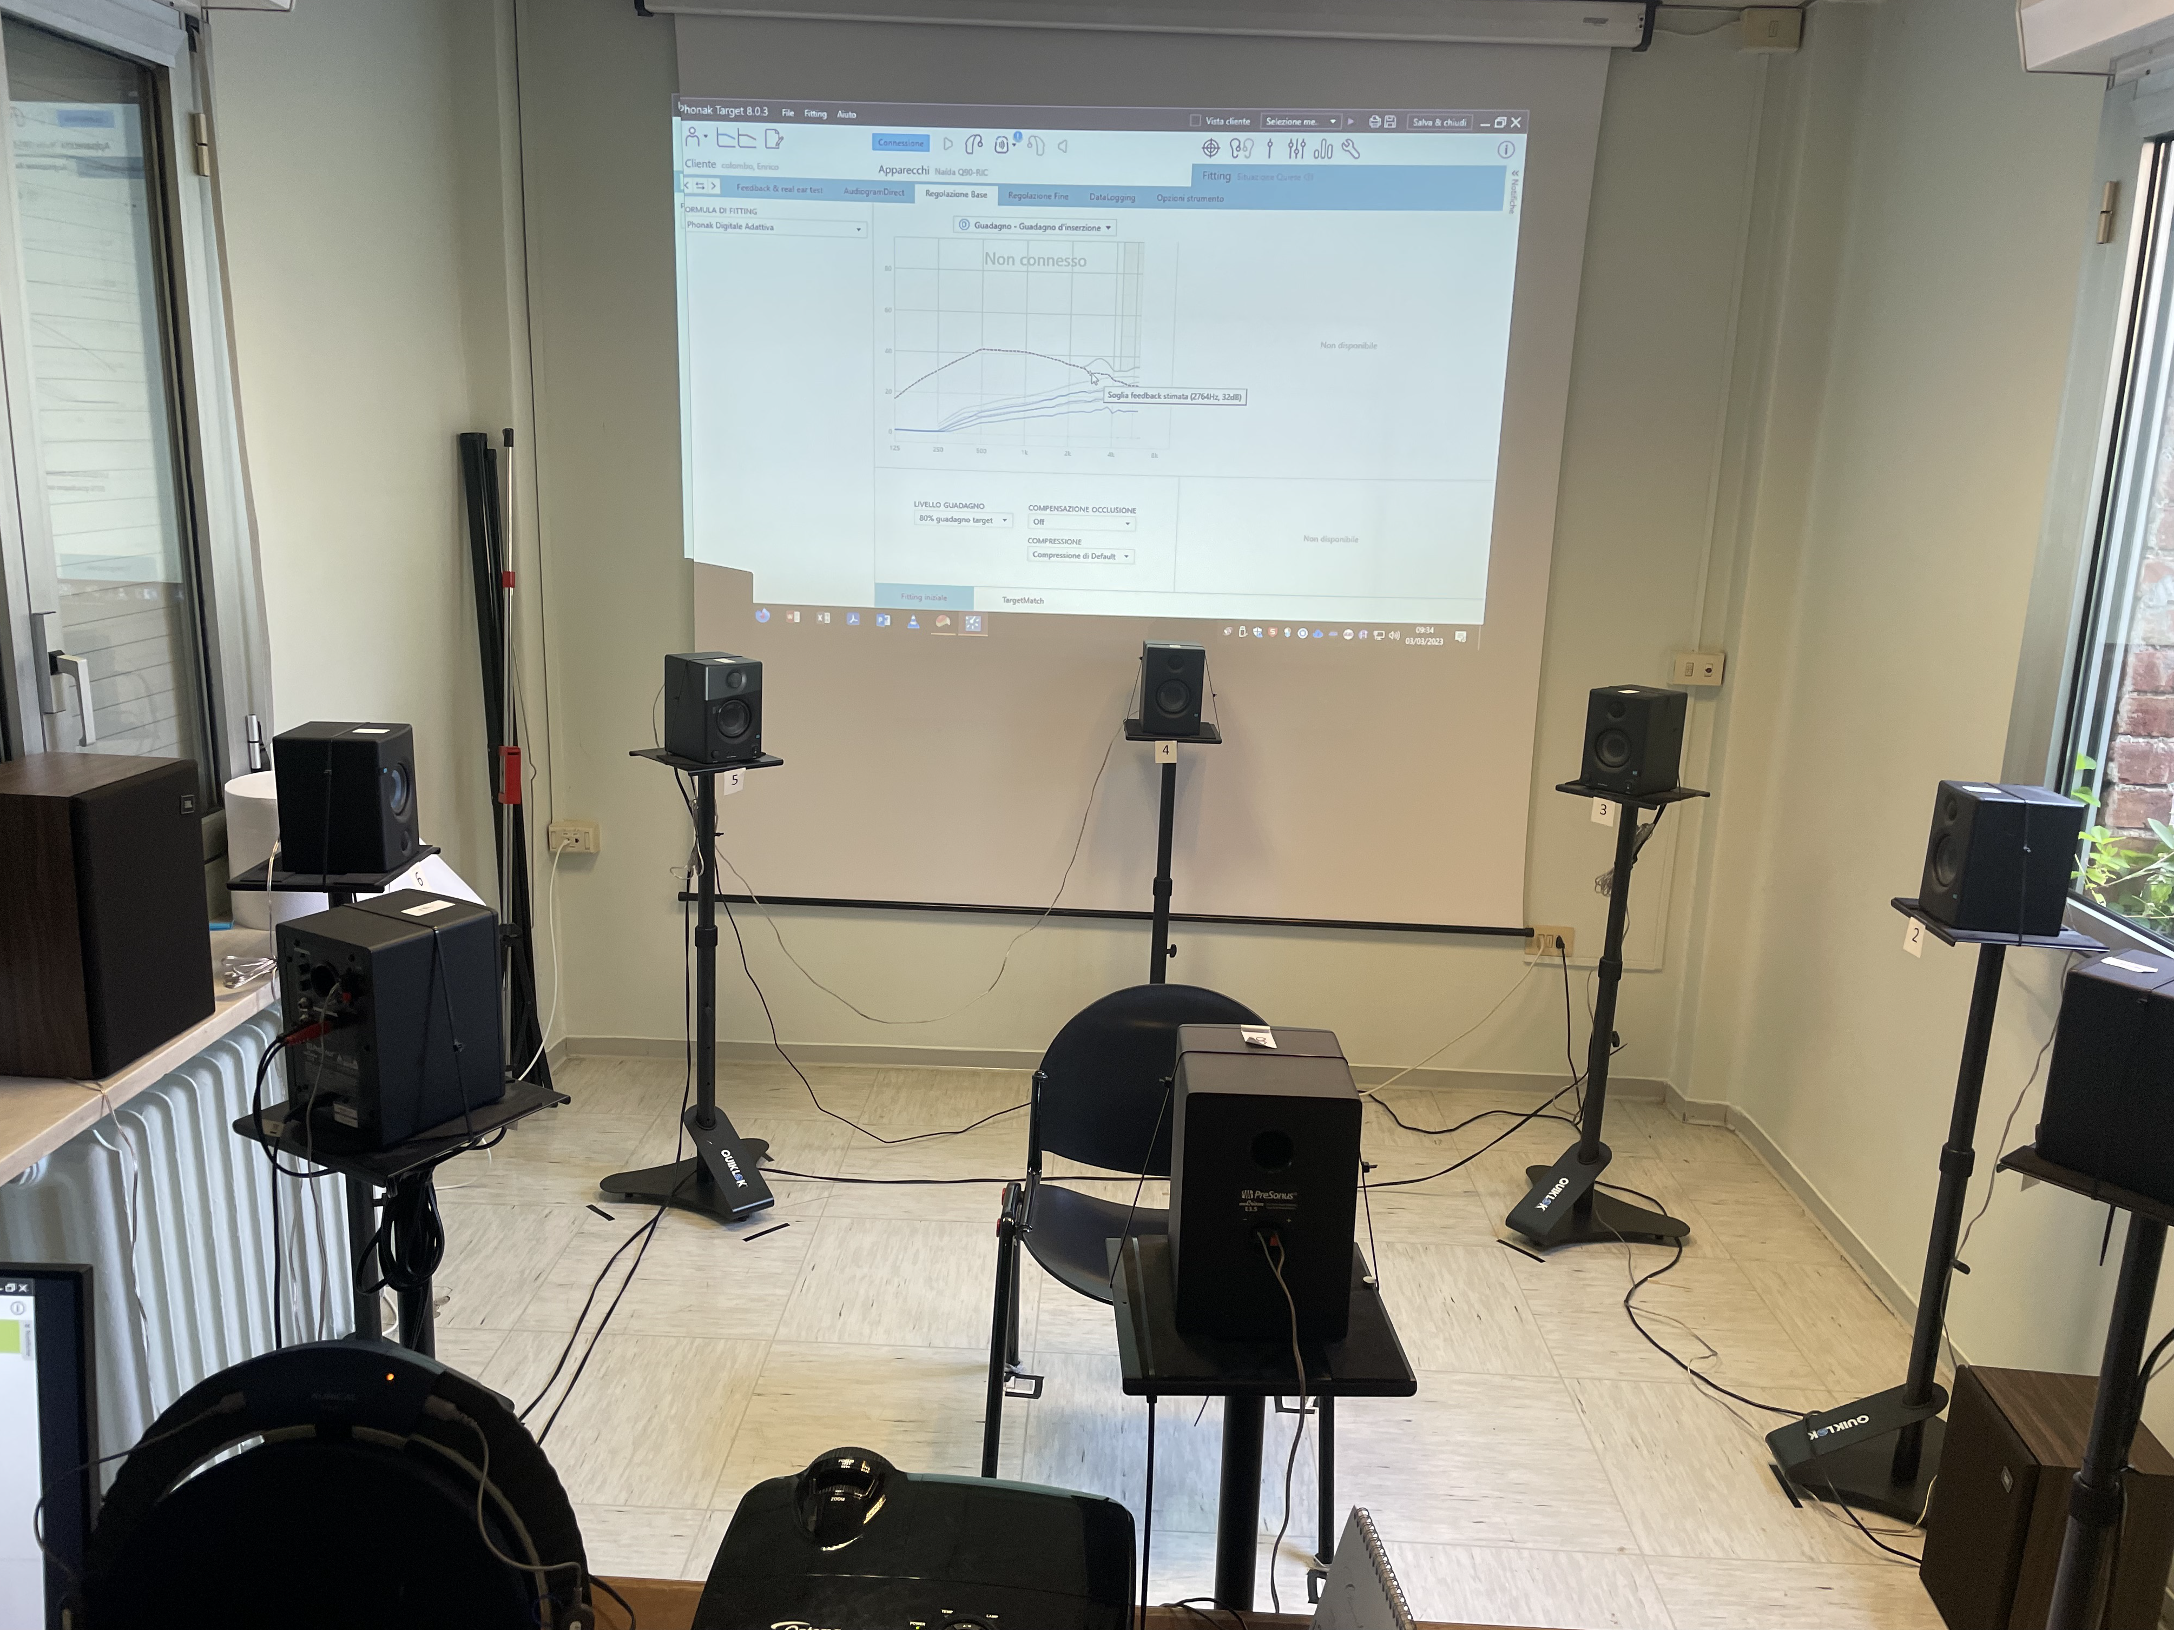

SRT/PTA dissociation
Assessment with the SiiMAx
Temporal discrimination (Gap in noise test)
Frequency tests (A§§E – test with music – speech therapist tests)
Localization test with words and sounds (360°)
Dichotic digit test (DDT)
Acceptable noise level
<7 or >11

Slide 9
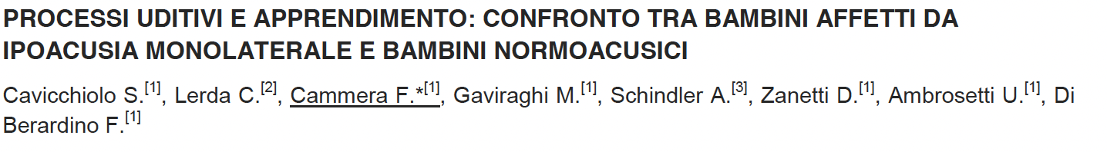
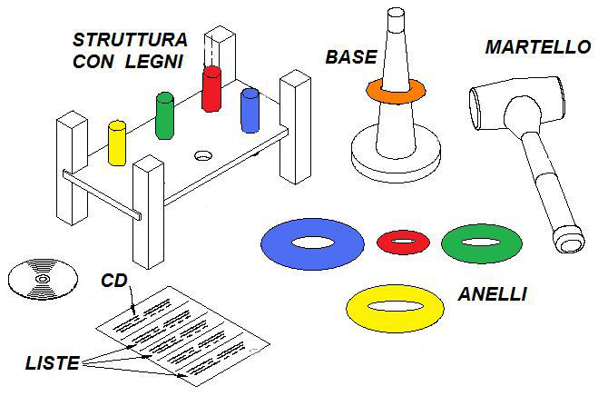
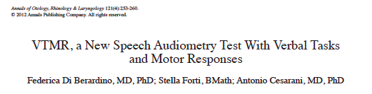
Speech therapist tests
SIAF 2017
Assessment
BVN 5–11 for:
- auditory discrimination, nonword repetition, phonemic analysis, phonemic fusion, word writing, nonword writing, and dictation in noise.
- S.I.F.T.E.R. and SANDERS questionnaires to quantify reported disability in school, family, and home settings.
Screening test

Slide 10
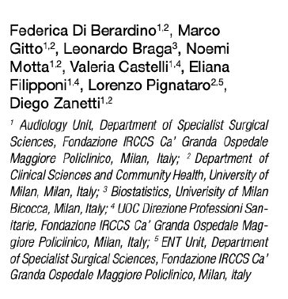
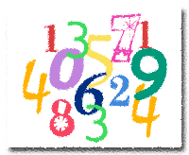
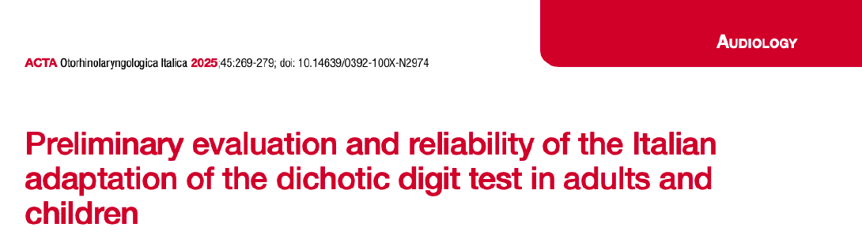
2025
DICHOTIC DIGIT TEST
ITALIAN VERSION
Left Right
1 - 4 2 - 8
4 - 7 5 - 9
2 - 5 6 - 10
9 - 8 10 - 4
6 - 9 1 - 7
9 - 4 8 - 5
10-2 9 - 1
5 - 1 4 - 6
7 -10 5 - 8
8 - 6 7 - 2
%CD Musiek
%CD italiano
5 lists
(8 sec – pause 4 sec)
Total time: 2 minutes
età
DX
SX
DX
SX
7
70%
55%
76,4%
53,9%
8
75%
65%
77,4%
70,9%
9
80%
75%
80,7%
72,2%
10
80%
78%
96,2%
85%
40 numers
n° correct answers x 2.5= 100% per each side
Intraclass correlation: 0.89
Notes:
Diversità di fase tempo ed intensità

Slide 11
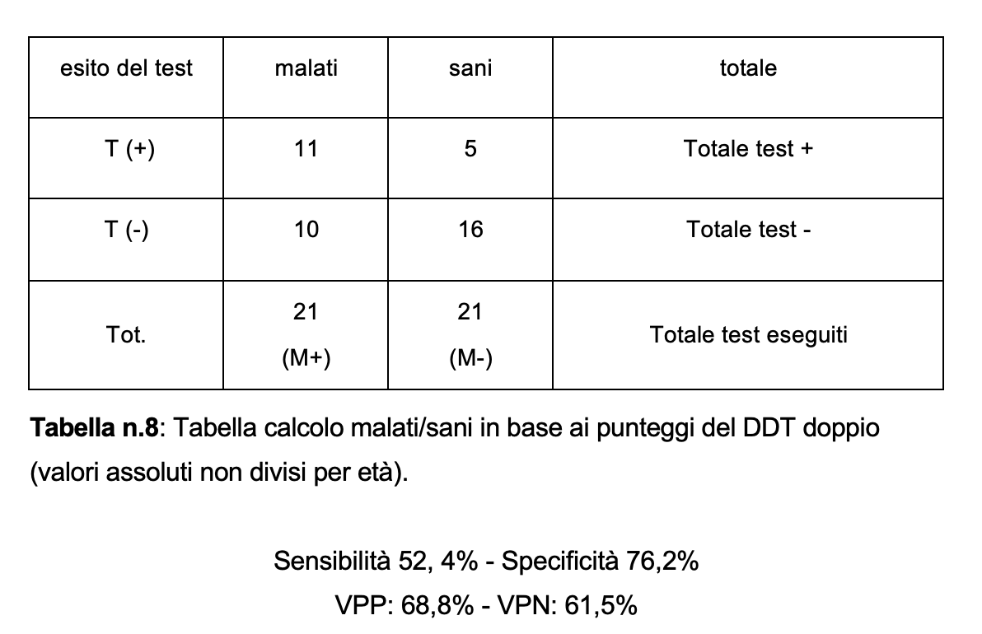
n=21 APD children, 6-10 anni

Slide 12

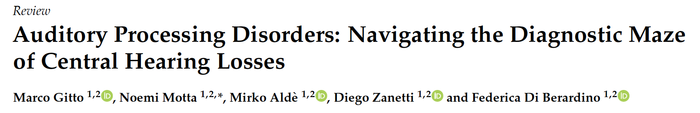

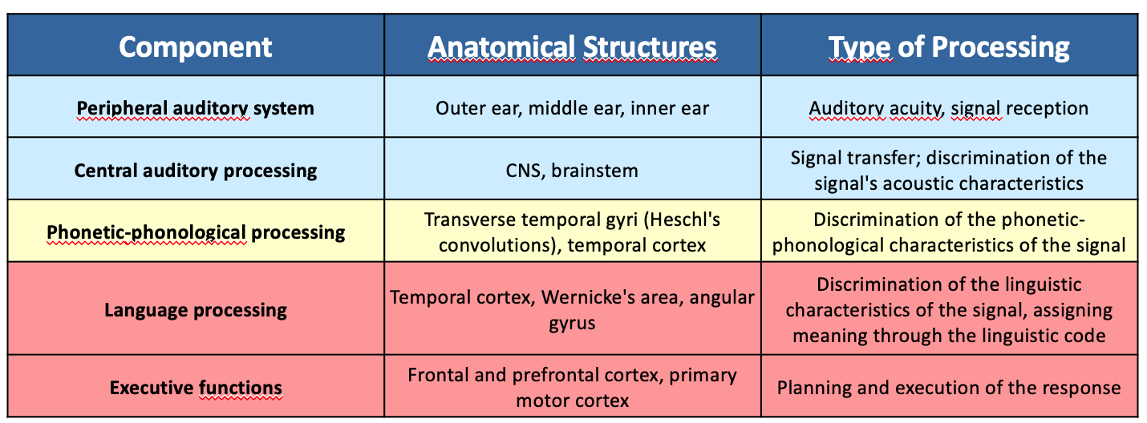
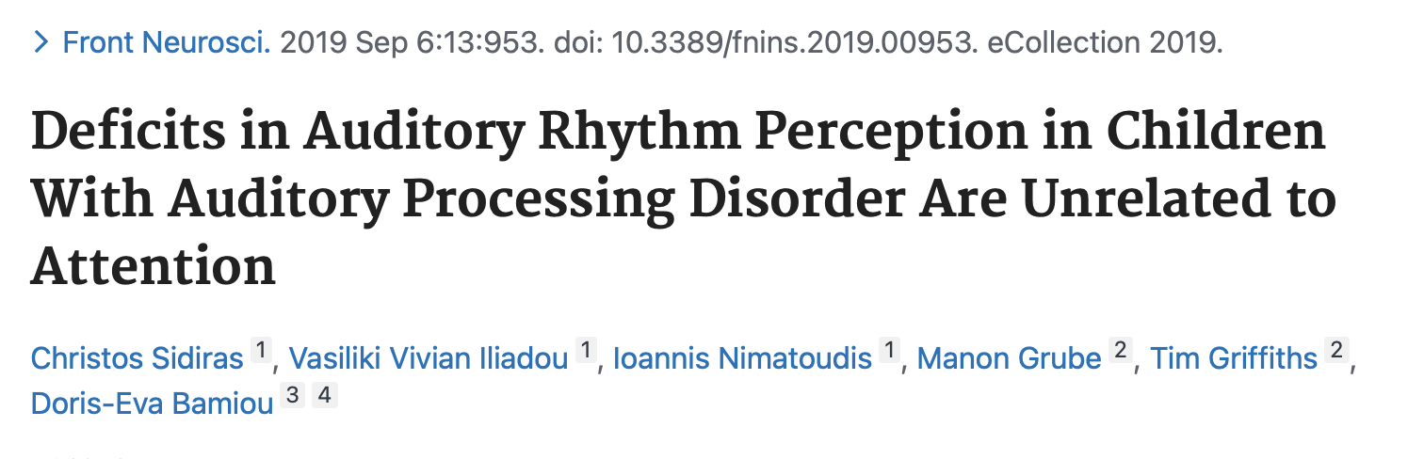
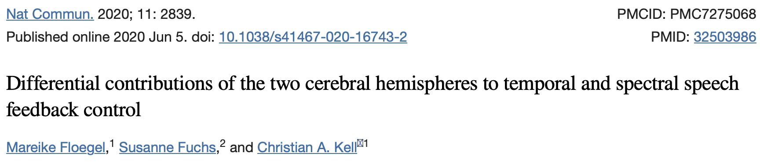
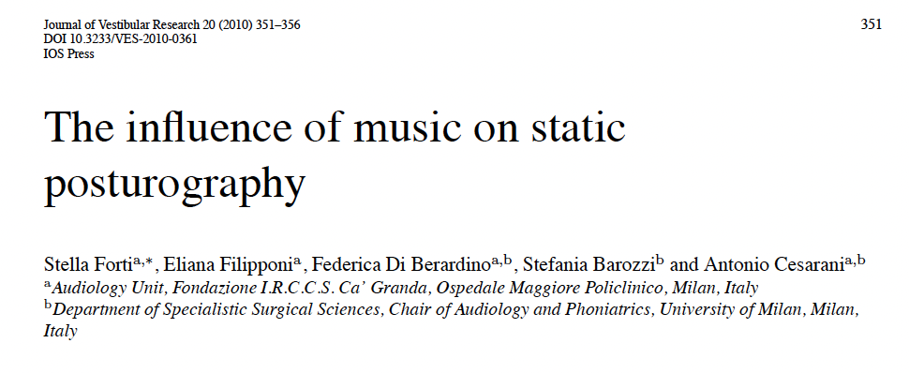
Assessment of central auditory processing disorder
THERAPY
Gail J. Richard Hierarchical Model
MUSIC
«the authors reveal that the left hemisphere preferentially controls temporal speech features while the right hemisphere controls speech by analyzing spectral features of the auditory feedback»

Slide 13
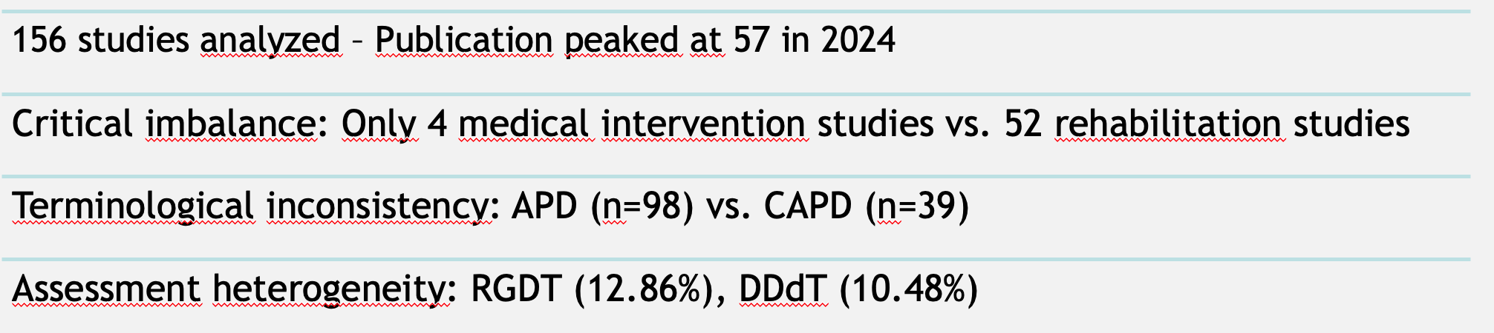
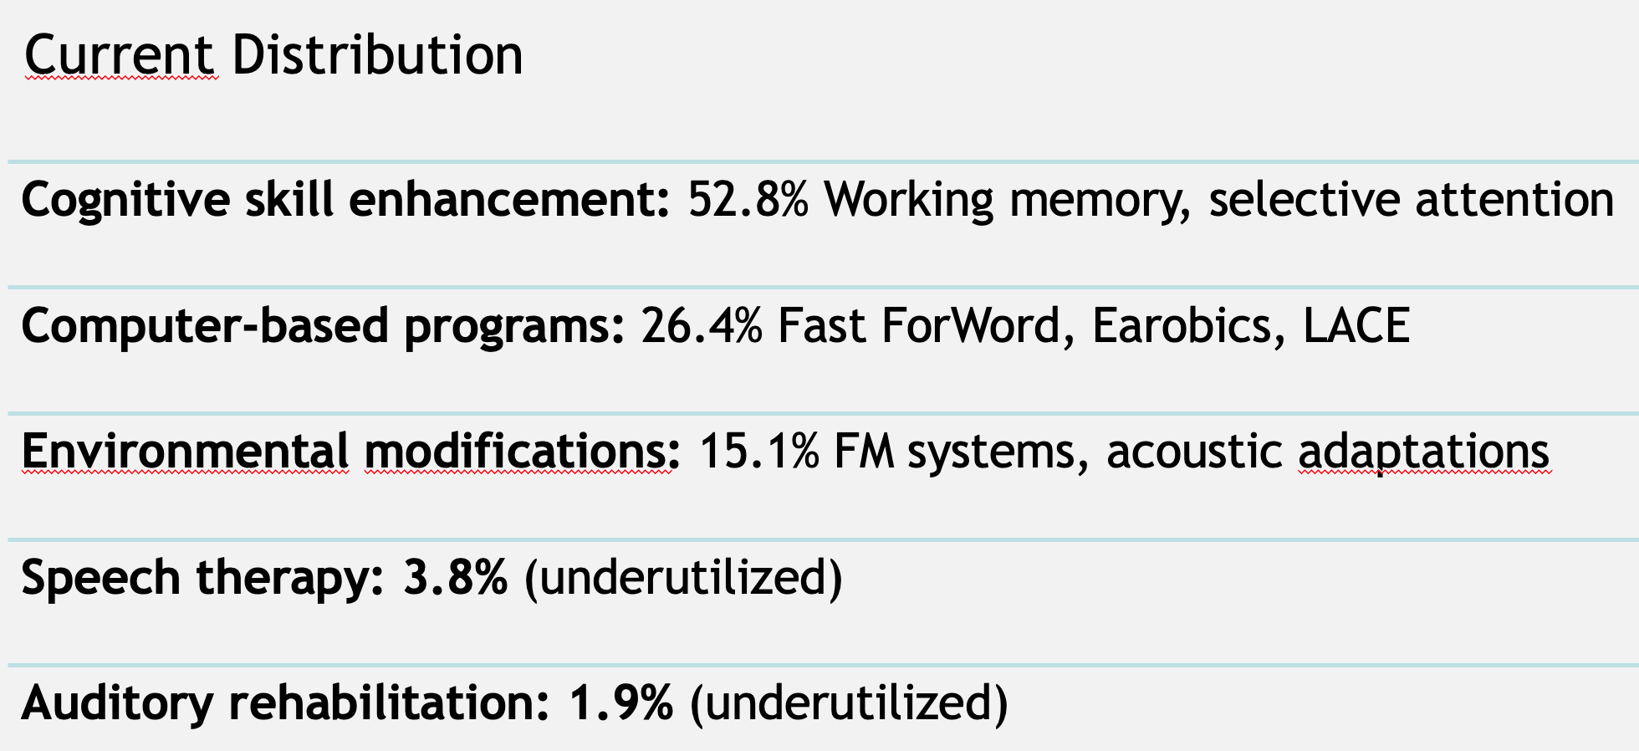
APD Research 2011-2025
Main problem: Absence of unified diagnostic criteria slow down evidence-based intervention development
Lack of clear assessment
Large variation in therapeutical protocols not based on an audiological assessment
Gitto, M., Motta, N., Aldè, M., Zanetti, D. and Di Berardino, F., 2025. Auditory Processing Disorders: Navigating the Diagnostic Maze of Central Hearing Losses. Journal of Clinical Medicine, 14(7), p.2256.

Slide 14


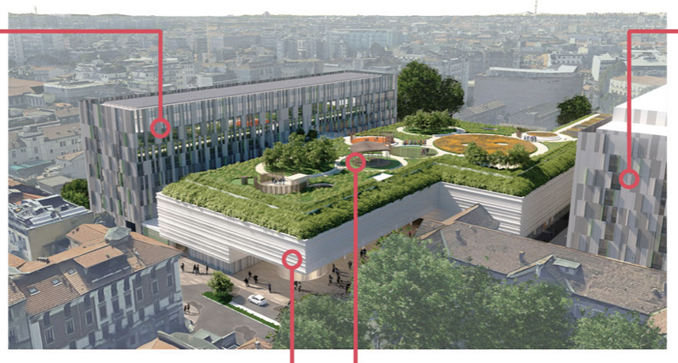
Dal 1465
audiologia@policlinico.mi.it
Policlinico oggi
Thank you for you kind attention!

