Slide 1




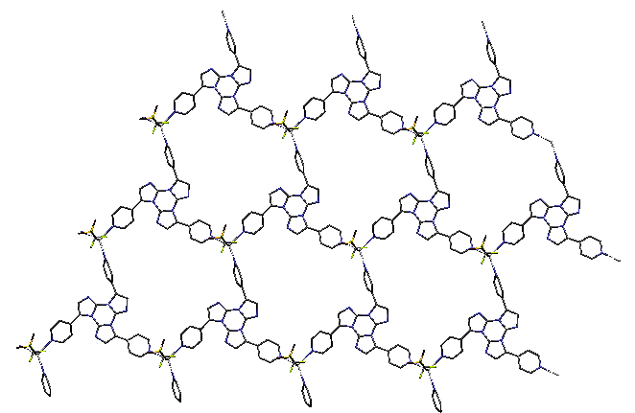
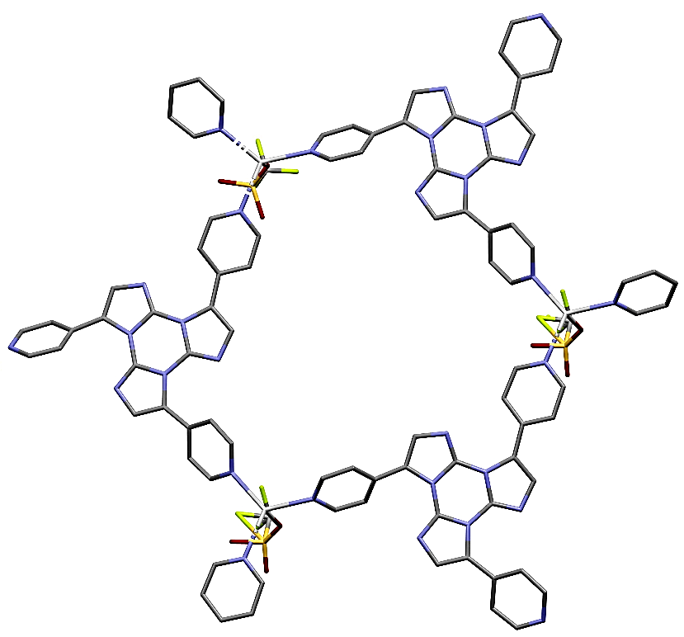
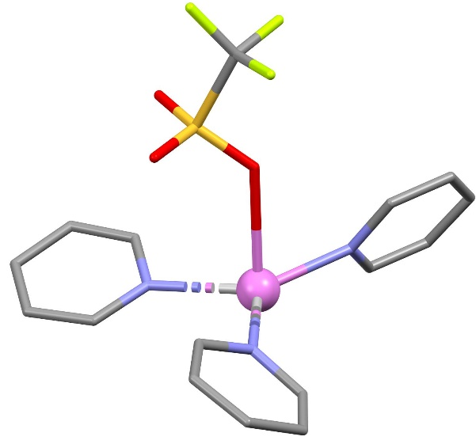
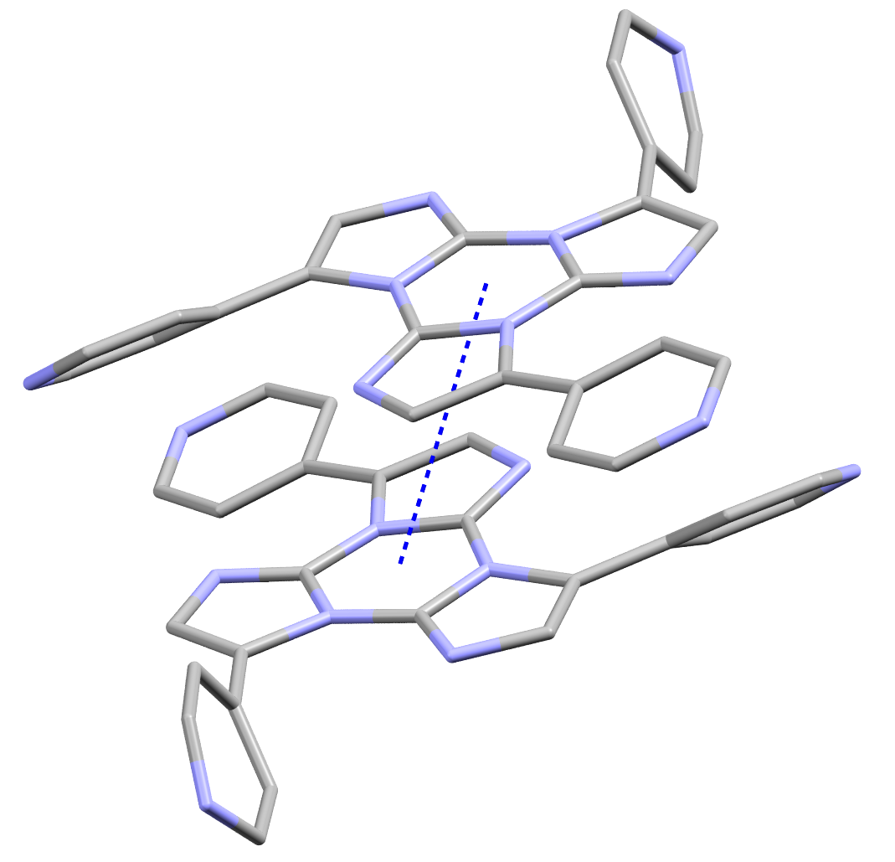


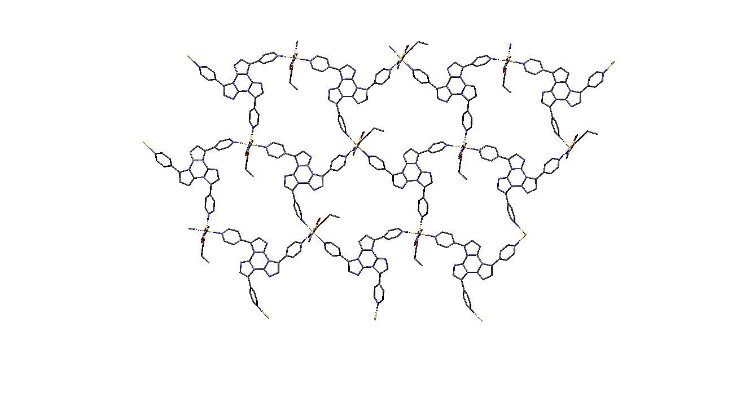
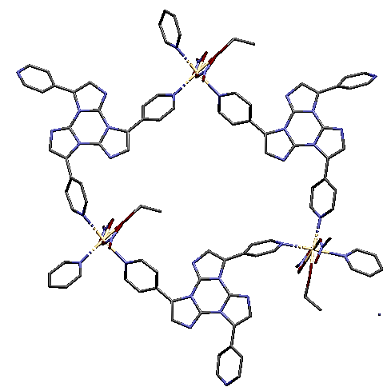
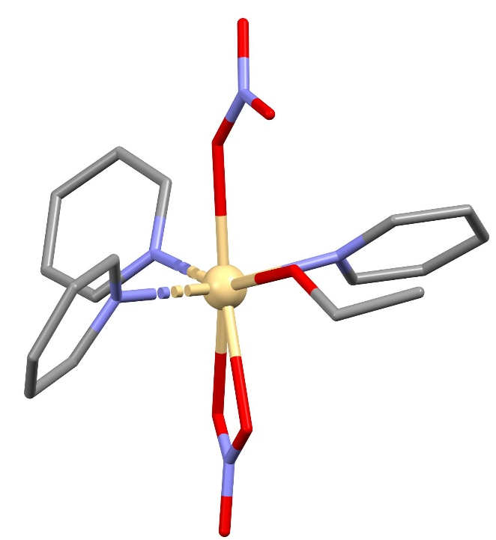
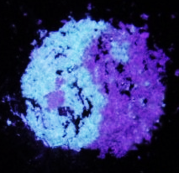
Layered Luminescent Ag(I) and Cd(II) Coordination Polymers (LCPs) assembled from a new tri-pyridyl Cyclic Triimidazole ligand
D. Blasi,ª M. Formenti, ª D. Malpicci,ª E. Cariati,ª E. Lucenti, ª and L. Carlucci,^{*a}
ªDipartimento di Chimica, Università degli Studi di Milano, Via C. Golgi 19 ,20133, Milano, Italy e-mail: delia.blasi@unimi.it
Introduction
Luminescent metal-organic frameworks and coordination polymers (LMOFs and LCPs)¹ are a class of very interesting materials that have drawn great attention thanks to their properties. They find application in fields such as the development of biological sensors and light-emitting devices. For these reasons, nowadays, the design of new LCPs is a very active and challenging research area. In this work, we report the synthesis of a new derivative of the cyclic triimidazole (TT)² molecule, an already known organic scaffold with very interesting luminescence properties. The new ligand (4py)₃TT, brings three pyridyl donor groups oriented with a trigonal symmetry and its reactivity has been explored toward the closed-shell Cd(II) and Ag(I) metals. Reaction of (4py)₃TT with silver(I) triflate and cadmium(II) nitrate allow us to isolate two new LCPs, [Ag((4py)₃TT)(CF₃SO₃)] (1) and [Cd((4py)₃TT)(NO₃)₂(EtOH)] (2). Compounds 1 and 2 have been characterized by SCXRD, XRPD, IR and photoluminescence spectroscopies. Intriguingly, compound 2 shows mechanochromic luminescence.
Synthesis of the ligand and of new Luminescent Coordination Polymers (LCPs)
The ligand (4py)3TT
Synthesis of new LCPs
XRPD and IR characterization
AgCF₃SO₃
[Ag((4py)₃TT)(CF₃SO₃)]
1
Microcrystalline powders of 1 and 2 have been obtained by reacting at room temperature overnight the proper precursors in, respectively, DCM/MeOH 1:1 and ethanol. The obtained bulk materials have been characterized by XRPD and IR spectroscopy.
RT, slow diffusion
Cd(NO₃)₂ ·4H₂O
[Cd((4py)₃TT)(NO₃)₂(EtOH)]
2
120°C, solvothermal conditions
XRPD
(4py)₃TT has been prepared through Suzuki cross-coupling between Br₃TT³ and 4-pyridinylboronic acid. The product has been purified by flash chromatography followed by precipitation.
Single crystals of 1 have been obtained at rt in few days by slow diffusion of a methanolic solution of silver(I) triflate into a ligand solution (DCM/MeOH 1:1). Single crystals of 2 have been isolated under solvothermal conditions (120°C, 72h) reacting (4py)₃TT with Cd(NO₃)₂ in EtOH.
Structural analysis
Compounds 1 and 2 crystallize, respectively, in P-1 and P2₁/c SGs. Both structures contain very similar 2D motifs of hcb topology. As expected, the ligand act as a trigonal donor, bridging through the pyridyl nitrogen atoms three different metal ions. Each metal atom results coordinated to three different ligands. The coordination sphere of tetrahedral silver atoms in 1 is completed by a triflate anion. In 2 the Cd ions are further coordinated to an ethanol molecule and to two nitrate anions giving a 7-coordinate environment
IR spectroscopy
1
1
2
.
ν S-O
ν N-O
In both 1 and 2, the layers stack parallel with an offset and the overall frameworks are stabilized by the presence of π-π interactions involving the cyclic triimidazole moiety of the ligand molecules. However, in 1 the layers stack along the [1 1 -1] direction and interact in pairs through such interactions; in 2 the stacking direction is [1, 0, -2] and adjacent layers are all involved in π-π interactions generating a columnar arrangement of the triimidazole fragments.
2
Comparison of IR spectra of the free ligand (black) with those of 1 (pink) on the left and of 2 (green) on the right.
Photoluminescence spectroscopy
(4py)₃TT)
Powders
(4py)₃TT)
Heated at 383 K for 1h
[Cd((4py)₃TT)(NO₃)₂(EtOH)]
Solid-state photoluminescence studies of the new ligand and of both 1 and 2 reveal the presence of one molecular fluorescence and one molecular phosphorescence associated with radiative deactivation from S₁ and T₁, respectively. Moreover, a low energy phosphorescence appears in the spectra of all solid compounds. This latter is probably associated with the solid-state aggregates generated through π-π interactions present in 1 and 2 and, presumably, in the ligand itself for which, despite many attempts, no single crystals suitable for SCXRD have been obtained so far.
Luminescence stimuli responsiveness of the ligand (temperature) and 2 (grinding) has been proven.
Powders – 298 K
After grinding – 298 K
[Ag((4py)₃TT)(CF₃SO₃)] – 298 K
298 K
τ_{av}=0,94 ns
τ_{av}=1,91 ns
τ_{av}=1,67 ns
τ_{av}=13,53 ms
τ_{av}=8,03 ms
τ_{av}=7,46 ms
τ_{av}=41,07 ms
τ_{av}=55,66 ms
τ_{av}=44,16 ms
τ_{av}=1043,98 ps
τ_{av}=1,69 ms
77 K
τ_{av}=1101,62 ms
77 K
τ_{av}=4,80 ns
τ_{av}=5,81 ns
τ_{av}=23,45 ms
τ_{av}=21,02 ms
τ_{av}=1378,80 ms
τ_{av}=1343,50 ms
τ_{av}=3,52 ns
τ_{av}=58,02 ms
τ_{av}=1417,28 ms
Conclusions
In this work, we report the synthesis of a new ligand, (4py)₃TT, whose reactivity has been explored toward Ag(I) and Cd(II) closed-shell metals. Two new luminescent coordination polymers, [Ag((4py)₃TT)(CF₃SO₃)] (1) and [Cd((4py)₃TT)(NO₃)₂(EtOH)] (2), have been isolated and characterized. Compounds 1 and 2 show similar 2D networks, in which three ligand molecules coordinate three different metal atoms giving rise to a 2D motif of hcb topology. The resulting layers stack parallel with a different offset for 1 and 2, driven by the presence of π-π interactions between ligand molecules. The new ligand and both 1 and 2 have been characterized by photoluminescence spectroscopy, showing similar behavior for all solid compounds and proving the influence of the temperature for (4py)₃TT, and of the grinding for 2. A low energy phosphorescence associated with the solid-state aggregates is present in all compounds.
References
[1] Liu, JQ., Luo, ZD., Pan, Y., Singh, A.K., Trivedi, M., Kumar, A., Recent developments in luminescent coordination polymers: Designing strategies, sensing application and theoretical evidences. Coord. Chem. Rev. 2020, 406, 213145.
[2] Lucenti, E., Forni, A., Botta, C., Carlucci, L., Giannini, C., Marinotto, D., Previtali, A., Righetto, S., Cariati, E., H-Aggregates Granting Crystallization-Induced Emissive Behavior and Ultralong Phosphorescence from a Pure Organic Molecule. J. Phys. Chem. Lett. 2017, 8, 1894-1898
[3] Lucenti, E., Forni, A., Botta, C., Carlucci, L., Giannini, C., Colombo, A., Marinotto, D., Previtali, A., Righetto, S., Cariati, E. The Effect of Bromo Substituents on the Multifaceted Emissive and Crystal-Packing Features of Cyclic Triimidazole Derivatives, ChemPhotoChem 2018, 2, 801 – 805.

