Slide 1
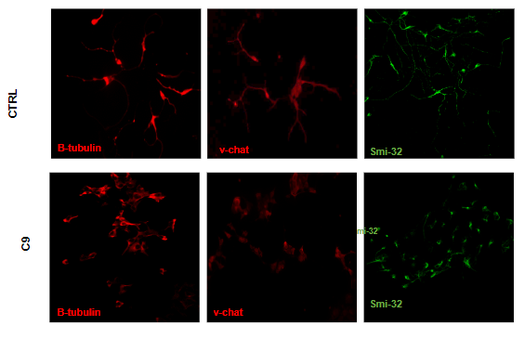
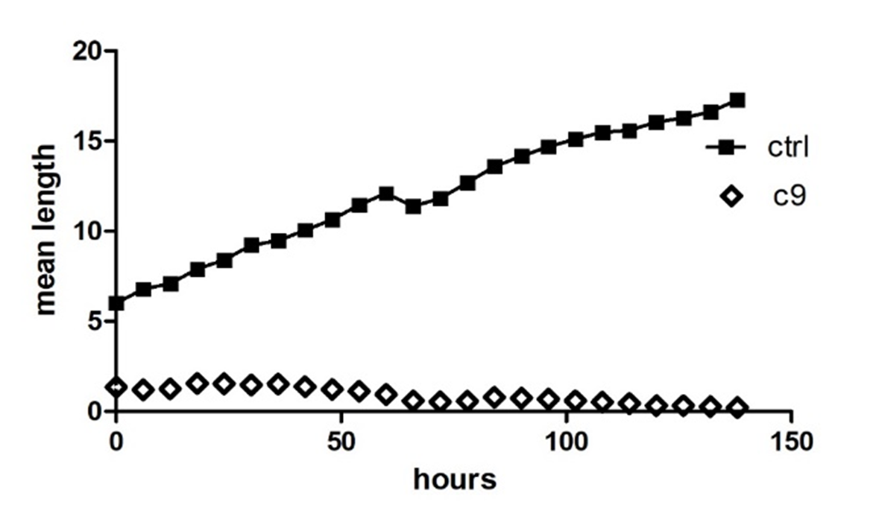
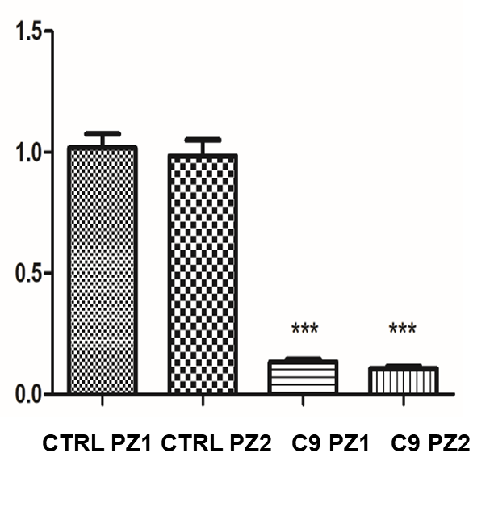
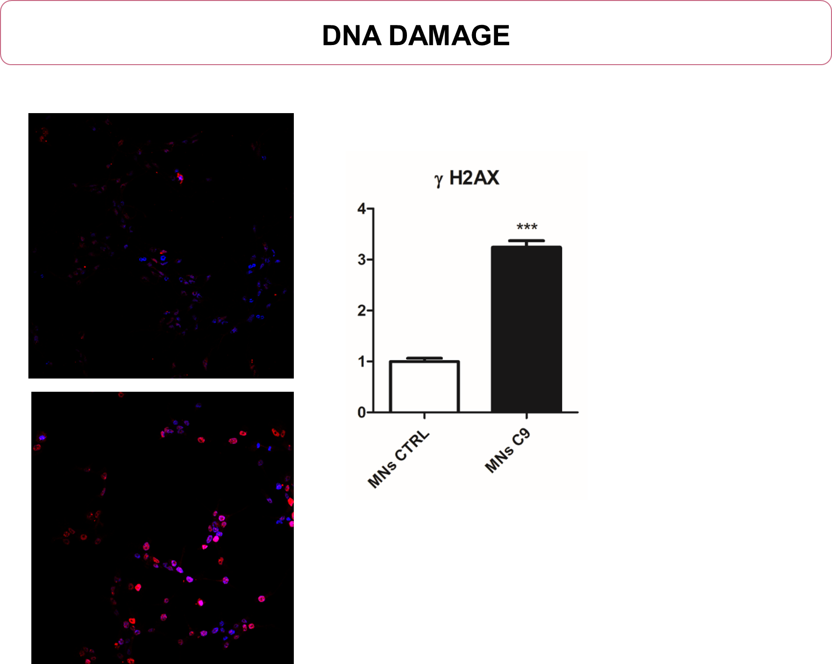
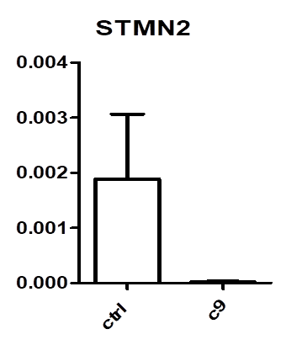
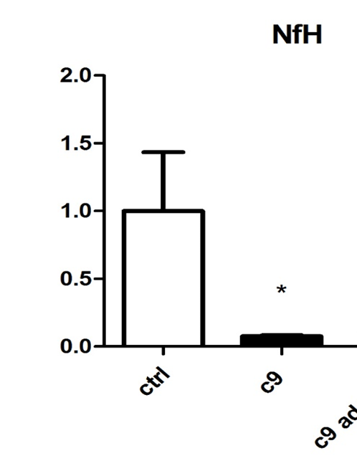
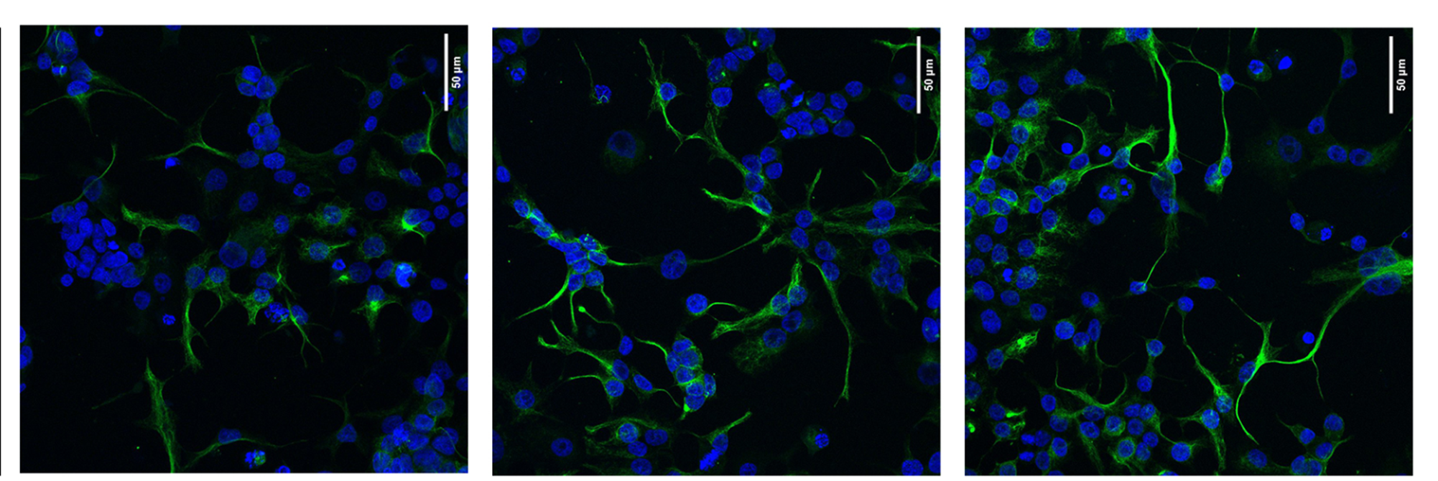
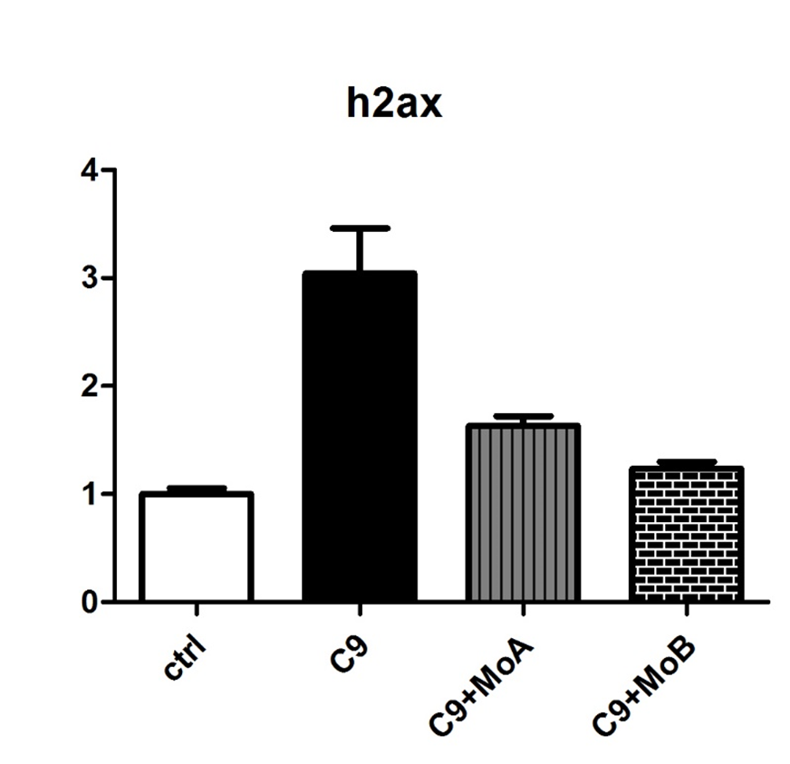
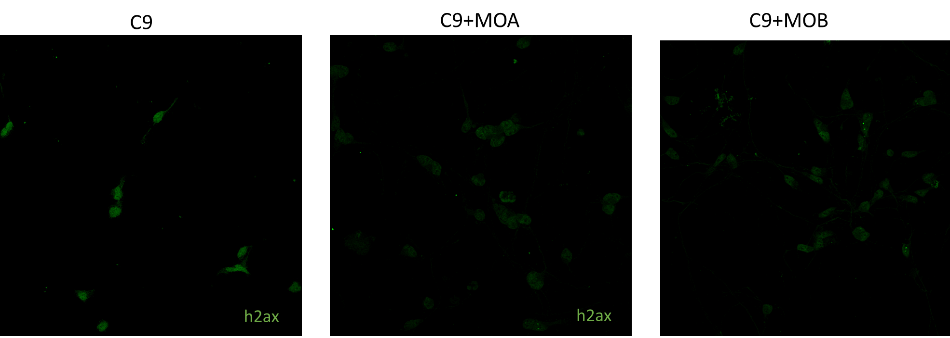
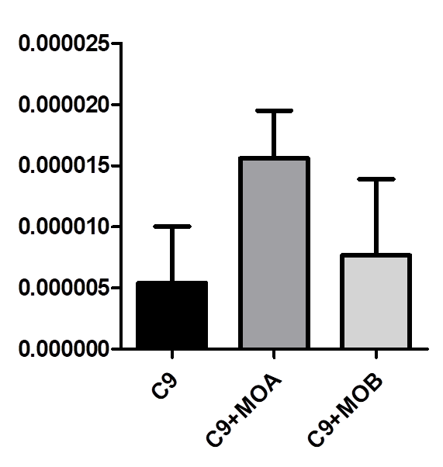
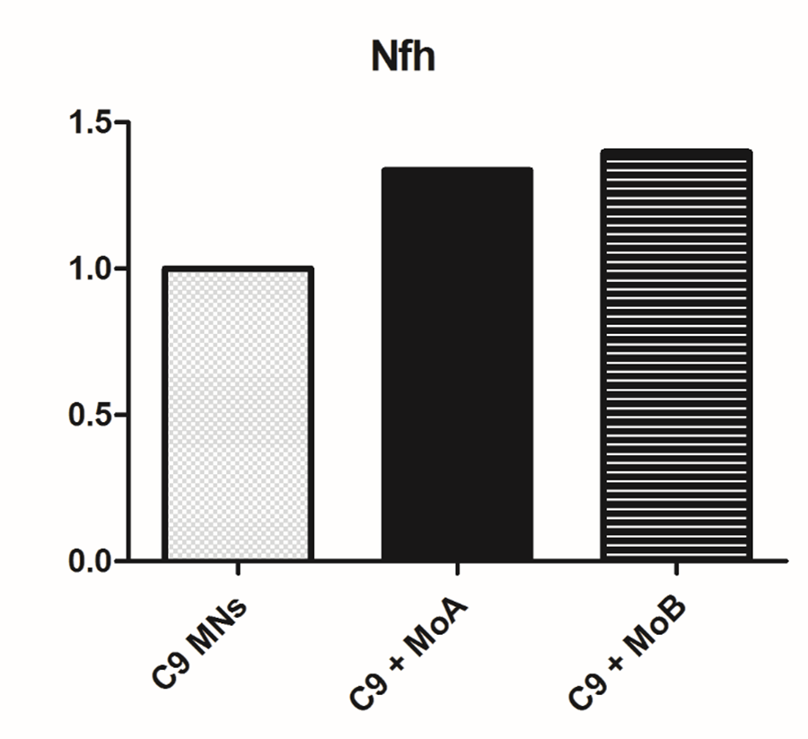
Changes in pathological phenotype of C9orf72 ALS iPSC-derived lines after treatment with Morpholino oligomers
19
M.BERSANI¹, M.TAIANA¹, F.BIELLA¹, M.NIZZARDO², S.GHEZZI², N.BRESOLIN², G.COMI², S.CORTI²
1 Department of Pathophysiology and Transplants, University of Milan
2 IRCCS Ca’ Granda Foundation, Ospedale Maggiore Policlinico Milano
BACKGROUND
Amyotrophic lateral sclerosis (ALS) is a fatal disorder characterized by progressive degeneration of motor neurons (MNs). GGGGCC repeat expansions in C9ORF72 gene are the most common identified genetic cause. Many possible mechanisms have been proposed, including loss of function of the C9Orf72 protein, gain of function from accumulation of RNA foci and sequestration of RNA binding proteins (RBPs), and toxicity caused by dipeptide repeats proteins (DPRs)
C9 iPSCs-DERIVED MNs CHARACTERIZATION
AXONAL LENGHT
Fig.1:C9 iPSC-derived MNs showed significant impairment of axonal elongation
MATERIALS AND METHODS
From patient-specific induced pluripotent stem cells (iPSC) we differentiated Motor Neurons (MNs) lines. We characterized the generated lines by immunostaining and qPCR. Our therapeutic approaches include the use of antisense oligonucleotides (ASOs) with Morpholino chemistry: MoA; against the C9ORF72 expansion motif and MoB, against the whole C9ORF72 gene. The efficacy of these therapy has been tested using specific antibodies and evaluating gene expression
Fig.3: C9 MNs show a strong decrease in axonal-related genes STMN2 and NfH levels in qPCR
h2ax
DNA DAMAGE
Fig. 2: C9 iPSC-derived MNs show an increase of DNA damage marker phospho-H2AX
MOLECULAR THERAPY: MORPHOLINO
h2ax
C9
C9+ MoA
C9+ MoB
Fig.8: immunostaining quantification analysis for h2ax confirms that MO treatment decreases expression of DNA damage proteins in iPSCs-derived MNs
CONCLUSIONS
DNA DAMAGE
iPSCs and iPSCs-derived MNs present some pathological hallmarks of C9ORF72-ALS, proving to be an useful patient specific model to study pathogenic mechansim of the disease and to test the efficacy of new therapies. Our preliminary data showed promising therapeutic potential for MOA and MOB.
AXONAL ELONGATION
STMN2
smi32
smi32
smi32
Fig.6: Mos rescue axonal elongation in C9 MNs and restore STMN2 and NfH expression
*
h2ax
This work is funded by Regione Lombardia (TRANS-ALS project) to GPC and Ministry of Health to GPC.

