Slide 1

UNIVERSITY OF MILAN
DOCTORATE SCHOOL IN CHEMICAL SCIENCES AND TECHNOLOGIES
AN INNOVATIVE APPROACH FOR HYDROPHOBIC SULFONATED POLYETHERSULFONE SUBSTRATES
V. Sabatini*, S. Checchia, G. Soliveri, H. Farina*, M. A. Ortenzi*, G. Di Silvestro*
Dipartimento di Chimica, University of Milan, Via Golgi 19-20133, Milan, Italy
*CRC Materiali Polimerici (LAMPO), Dipartimento di Chimica, University of Milan,
Via Golgi 19-20133 Milan, Italy
e-mail: valentina.sabatini@unimi.it
Notes:
1

Slide 2

STATE OF ART: Self-cleaning materials can be a optimal solution for covering solar cells, whose service life and efficiency can be enhanced by preventing accumulation of dust and filth on cell covers that can cause the loss of incident light through scattering or light absorption.
GOAL OF THE PROJECT: The use of sulfonated Polyethersulfone (SPES), carrying sulfonic acid groups directly on the polymeric chain, can be advantageous for the modulation of hydrophilic/hydrophobic properties: the use of Ionic Liquids (I.Ls.) combined with SPES can be a way to create tailor-made hydrophobic materials for solar cells covering.
SPES
I.Ls.
Obtained starting from sulfonated comonomer;
Excellent thermal properties: T_{g} up to 230ºC;
Excellent UV resistance and optical features.
Modulating cationic apolar groups can influence the tendency of I.Ls. towards efficient ion packing and, in turn, hydrophobic features.
UNIVERSITY OF MILAN
DOCTORATE SCHOOL IN CHEMICAL SCIENCES AND TECHNOLOGIES
Notes:
2

Slide 3
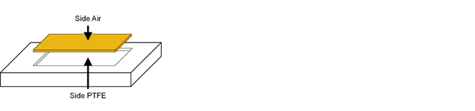
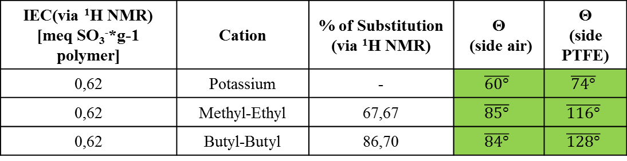
Cation exchange reaction between SPES and I.Ls.
After the addition of I.Ls. the hydrophobic properties increase as the quantity of sulfonated groups increase due to the higher number of potassium ions available for substitution with I.Ls. cations.
IEC(via ¹H NMR) [meq SO₃⁻*g-1 polymer] | Cation | % of Substitution (via ¹H NMR) | Θ (side air) | Θ (side PTFE)
0,62 | Potassium | - | $$\overline{60°}$$ | $$\overline{74°}$$
0,62 | Methyl-Ethyl | 67,67 | $$\overline{85°}$$ | $$\overline{116°}$$
0,62 | Butyl-Butyl | 86,70 | $$\overline{84°}$$ | $$\overline{128°}$$
UNIVERSITY OF MILAN
DOCTORATE SCHOOL IN CHEMICAL SCIENCES AND TECHNOLOGIES
Notes:
3

Slide 4
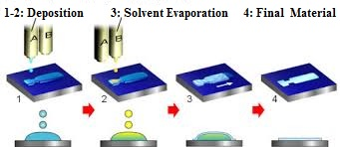
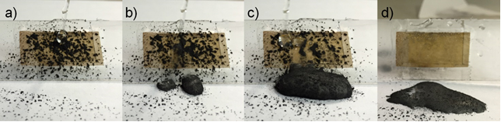
STUDY OF STRUCTURE AND DIMENSIONAL STABILITY
Structure
Morphology
Thermal properties
1) SAXS
2) ESFR of Grenoble
Totally amorphous polymer
Scanning Electron Microscopy
Roughness morphology
Differential Scanning Calorimetry
Glass transition temperature up of 230ºC
Easy processability of SPES due to its structure, thermal properties, viscosity and surface energy makes it a good material for the production of films through InkJet printer technology, a very simple and economic deposition technique.
UNIVERSITY OF MILAN
DOCTORATE SCHOOL IN CHEMICAL SCIENCES AND TECHNOLOGIES
Notes:
4

