Slide 1
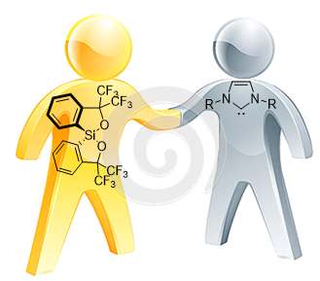
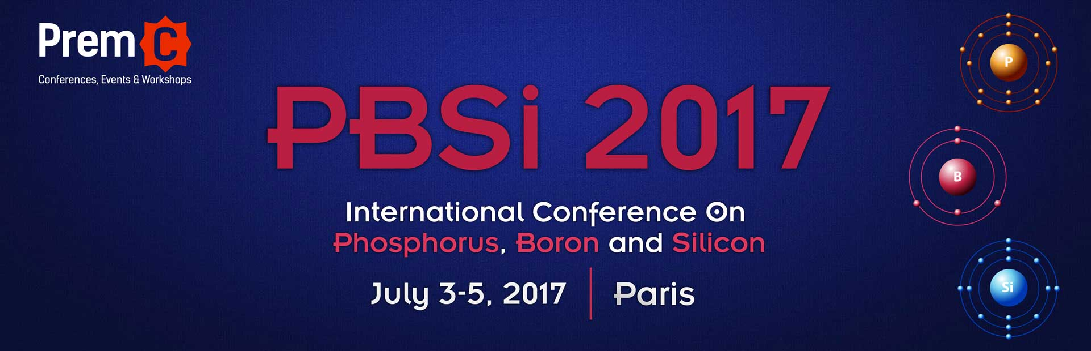
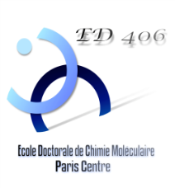


When Martin’s Spirosilane Meets a NHC Carbene
Presentation by Fabrizio MEDICI
fabrizio.medici@upmc.fr
Supervisor: Pr. Louis Fensterbank
Co-Supervisor: Dr. Gilles Lemière

Slide 2
Martin’s Spirosilane
First Synthesis reported in 1979 by J. C. Martin

Slide 3
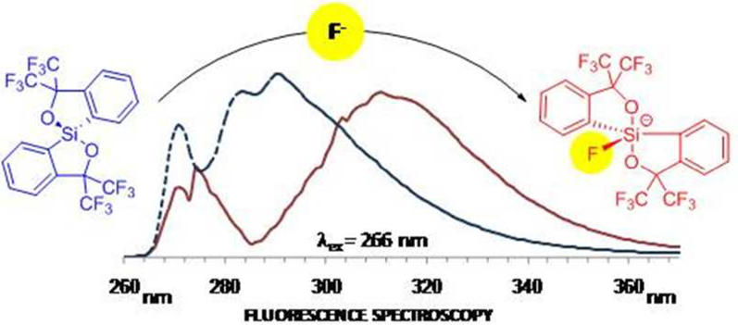
Martin’s spirosilane in the years
Pentacoordinate adducts
Fluoride sensor
H. Lenormand, J.-P. Goddard, L. Fensterbank, Org. Lett., 2013, 15, 748-751
“exotic” species
Etc…⁴
⁴ a)E. L. Zins, L. Krim, H. Lenormand, J.-P. Goddard, L. Fensterbank,J. Phys. Chem. A 2013, 117, 3296–3303. b) N. Kano, H. Miyake, K. Sasaki, T. Kawashima, Heteroat. Chem. 2015, 26, 183–186.

Slide 4
N-Heterocyclic Carbene
First isolated NHC, reported by Arduengo in 1991¹
NHC Carbene a versatile ligands
Steric hindrance influenced by R
Electronic properties modulated by the nature of R and X
Main group coordination chemistry
Metal coordination chemistry
¹ A. J. Arduengo, R. L. Harlow, M. Kline, J. Am. Chem. Soc. 1991, 113, 361–363
² Kretschmer R., Ruiz D. A., Moore C. E., Rheingold A. L., Bertrand G., Angew. Chem. Int. Ed., 2014, 53, 8176−8179.
³ Martin, D.; Soleilhavoup, M.; Bertrand, G. Chem. Sci. 2011, 2, 389
⁴ A. Johnson, M. C. Gimeno, Chem. Commun., 2016, 52, 9664
⁵ R. Savka , H. Plenio, Dalton Trans., 2015, 44, 891

Slide 5
N-Heterocyclic Carbene and Silicon
State of the Art

Slide 6
Martin’s Spirosilane: Synthesis Update
First synthesis¹:
Low reproducibility
¹ E. F. Perozzi, J. C. Martin, J. Am. Chem. Soc, 1979, 101, 1591-1953

Slide 7
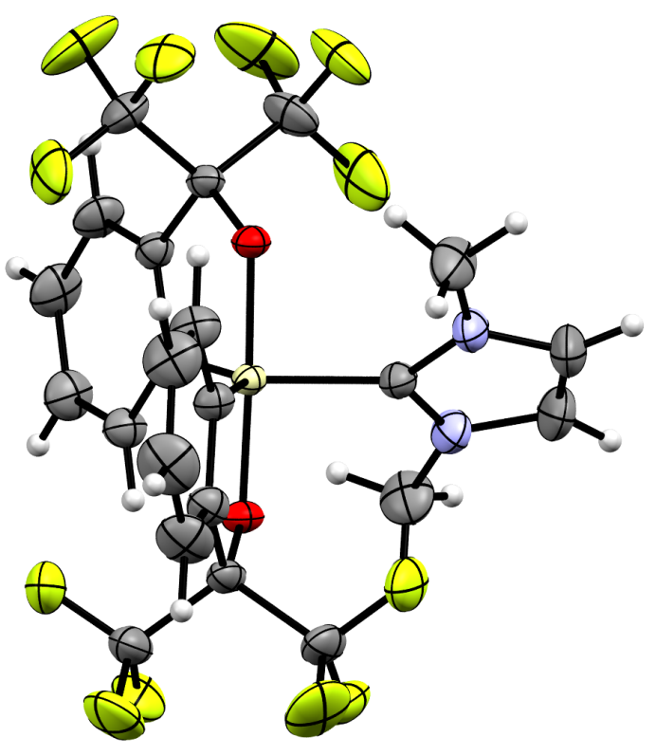
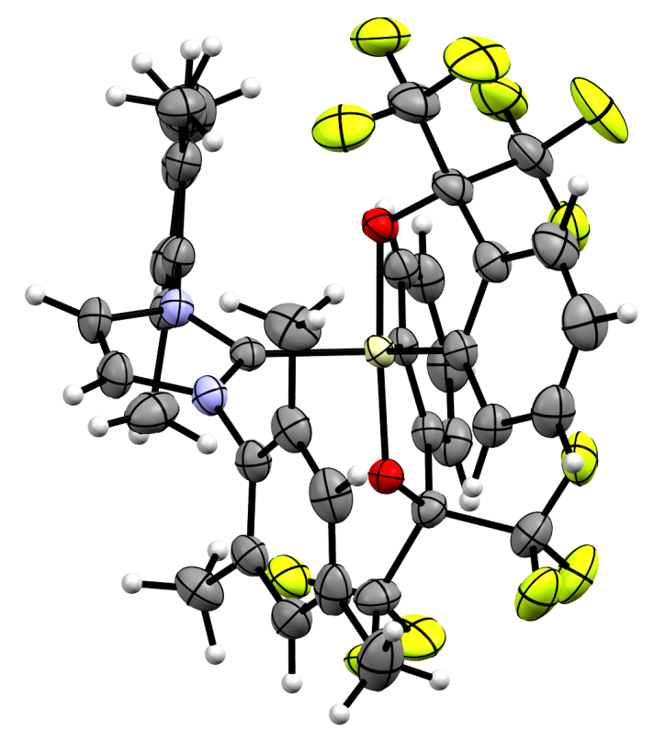
NHC-Spirosilane Interaction
Si-C (imid.): 1,943Å
O-Si-O: 178,05°
X-Ray structure
Si-C (imid.): 1,956Å
O-Si-O: 176,66°
X-Ray structure

Slide 8
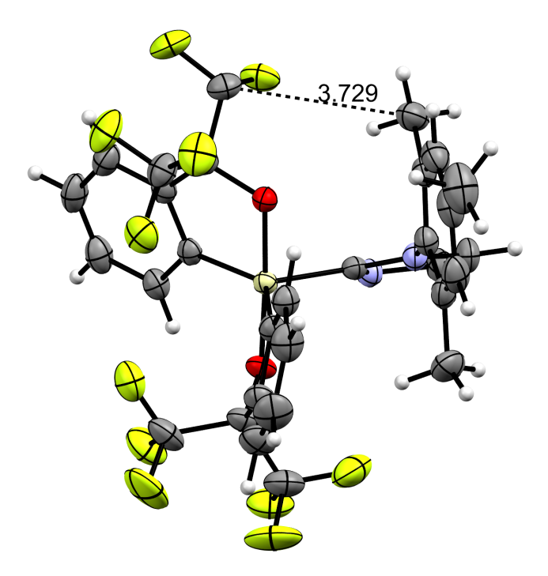
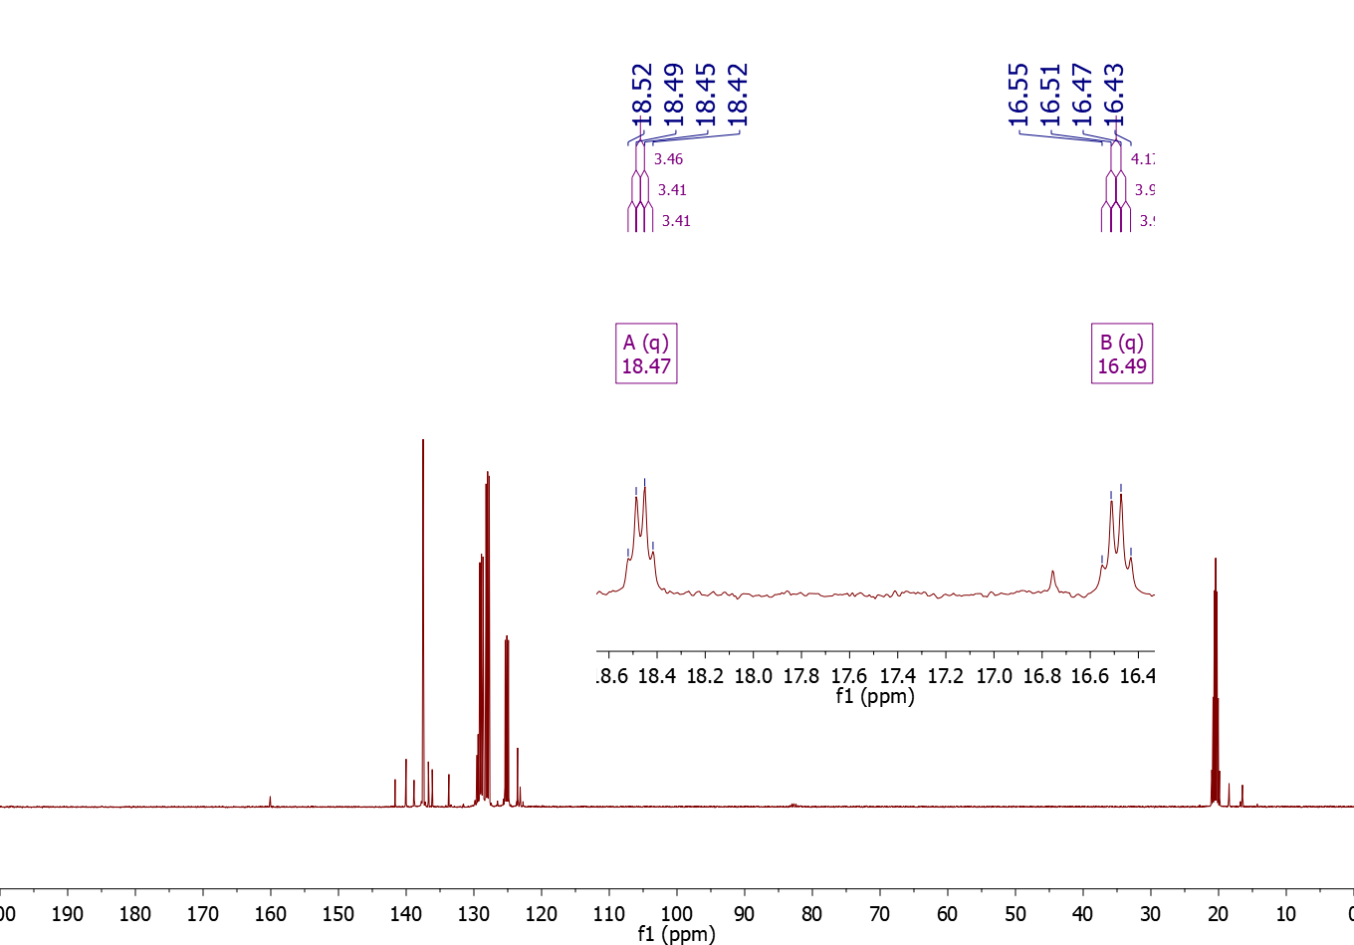
For C-F coupling throught space see: Coupling Through Space in Organic Chemistry F. B. Mallory, C. W. Mallory, in eMagRes, John Wiley & Sons, Ltd, 2007

Slide 9
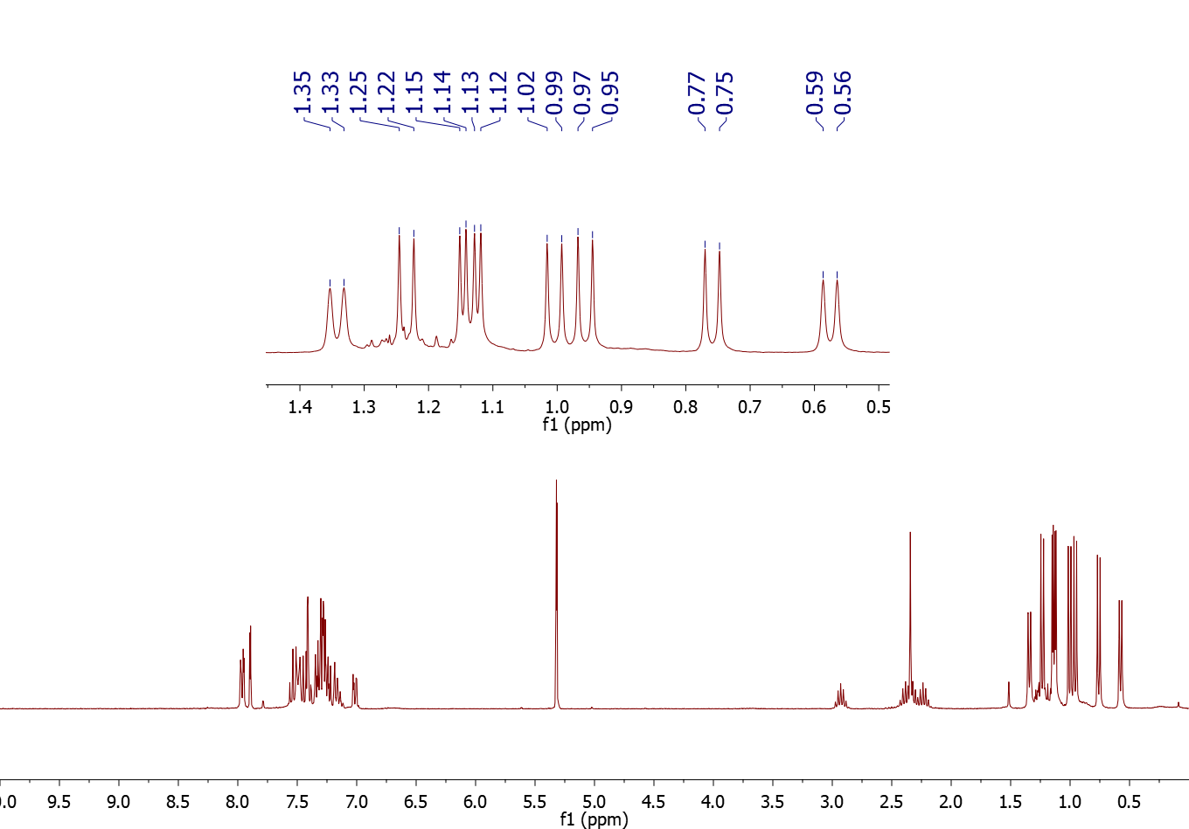
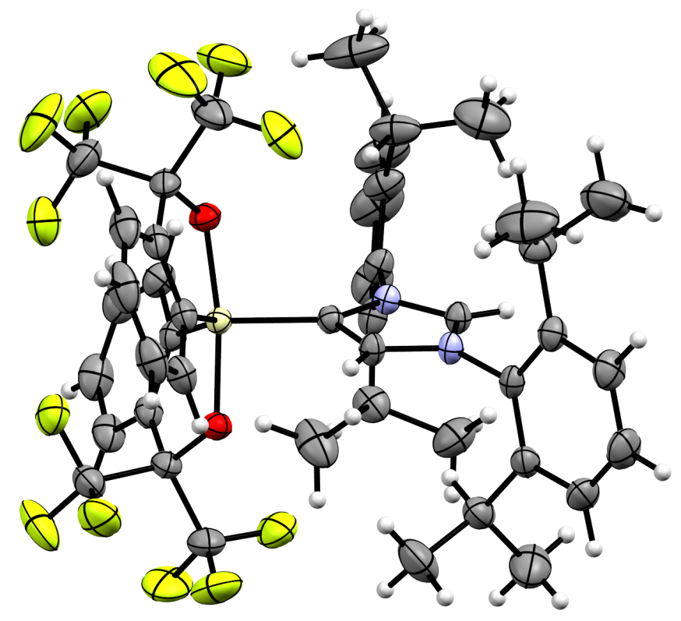
NHC-Spirosilane Interaction
Abnormal Adduct!
Si-C (imid.): 1,909Å
O-Si-O: 170,77°
X-Ray structure

Slide 10
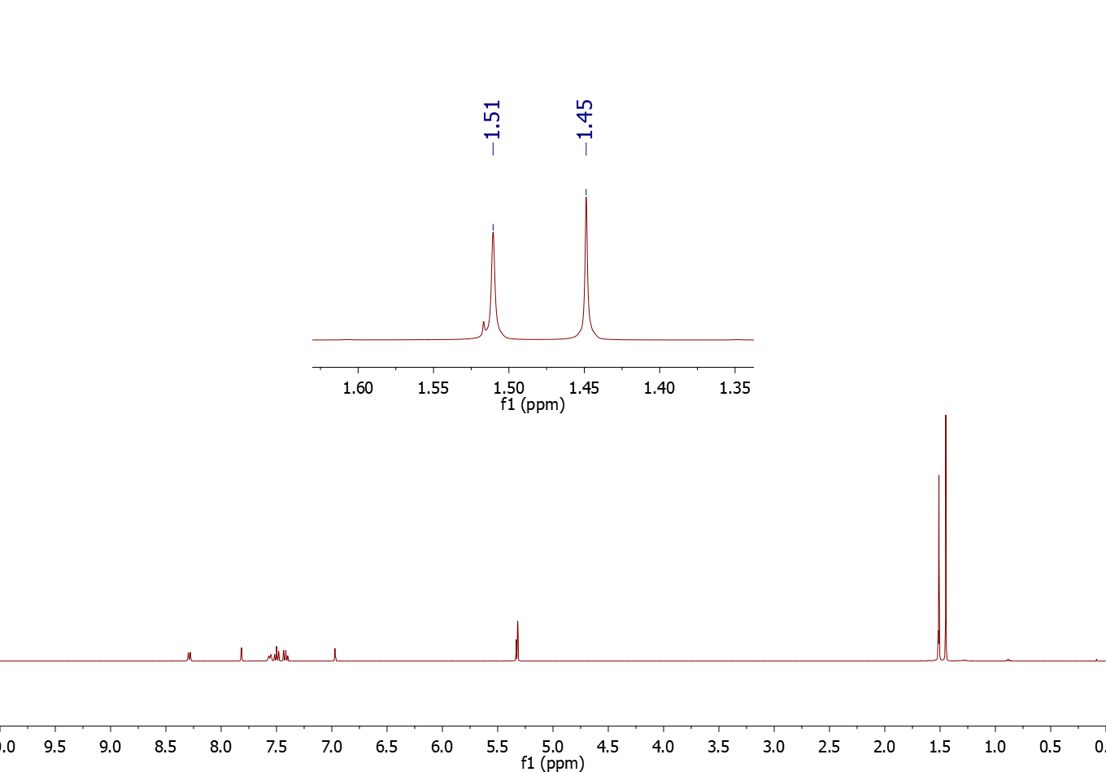
NHC-Spirosilane Interaction
Abnormal Adduct!

Slide 11
Abnormal Adduct In Literature

Slide 12
Frustrated Lewis Pair
Normal Acid-Base Lewis adduct Vs. Frustrated Lewis Pair (FLP)
The activation of small molecules (like hydrogen) is a great field of interest. Frustrated Lewis Pairs are good candidates to perform this kind of reactions.

Slide 13
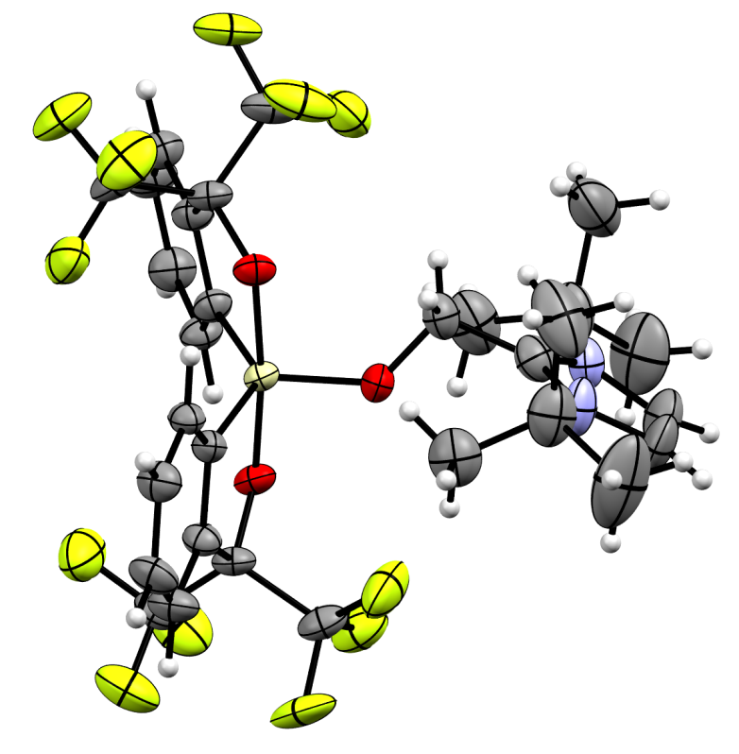
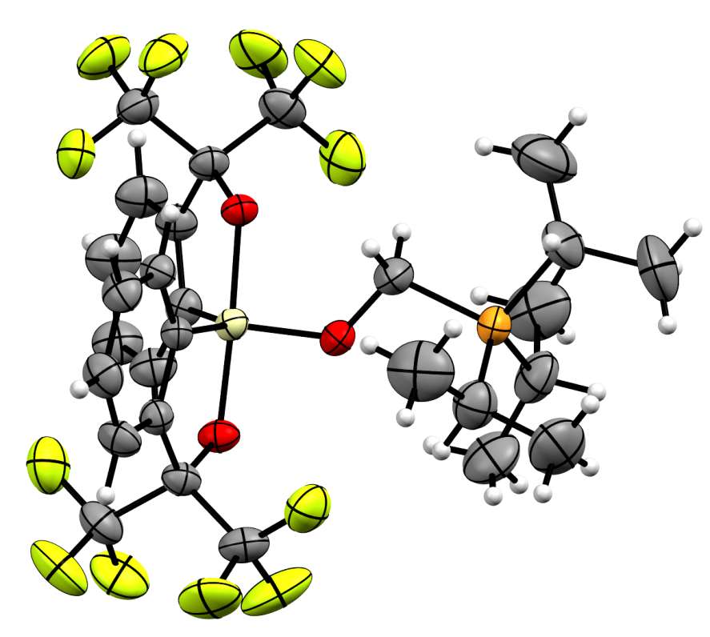
NHC-Spirosilane and Paraformaldehyde
X-Ray structure
X-Ray structure
Si-O (form.): 1,676Å
O-Si-O: 173,61°
Si-O (form.): 1,694Å
O-Si-O: 176,71°

Slide 14
Hydrogen and Carbon Dioxide Activation
?
Lewis Base
P: 1, 5, 15, 25, 50 bar
Solvents: PhMe, C₆H₅Br, CH₂Cl₂
T: rt, 80°C, 110°C
t: 10’, 1h, 4h, 24h

Slide 15
Abnormal adducts and metals

Slide 16
Abnormal adducts and metals in Literature
For a review on anionic carbene: A. Nasr, A. Winkler, M. Tamm, Coordination Chemistry Reviews, 2016, 316, 68–124

Slide 17
Abnormal adducts and metals
Deprotonation

Slide 18
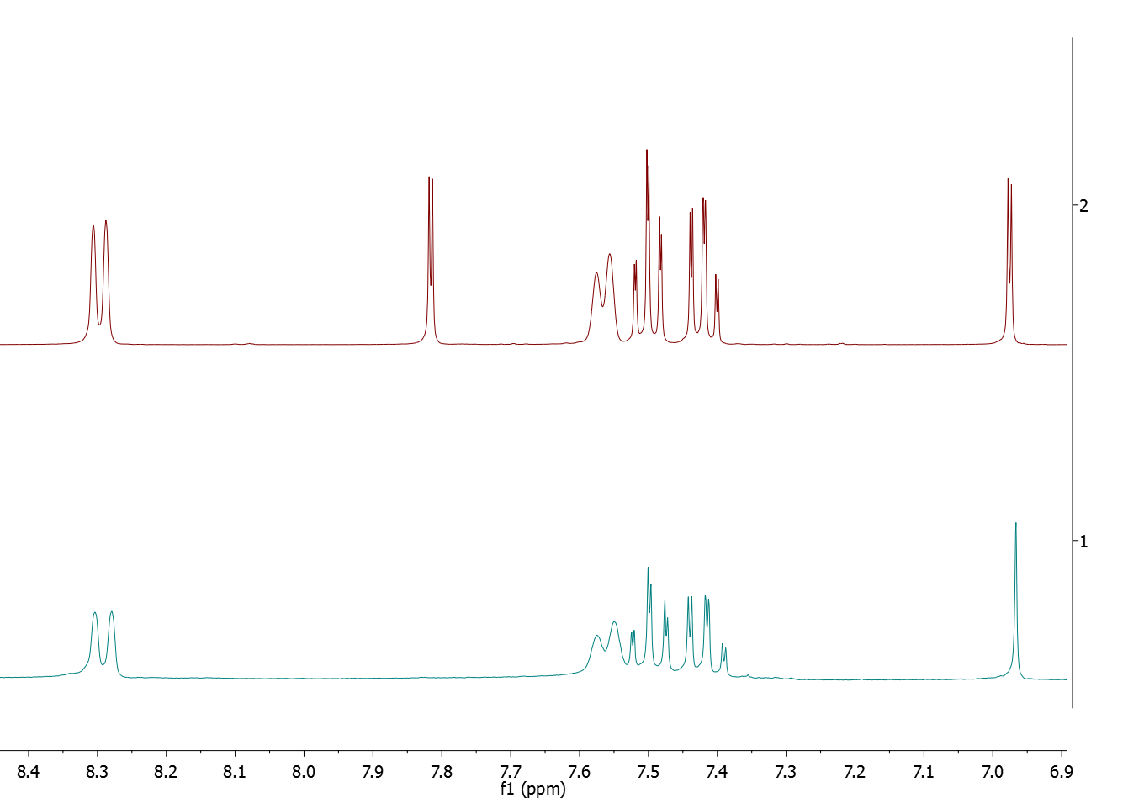
Protonated Form
Deprotonated Form

Slide 19
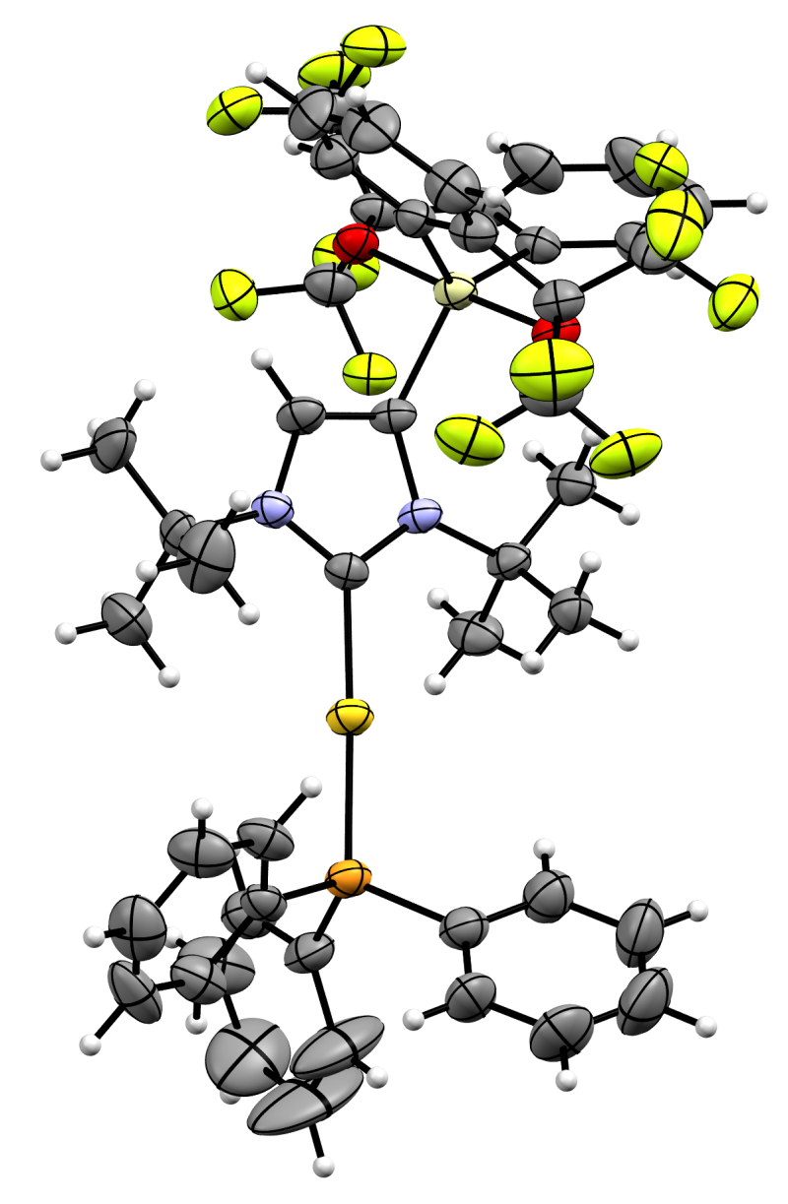
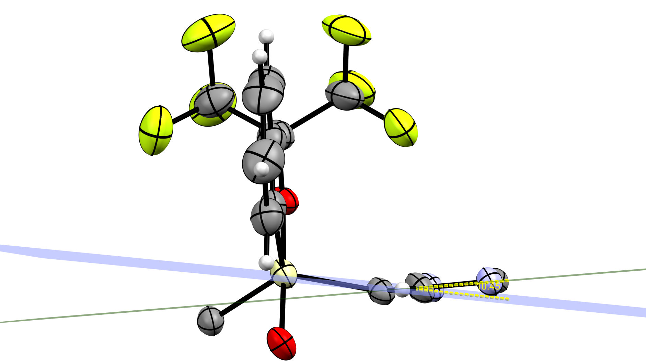
Abnormal adducts and metals
Complexation
Si-C (Imid.): 1,914Å
C-Au: 2,044Å
O-Si-O: 176,71°
C-Au-P: 177,69°
X-Ray structure

Slide 20
Conclusion
Optimisation of the Martin’s spirosilane synthesis
Isolation and characterisation of pentacoordinate complexes with different NHC-Carbenes
Synthesis of one of the first pentacoordinate «abnormal» adduct with a tetravalent non halosilane
Investigation of the FLP properties with H₂ and CO₂
Succesfull deprotonation of the “abnormal” adduct and complexation with PPh₃AuCl
Paper to be submitted

Slide 21
Perspectives
Completion of studies regarding activation of H₂ and CO₂
Deprotonation of the “Abnormal” IPr adduct
Investigation of the reactivity with other metals: [Cu], [Ag], [Pd], [Ni], [Rh] etc…
…and their reactivity
Investigations of new pentacoordinate complexes with carboxylate
…and alcohol

Slide 22
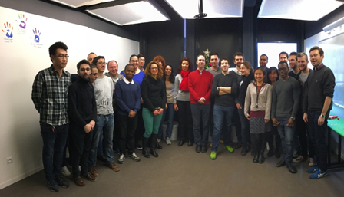


Acknowledgments
Pr. Louis Fensterbank
Dr. Gilles Lemière
Geoffrey Gontard for X-ray structure
Internship: Sebastien Curpanen
MACO team

Slide 23
Thank You for Your Attention

